Slide 1
LIGHT DESIGN
Technical Theatre

Slide 2
LIGHT DESIGN PROJECT
LIGHT PRODUCTION
Light Research
Light Notes
Light Plot
Instrument Schedule Sheet
Light warn/go cues in script
Light cue sheet
LIGHT DESIGN APPLICATION
Design and produce a gobo applicable to your show. Must be able to fix into a Source Four, be focused and explained to the class.

Slide 3
RESEARCH
Interior: practicals, (sconces, floor lamps, table lamps, chandeliers, etc.)
Exterior: types of trees, sunsets, sunrise, clouds, water, fire, sun, sky, storms, etc.
Special Effects: fire, water, rotating gobos, sfx within the script context
Gobos: nature, breakups, windows, etc.

Slide 4
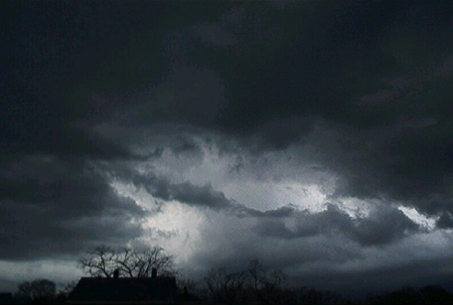
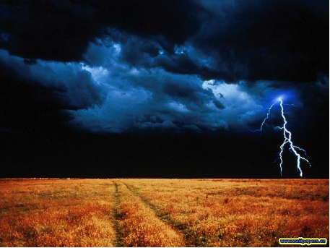
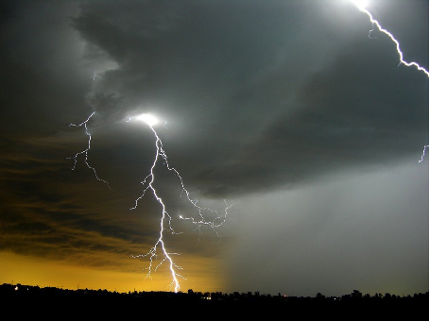
STORM RESEARCH

Slide 5
LIGHT NOTES
Explicit – Finding facts within the script
“Oh, what a beautiful morning!”
Implicit – Use context clues; what can you imply from the script
Creative – Enhance with your design concept
Adding gobos for textures
Adding gels for colors
PG # | Light Effect | Description/Notes
1 | Stage lights up | All practicals on
13 | Desk lamp out | Character turns on when exits
22 | Lightening | Sync with thunder 3-4 strikes

Slide 6
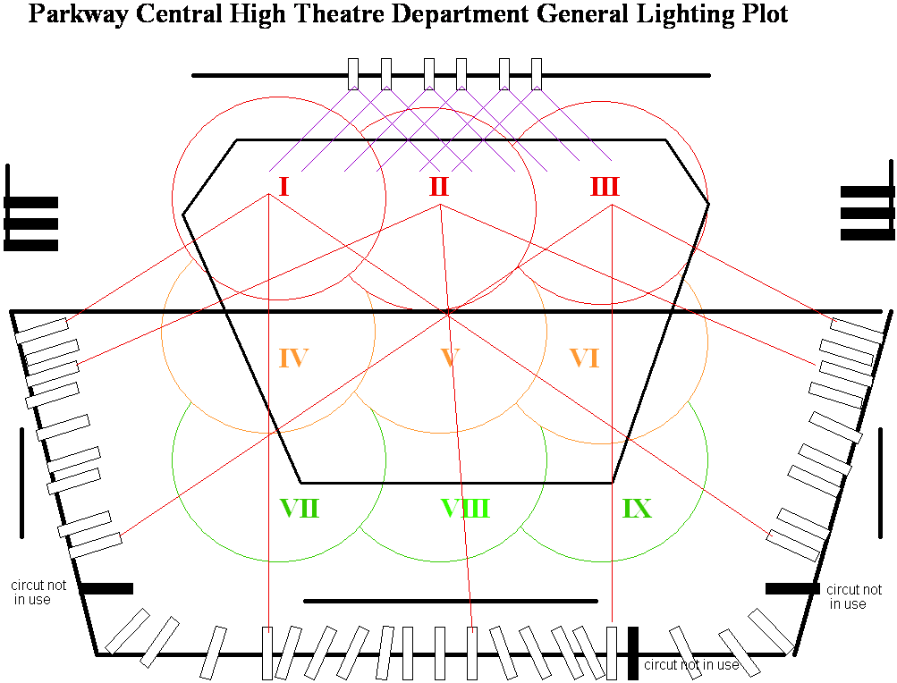
LIGHT PLOT areas 1-2-3

Slide 7
LIGHT PLOT areas 4-5-6

Slide 8
LIGHT PLOT areas 7-8-9

Slide 9
LIGHT PLOT all areas

Slide 10
LIGHT PLOT EXAMPLE

Slide 11
LIGHT PLOT- the elephant man

Slide 12
LIGHT FIXTURE SYMBOLS

Slide 13
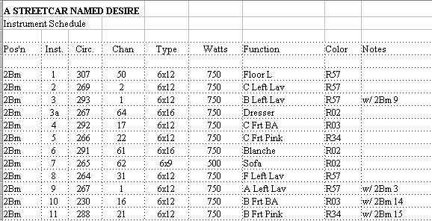
INSTRUMENT SCHEDULE
A detail list of light fixtures noting where they hang, what area they light and special notes:
Gel colors
accessories
Should correspond with the light plot
Instr.#-------- Circuit# | Instrument | Batten | Area | Gel Color | Accessories/notes
1-1 | S4-19 | A | IV | R01 | iris
2-2 | Fr 10” | A | X | R27 | Shutter DR
3-3 | S4-50 | B | XI | R52 | none

Slide 14
The elephant man
Although its missing some information, what is there, corresponds with the light fixtures on the light plot.
This sheet allows space for specific details about each light, where there is not room on the light plot.

Slide 15
LIGHT CUES
SCRIPT:
Warn cues: Yellow
Go cues: Green
CUE SHEET:
Cues should reflect what is in the script
Pg # | Cue # | Time | Description
1 | 1 | --- | Preshow house@ 80%
1 | 2 | 5 | Preshow – house to 40%
1 | 3 | 5 | House OUT practicals on
1 | 4 | 5 | Stage OUT Running blues on
1 | 5 | 3 | Stage UP 80% All practicals on
13 | 6 | 0 | Desk lamp OUT
22 | 7 | 0 | 3 flashes Sync with thunder

Slide 16
GOBO Project
Sketch a design of your gobo and have it checked. Do research if needed!!! (types of trees, windows etc)
Redraw the design as a final version.
Cut out the gobo using a disposable pie, using an exactor knife
You will demonstrate the gobo during the semester final project presentation

Slide 17
GOBO EXAMPLES

Slide 18
GOBO EXAMPLES

Slide 19
ELEMENTS OF DESIGN
LINE
Angled, jagged, straight, curved or combination?
SHAPE
outlines or silhouettes?
any reoccurring objects?
TEXTURE
smooth=orderly, finished, sleek, elite,
rough=harsher, chaotic, poor, earthy,
MASS
spatial arrangement of the stage
Chaotic, spacious or varied?
heavy or light?
COLOR
Any reoccurring colors?
Do colors contradict or compliment the overall feeling or mood of the script?

Slide 20
PRINCIPLES OF COMPOSITION
UNITY
What is it that connects the show together?
theme, color, feeling, shape? character? An idea?
HARMONY
Harmonious vs inharmonious?
CONTRAST
contradict your visual theme
VARIATION
varying any of the design elements of a given pattern
BALANCE / PROPORTION
symmetrical vs asymmetrical?
EMPHASIS
direct the audience’s attention - giving accent to : a part of a the stage, costume, actor,

