Slide 1
PLAY PRODUCTION
THEATRE ARTS

Slide 2
PLAY
PRODUCER
TECH DIRECTOR
DIRECTOR
BUSINESS MANAGER
Master Carpenter
Lighting Designer
Costume Designer
Properties Designer
Makeup Designer
House Manager
Scenic Designer
Sound Designer
Publicist
Production Stage Manager
Company Stage Manager
ACTORS
TICKETS
USHERS
CREWS
ADS
Audience

Slide 3
MUSICAL
conductor
vocal director
PRODUCER
choreographer
TECH DIRECTOR
DIRECTOR
BUSINESS MANAGER
Master Carpenter
Lighting Designer
Costume Designer
Properties Designer
Makeup Designer
House Manager
Scenic Designer
Sound Designer
Publicist
Production Stage Manager
Company Stage Manager
ACTORS
TICKETS
USHERS
CREWS
ADS
Audience

Slide 4
SCENERY
Noises Off
MARY POPPINS
http://youtu.be/QlUXbtzCJjU
Newsies
http://youtu.be/aEspfwrdkrs

Slide 5
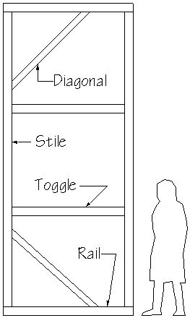
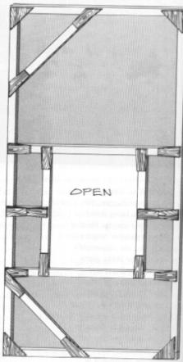
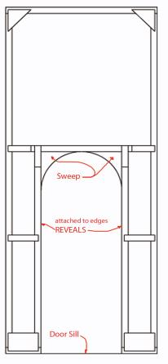
STOCK SCENERY - Flats
WALL FLAT
WINDOW FLAT
DOOR FLAT
Hard Cover: “Hollywood Flat” Soft Cover: “Broadway Flat”

Slide 6
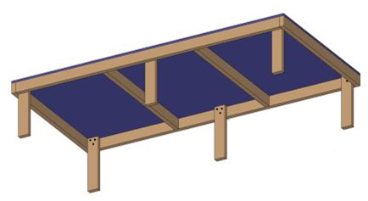
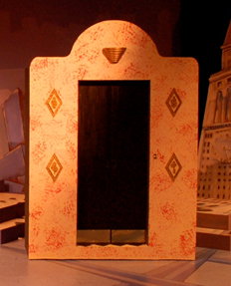
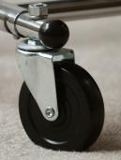
STOCK SCENERY – Platforms & Wagons
Platform
Stationary
Elevated
Wagon
Add Casters
Movable scenery

Slide 7
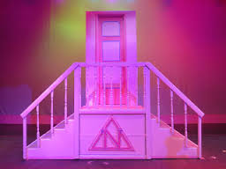
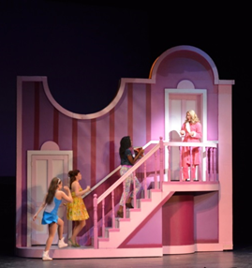
STOCK SCENERY - Stairs
Dependent
Independent

Slide 8
LIGHTING
Billy Elliot – “Lights the Lights”
http://youtu.be/spG3J4ODJSQ
LION KING http://youtu.be/e5nZCVXUk3I
Cell Block Tango” – Chicago
http://youtu.be/KA6R1DMb-Z8

Slide 9
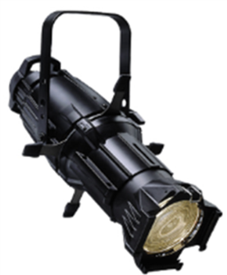
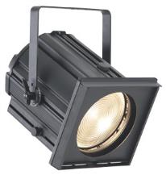
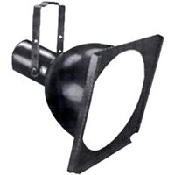
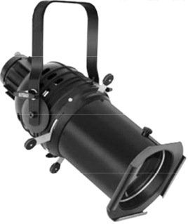
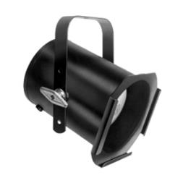
lIGHTING
SOURCE 4
FRESNEL
SCOOP
PAR CAN
6X9 ELLIPSOIDAL

Slide 10
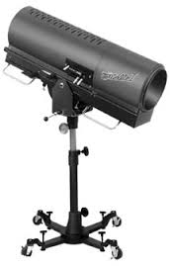
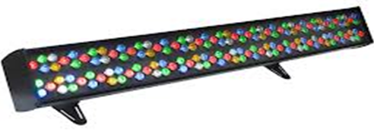
LIGHTING
FOLLOW SPOT
3-CIRCUIT STRIP LIGHTS
LED STRIP LIGHTS

Slide 11
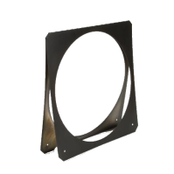
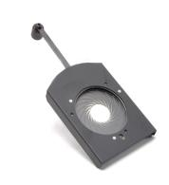
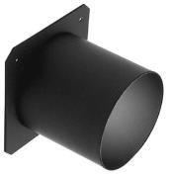
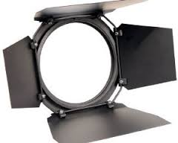
LIGHTING
GOBO GOBO HOLDER
GEL GEL FRAME
TOP HAT
BARN DOORS
IRIS

Slide 12
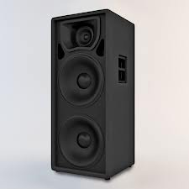
SOUND

Slide 13
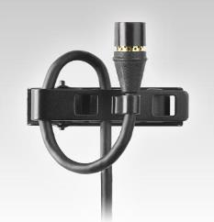
SOUND
SOUND REINFORCEMENT
Microphones
Body mics
Hand held mics
Hanging mics
Floor mics

Slide 14
SOUND
SOUND REPRODUCTION
Recorded
live
Music
Sound effects

Slide 15
COSTUME

Slide 16
COSTUME RESEARCH

Slide 17
COSTUME RENDERINGS
Color sketch of costume design
Shows all clothing, shoes, and any accessories worn by the character
Attach swatches of the materials used to create the costume at the top of the color rendering.

Slide 18
COSTUME PRODUCTION

Slide 19
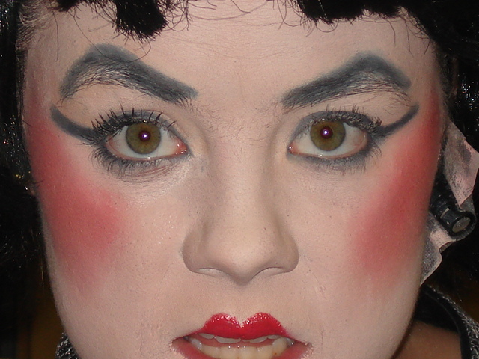
MAKEUP

Slide 20
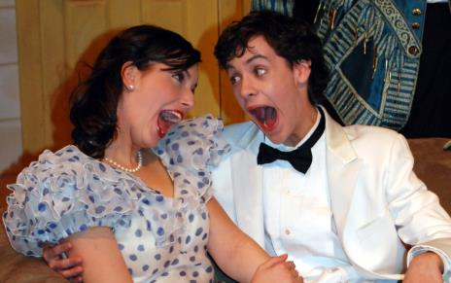
MAKEUP
OLD AGE
CHARACTER “STRAIGHT”

Slide 21
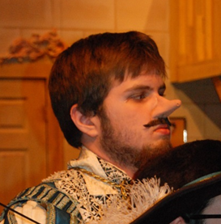
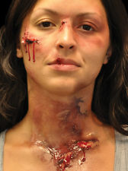
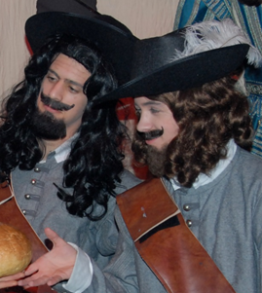
MAKEUP
SPECIAL EFFECTS
3-D MAKEUP

Slide 22
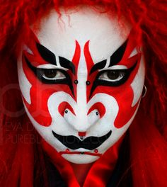
MAKEUP
FANTASY
STYLIZED

Slide 23
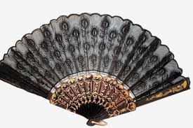
PROPERTIES

Slide 24
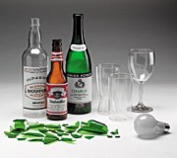
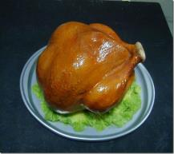
PROPS
SCENIC PROPS
DECRORATIVE PROPS
HAND PROPS
PERISHABLE PROPS
SPECIAL EFFECT PROPS

Slide 25
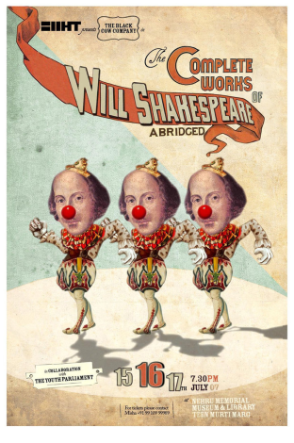
PUBLICITY

Slide 26
PUBLICITY

Slide 27
POSTERS SHOULD HAVE…
Theatre Company presenting
Title of play
Playwright
Dates of Production
Time of show
Place its presented
Ticket Prices
Box Office Phone
Producer
Eye catching logo
!

