Slide 1
Resumes

Slide 2

Resume Format
One page document
10-12pt format
Increase type size for emphasis
More Emphasis: Bold, Italic, or Bold Italic

Slide 3
Heading
Name
Category (Optional)
  Must come through
    Actor
    Singer
    Dancer
    Actor/Singer
    Singer/Actor
    Singer/Dancer
    Actor/Singer/Dancer

Slide 4

Heading
Vital Statistics
Phone Number
  Service, agency, or cell #
Height, weight, eyes, hair
Age
Voice
Measurements
  Modeling/commercial resumes

Slide 5
Credits
List by genre, emphasis & best credits
Give a positive but honest description of work
List name of Theatre rather than institution
  “Jeckyl Theatre, St. Louis MO” rather than “Lindenwood University”
Drop “community” and/or “civic theatre”
  “Dodd Theatre Center” rather than “Doddsville Community Players”
DO NOT LIE
  You may “Stretch the truth”
Most important credits first
  Professional before school
    Do not list high school unless it is a specialized school or received a noteworthy award
Hierarchy
Theatre
  Broadway
  National Tours
  Off-Broadway
  Showcase
  Stock
  Regional
Film
Television

Slide 6


Training
Summarize education
  Identify acting training & related skills
List training for specific areas, give name of instructor
  Doesn’t matter if you like or you learned from them. It’s about NAME RECOGNITION

Slide 7
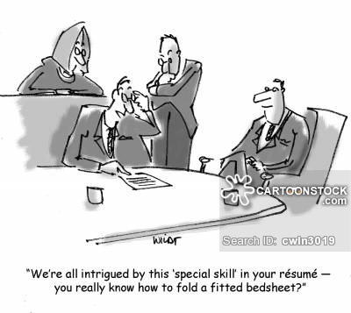
Special Skills
Music related skills:
  Proficiency with musical instruments
Athletics:
  Horseback riding, swimming, drive a car (automobile, standard), motorcycle, truck
Hobbies:
  Photography, graphic design, American Sign Language, carpentry, electronics
Acting related skills:
  Dialects, imitations, stage combat, mime, acrobatics
List special talents useful in film or commercial work or extra attraction to a theatre company
BE SELECTIVE
Include things you can do REALLY well
Don’t Lie!
*If you have a second career in theatre (Directing, tech theatre), then list “Directing resume on request”, etc… Only do so if willing to work in that area!*

