Slide 1
Revues, Operas & Musicals
Differences, Similarities and Characteristics

Slide 2
REVUES
Song, dance, music, comedy acts, sketches, specialty numbers
No plot or idea to tie show together
Sometimes a theme
2 Types:
1. Vaudeville
2. Burlesque

Slide 3
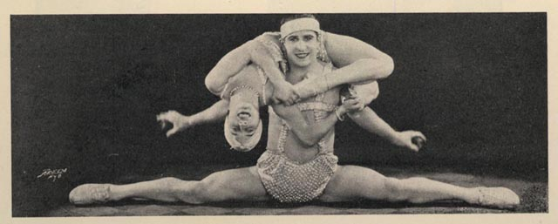
REVUES - Vaudeville
unrelated acts of comedians, singers, dancers, sketches, trained animals, magicians, jugglers, acrobats and well… anything!
https://youtu.be/Rm4uiALzTcs

Slide 4
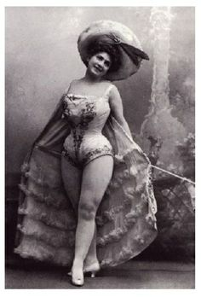
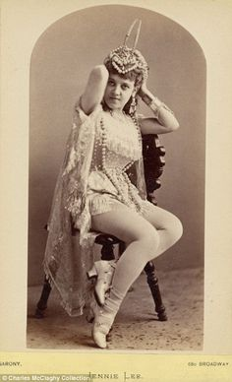
REVUES - Burlesque
Began as a satirical parody of a play or custom
Later featured beautiful women in skimpy costumes

Slide 5
REVUES - modern
Type of multi-act popular theatrical entertainment that combines music, dance and sketches. Though most famous for their visual spectacle, revues frequently satirized contemporary figures, news or literature
Examples:
Ain’t Misbehavin’
Side By Side By Sondheim
Smokey Joe’s Cafe
https://youtu.be/ByIDC_dNUTw

Slide 6
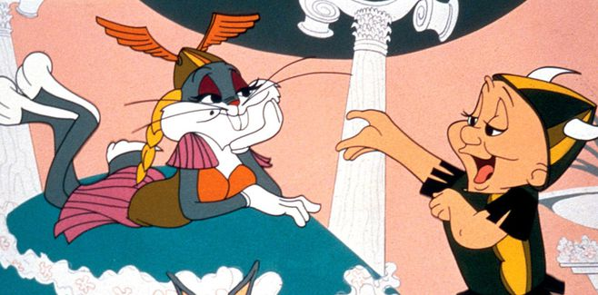
OPERAS
Music and singing
3 Types:
Operettas
Grand Operas
Light/Comic
“What’s Opera, Doc?” https://youtu.be/6jDcWAWRRHo

Slide 7
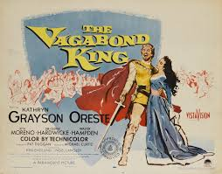
OPERETTAS
Oldest Form
Includes dialogue and humor
Plot: unhappy or unfulfilled romances between Kings and commoners; may appear trivial
Melodic music = well trained, semi-operatic voices required
Examples:
The Student Prince in Old Heidelberg
Bitter Sweet
The Vagabond King

Slide 8
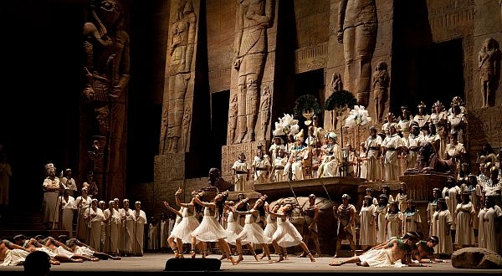
GRAND OPERAS
Large spectacles
Lavish costumes, set, special effects
Plots based on or around historic events
Example:
Aida - Giuseppe Verdi - Arena di Verona 2012
https://youtu.be/l3w4I-KElxQ

Slide 9
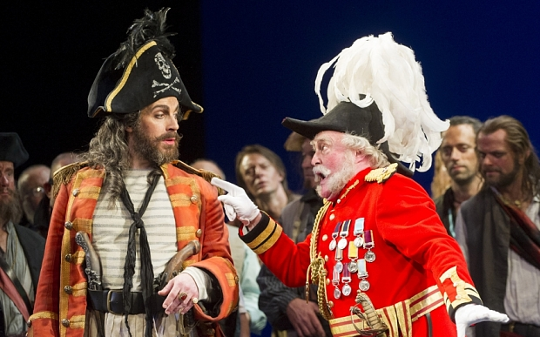
LIGHT/COMIC OPERA
Wit, humor and dialogue
Usually a happy ending
Examples:
The Mikado
H.M.S. Pinafore
The Pirates of Penzance https://youtu.be/hlTisI_HSgw
https://youtu.be/IEicdkW295c

Slide 10
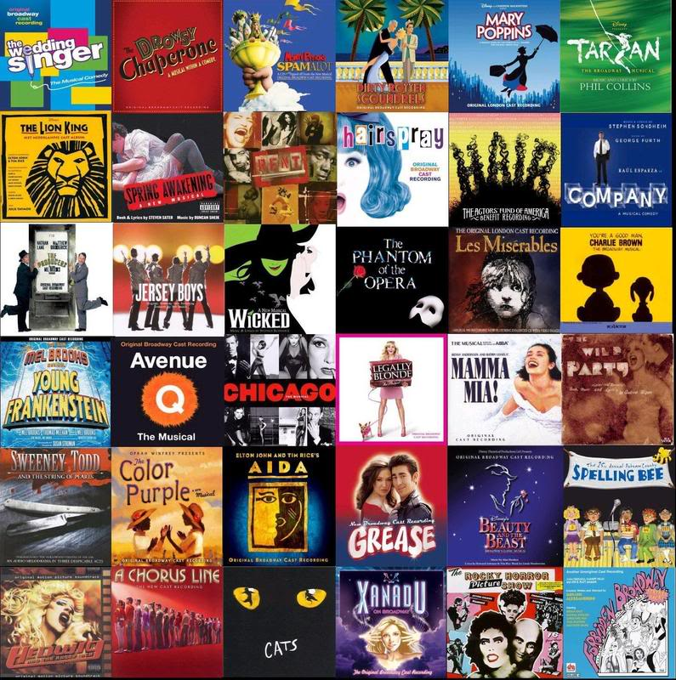
MUSICALS
combination of music, dance, song, acting, technical aspects

Slide 11
MUSICALS – VARIETY OF SOURCES
play
novel
Hello, Dolly!
Thornton Wilder's 1938 farce The Merchant of Yonkers which was retitled, “The Matchmaker”
Kiss Me Kate
W. Shakespeare’s Taming of the Shrew
Oliver!
Oliver Twist by Charles Dickens
My Fair Lady
Pygmalion by George Bernard Shaw

Slide 12
MUSICALS – VARIETY OF SOURCES
Fiddler on the Roof
Tevye and his Daughters (or Tevye the Dairyman) and other tales by Sholem Aleichem
Cinderella
based on the fable, particularly the French version Cendrillon, ou la Petite Pantoufle de Verre, by Charles Perrault.
Cats
Old Possum's Book of Practical Cats by T. S. Eliot
stories
poems

Slide 13
MUSICALS – VARIETY OF SOURCES
Film
life of a person/ artist
Promises, Promises
1960 film,The Apartment by Billy Wilder
The Wiz
1939 film The Wizard of Oz
Funny Girl
based on the life and career of Broadway, film star, and comedienne Fanny Brice and her stormy relationship with gambler Nick Arnstein. Its original title was My Man
Sunday in the Park with George
is based on the life of artist, George Seurat and his painting: "A Sunday Afternoon on the Island of La Grande Jatte"

Slide 14
MUSICALS – VARIETY OF SOURCES
history
comic strip
original concept
1776
based on the events surrounding the signing of the Declaration of Independence.
Li’lAbner
Li'l Abner by Al Capp; hillbillies, satiric topics ranging from American politics and incompetence in the United States federal gov. to propriety and gender roles.
Company
concept musical composed of short vignettes, presented in no particular chronological order

Slide 15
MUSICALS - PRESENTATIONAL
does not represent or imitate real life
presented to the audience
suggested scenery for locations...little attempt at illusion
dialogue is related through songs
orchestra and conductor visible
dancers appear for no reason but to add talent
elaborate, large and spectacle shows
42nd street
La Cage aux Folles
simple, small and inexpensive shows
The Fantasticks
You’re A Good Man Charlie Brown

Slide 16
MUSICALS – COLLABORATIVE
Book writer
Director
Composer
Lyricist
Producer
Choreographer
Actors
Dancers
Designers

Slide 17
MUSICALS – MULTI-TALENTED PERFORMERS
act, sing and dance....... plus........
be funny (Forum)
play instruments (Fiddler, Singing in Rain)
skate (Starlight Express)
juggle, trapeze (Barnum)

Slide 18
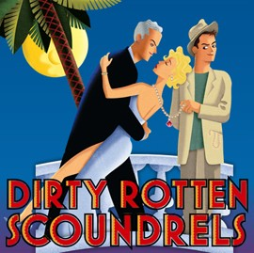
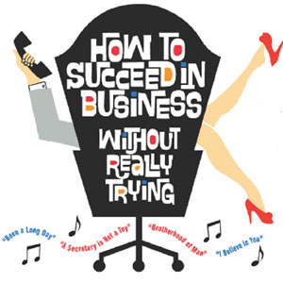
MUSICALS – GENRES
COMEDY
humorous with exaggerations, full of surprises and happy endings
Dirty Rotten Scoundrels https://youtu.be/C5WpXp8ct4c
ROMANTIC COMEDY
same as above with love relationship subplots
How To Succeed in Business Without Really Trying
https://youtu.be/QWZO3wBJViM

Slide 19
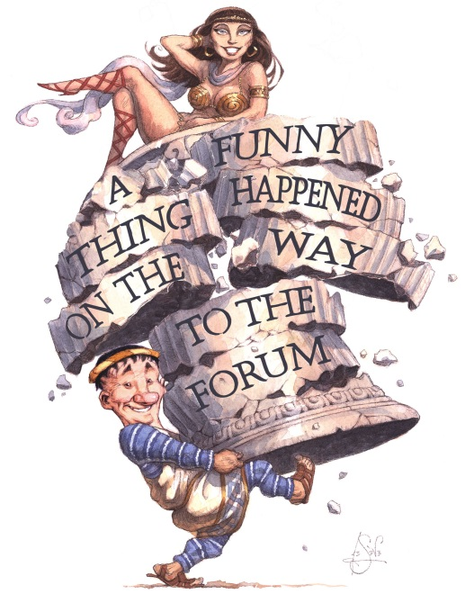
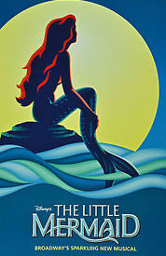
MUSICALS – GENRES
FARCE
misunderstandings and mistaken ID, improbable comic actions, funny chases and happy endings
A Funny Thing Happened On the Way To The Forum
https://youtu.be/8SRy5ngHShA
FANTASY
takes audience away from reality to unrealistic environments with strange and unusual characters
The Little Mermaid
https://youtu.be/2DUXVAg7oWg

Slide 20
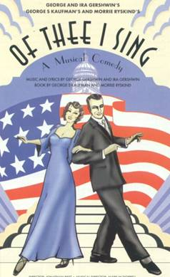
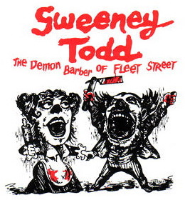
MUSICALS – GENRES
SATIRE
makes fun of customs, beliefs or institutions of a particular time period or place
Of Thee I Sing.... satirizes American politics
https://youtu.be/FInW3HCY9VU
MELODRAMA
complicated plot with contrived activities, characters include a hero, heroine and villain; good overcomes evil
Sweeney Todd
https://youtu.be/QAWWiYy_frY
https://youtu.be/QIl0-Wc_c_4

Slide 21
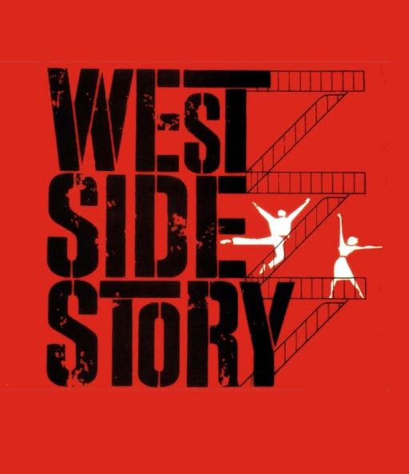
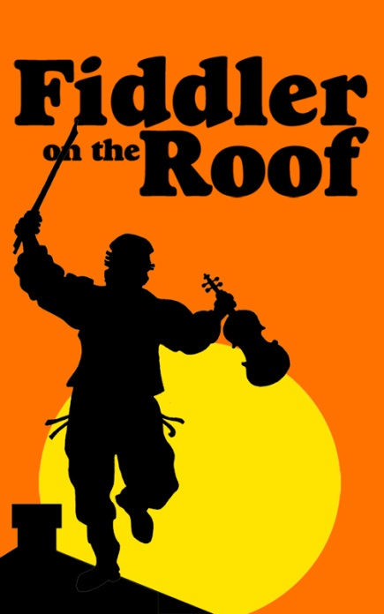
MUSICALS – GENRES
TRAGEDY
unhappy ending where the protagonist “falls” to death or despair, well rounded characters
West Side Story
https://youtu.be/CoE5Y6peV9E
DRAMA
serious storyline, but is not tragic or melodramatic
Fiddler on the Roof
https://youtu.be/6slyYuGA4to

