Slide 1
SCENIC DESIGN
Technical theatre

Slide 2
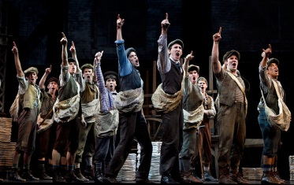
PURPOSE OF SCENIC DESIGN
Purpose of Scenic Design:
Helps the audience to understand the world of the play
Reinforces the production concept visually
Newsies
http://youtu.be/aEspfwrdkrs

Slide 3
ESSENTIAL QUESTIONS
What precautions are necessary to insure the safety of the performers?
How do the elements of Scenic Design work together to realize the director’s vision?

Slide 4
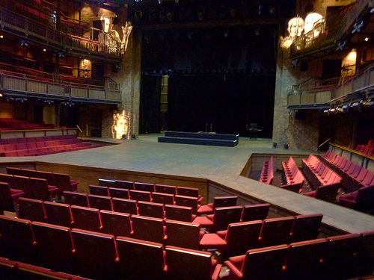
SCENIC DESIGN
PRACTICAL CONSIDERATIONS
Needs of Director
Budget
Time Frame
Size/Shape of the Theater
Abilities of Crew
Needs of the Actor
Special Blocking
Personality of the characters

Slide 5
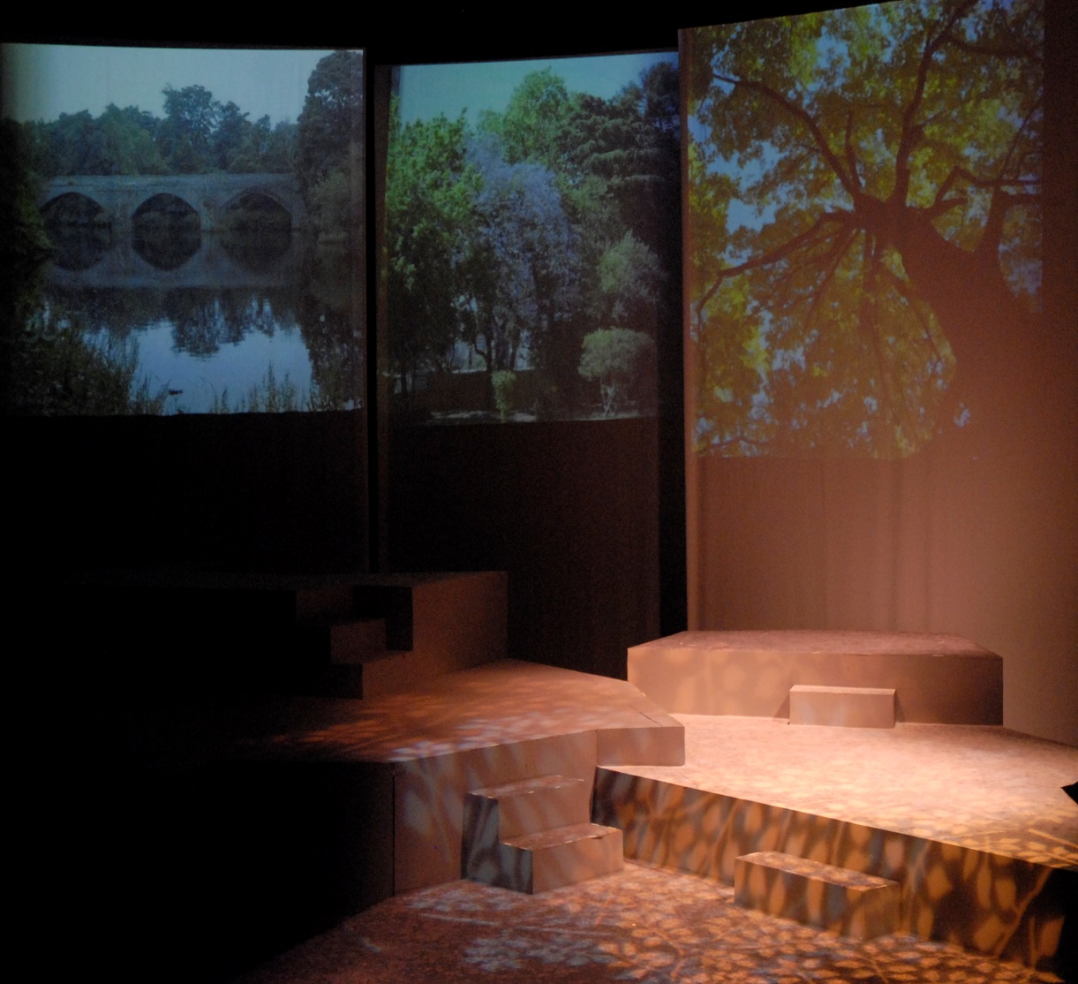
SCENIC DESIGN
CONCEPTUAL RESEARCH
A-D-M theory
Given Circumstances
Mood
Style
Research
Production Concept
  Elements of Design
  Principles of Composition
The Prime of Miss Jean Brodie

Slide 6
“ACTION-DOCUMENTATION-METAPHOR” approach to design
Created by: NY designer Mordecai Gorelik (1900-1975)
ACTION
Elements required by the director and actors to stage the show
Doors
Windows
Steps
Furniture
DOCUMENTATION
Locate the action of the play in a GENERAL and SPECIFIC place
London, Berlin, New York
alley, kitchen, forest
specific time period -- 1890, 1936, 2000.

Slide 7
“ACTION-DOCUMENTATION-METAPHOR” approach to design
METAPHOR
Gorelik's trademark
used to assist the designer in developing a specific tone, mood, style, or feel for the play.
metaphor : “A figure of speech in which a word ... that ordinarily designates one thing is used to designate another, thus making an implicit comparison..."
For example: "All the world's a stage,..." (William Shakesepare, As You Like It, Act II, scene 7). In less poetic terms -- the world is a stage. (Note: A simile would add the work like: The world is like a stage.)

Slide 8
METPHOR EXAMPLE
Moliere's The Imaginary Invalid (1673) could be "an apothecary's shop," a drug store.
Argan, Moliere's imaginary invalid, does not live in a drug store
(according to Gorelik: that would be "crude expressionism,") but the set, his sitting room, could have the tone, mood, style, and feel of a 17th century drugstore.

Slide 9
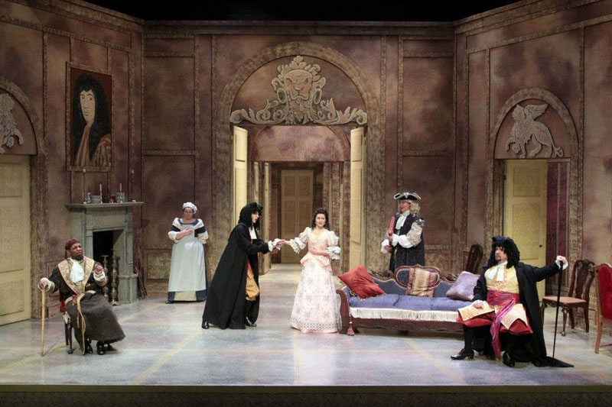
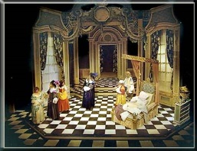
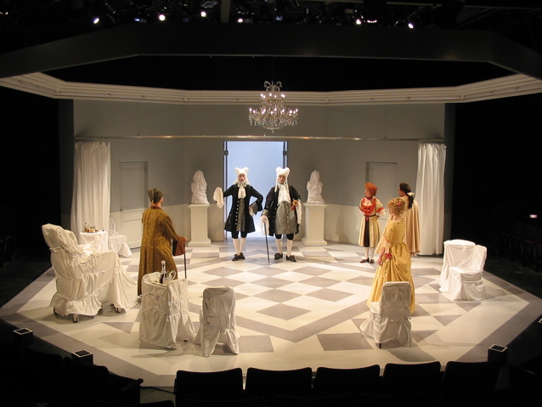
Imaginary Invalid
SCENIC DESIGN

Slide 10
SCRIPT ANALYSIS
GIVEN CIRCUMSTANCES
  Date/Season/Climate – time period, historical, hot, cold,
  Geographical Location - Memphis? N.Y.? Attic above store?
  Political Environment – war, peace, divorce, jail, laws
  Social Environment – hobbies, music, dance, sing, family, friends, love, hate
  Economic Environment – poor, middle, rich, lost it all, poser
  Religious Environment- values, morals, religion
  ALL OF THIS CAN INFLUENCE HOW YOU DESIGN A SET!!

Slide 11
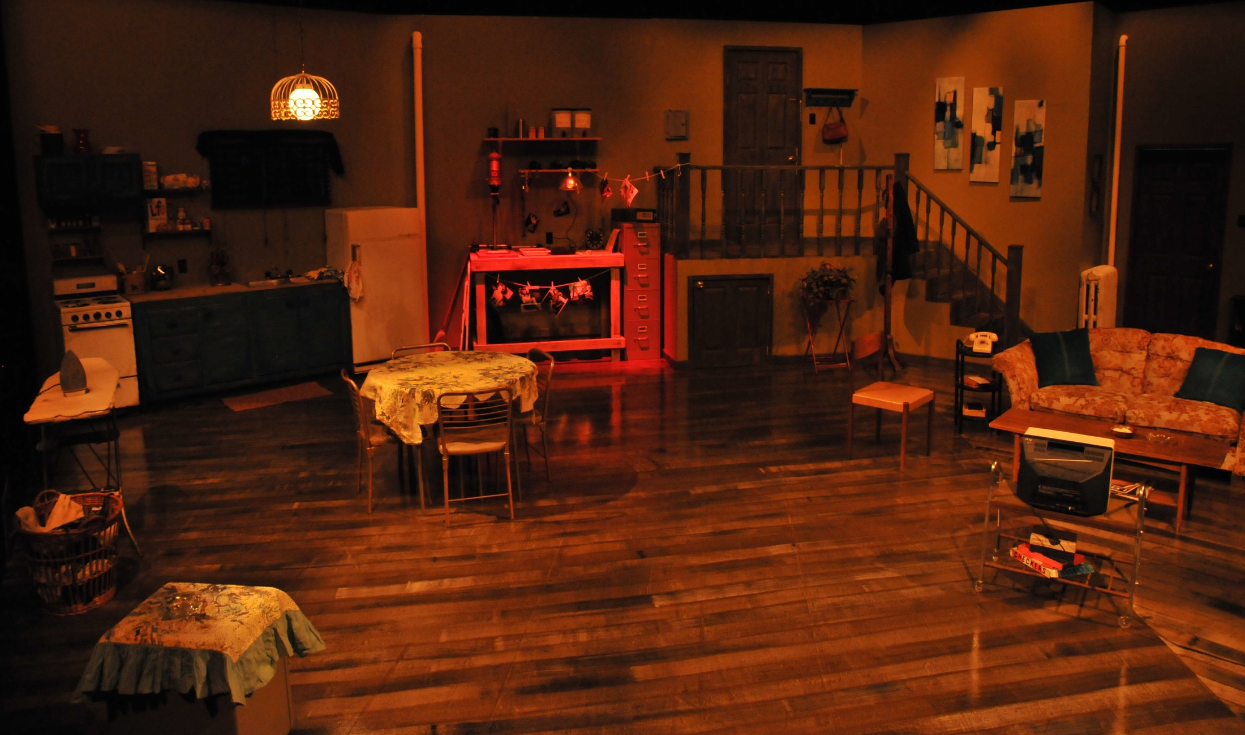
Wait Until Dark
Date: 1964
Loc: NY apartment
Season: Spring
Pol: murder, theft, drugs
Rel: christian
Econ: lower middle class
Social: wife- blind, cooks, cleans, blind stick
husband-smokes, reads, watch tv, photographer, travels business,

Slide 12
SCRIPT ANALYSIS
MOOD
feelings evoked throughout the play
STYLE
how the play is presented to the audience
  Representational – give an illusion of reality; 4th wall
    Realistic – box sets; flats create interior setting
    Abstract – minimalistic sets to suggest the environment
  Presentational – emphasis theatricality; no illusion; break 4th wall and perform to the audience
    Wing-boarder-backdrop sets

Slide 13
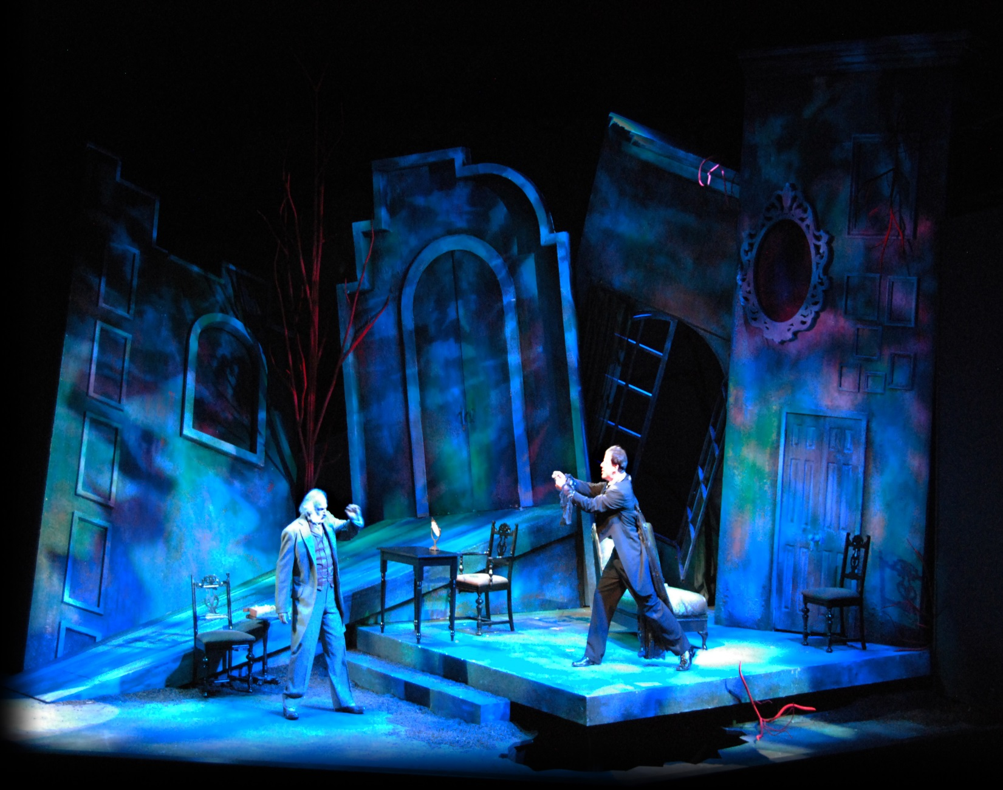
Dracula

Slide 14
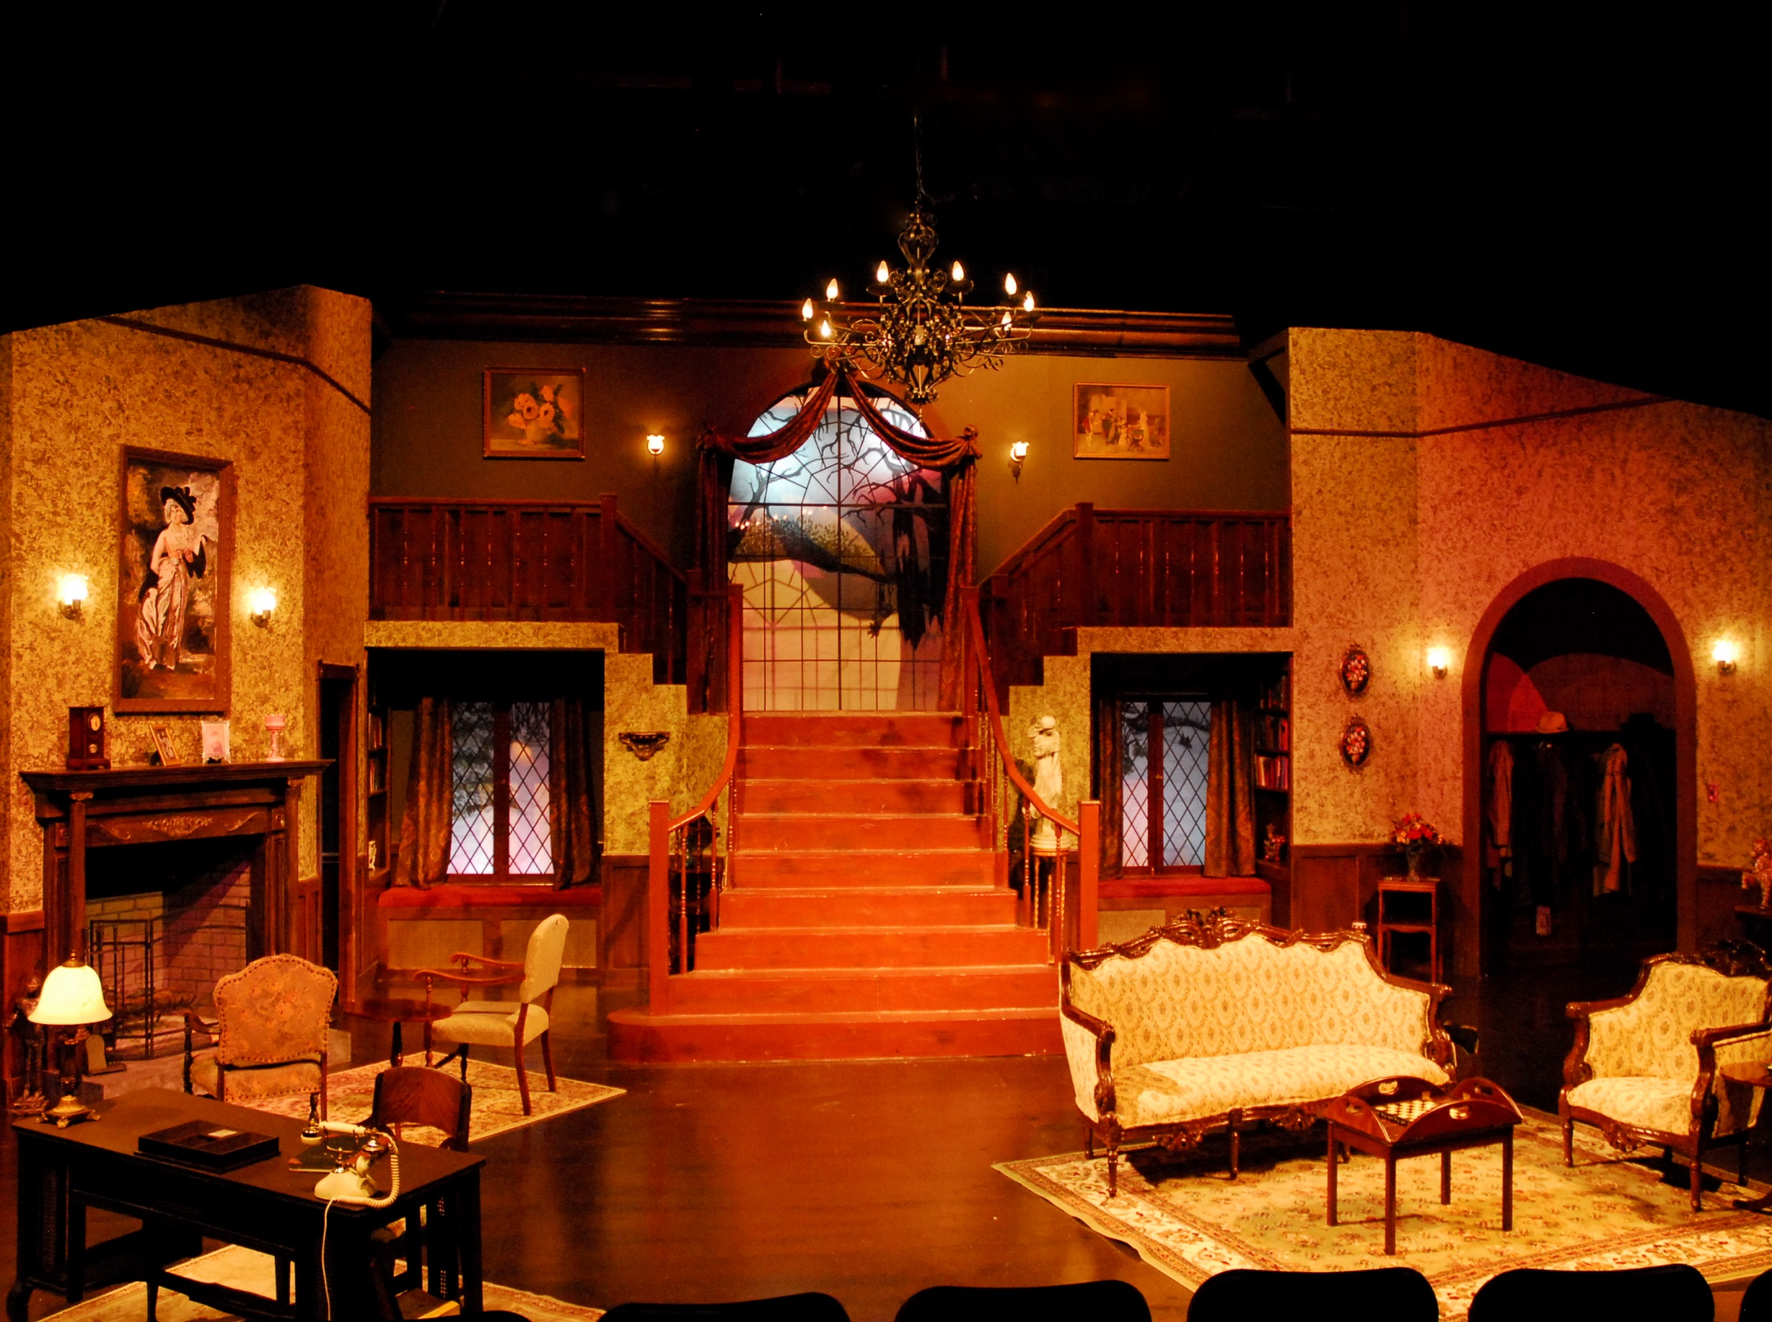
The Mousetrap

Slide 15

RESEARCH - ART DECO
Characteristics
Elegant, strong geometric forms
Integration of motifs and elements
Streamlined or curvilinear shapes including stepped shapes and rounded corners
Rich planes of saturated color (later integrating pastels and neutrals)
Use of "new" materials and innovative combinations such as chrome, stainless steel, glass and mirrored accents, inlays of metals, aluminum, Bakelite
Simplified ornamentation
Exotic cultural influences and graphical elements such as sunbursts, zigzags, thunderbolts

Slide 16
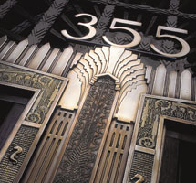
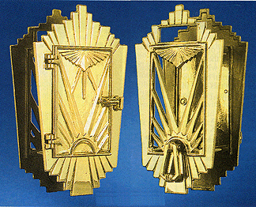
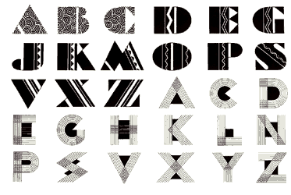
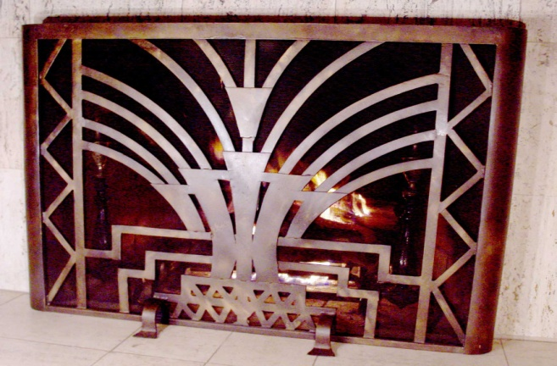
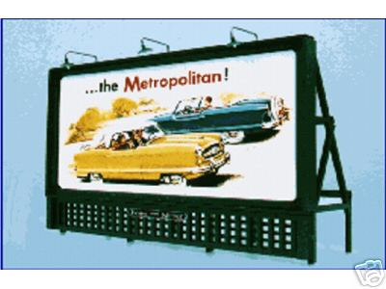
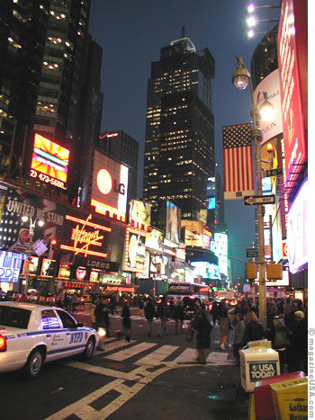
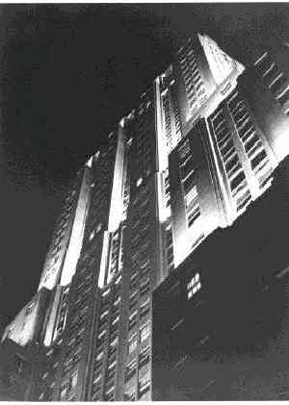
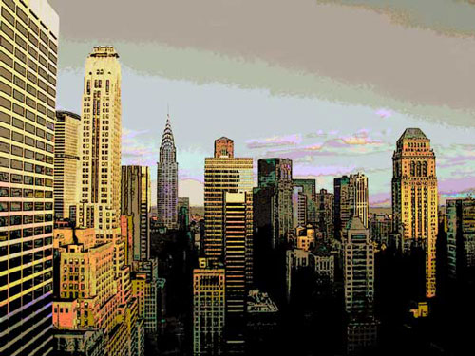

Slide 17
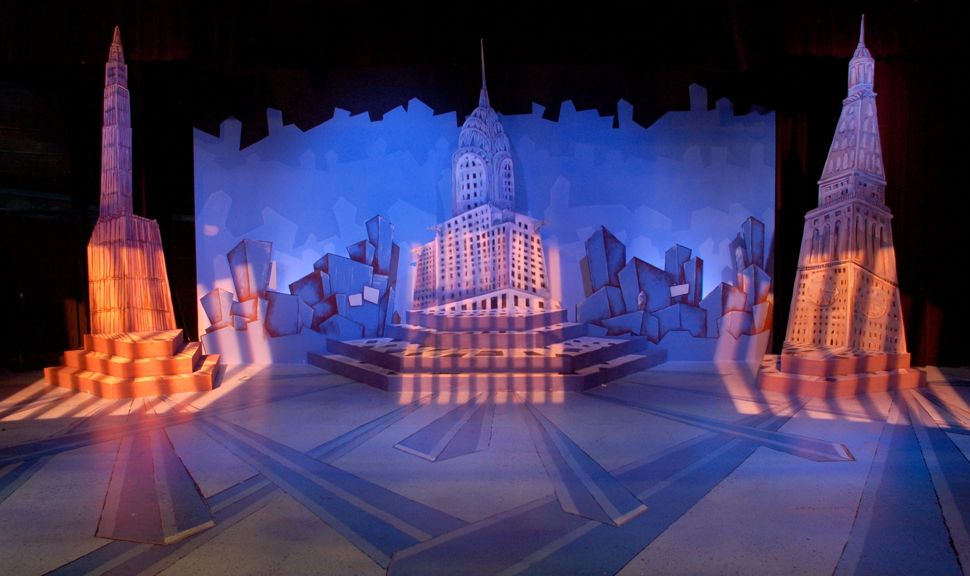
PARKWAY CENTRAL PRESENTS:
THOROUGHLY MODERN MILLY

Slide 18
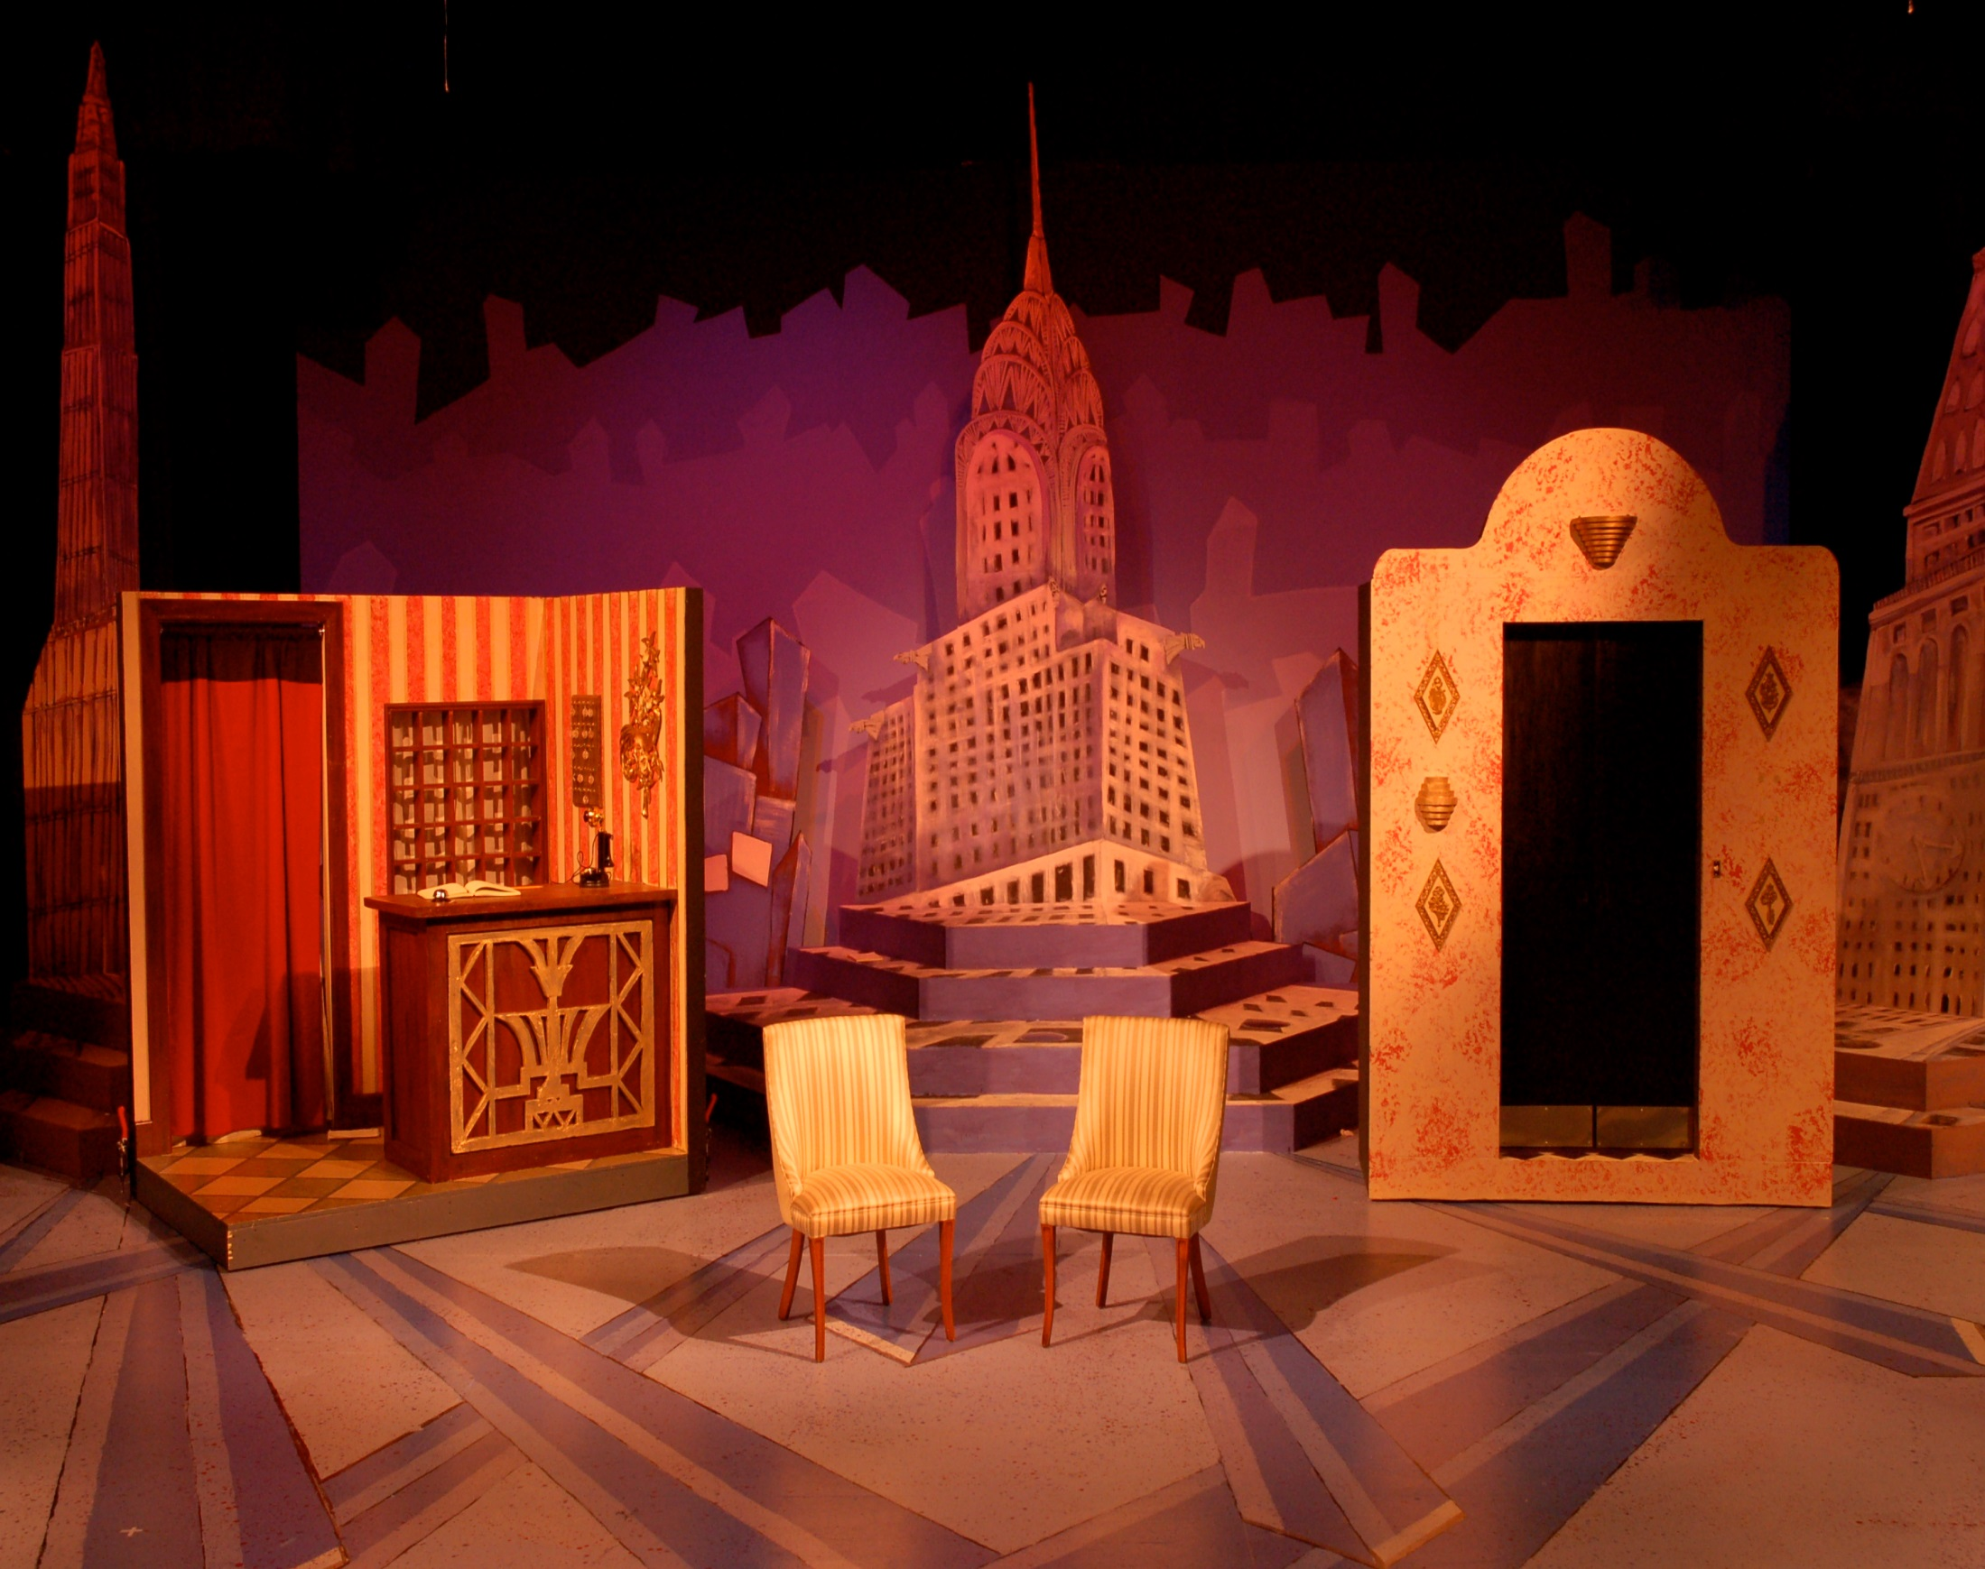

Slide 19
ELEMENTS OF DESIGN
LINE
Angled, jagged, straight, curved or combination?
SHAPE
outlines or silhouettes?
any reoccurring objects?
TEXTURE
smooth=orderly, finished, sleek, elite,
rough=harsher, chaotic, poor, earthy,
MASS
spatial arrangement of the stage
Chaotic, spacious or varied?
heavy or light?
COLOR
Any reoccurring colors?
Do colors contradict or compliment the overall feeling or mood of the script?

Slide 20
PRINCIPLES OF COMPOSITION
UNITY
What is it that connects the show together?
theme, color, feeling, shape? character? An idea?
HARMONY
Harmonious vs inharmonious?
CONTRAST
contradict your visual theme
VARIATION
varying any of the design elements of a given pattern
BALANCE / PROPORTION
symmetrical vs asymmetrical?
EMPHASIS
direct the audience’s attention - giving accent to : a part of a the stage, costume, actor,

Slide 21
PRODUCTION CONCEPT
The central creative idea that unifies all designing aspects of the production.
Unifies all the areas of technical design in a production.
Becomes a visual interpretation of the playwright’s words.
WICKED Scenery: Design Concept (blendspace)
http://youtu.be/ytFSehs2Rxw

Slide 22
SCENIC DESIGN PRODUCTION
Practical considerations
  Needs of Director
  Budget
  Time Frame
  Size/Shape of the Theater
  Abilities of Crew
  Needs of the Actor
  Special Blocking
  Personality of the characters
Conceptual research
  A-D-M theory
  Given Circumstances
  Mood
  Style
  Script Research
  Production Concept
Presentations Materials
  Color Renderings
  3D & computer models
  virtual models
Working Drawings
  Floor plans
  Front & Rear Elevations
  Detail Drawings
  Section Views

Slide 23
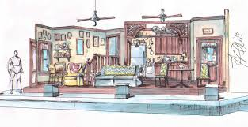
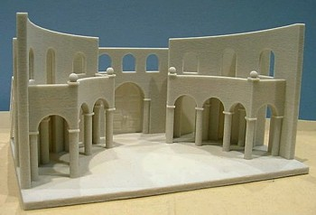
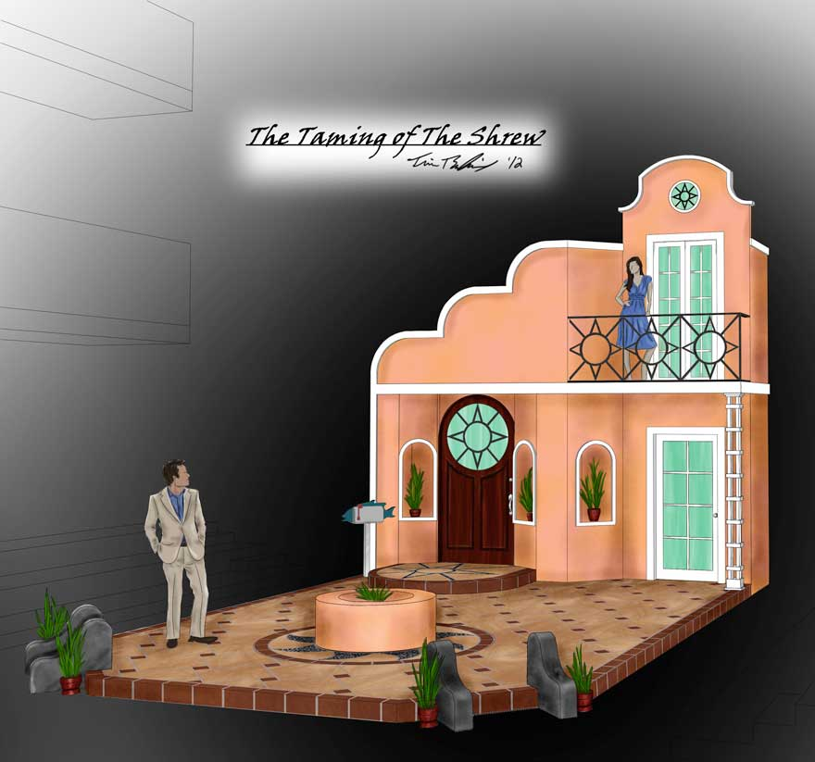
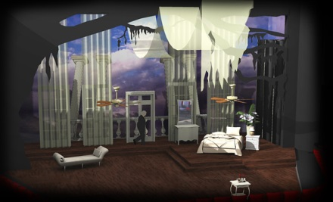
COLOR RENDERING
3D MODEL
COMPUTER MODEL
VIRTUAL MODEL

Slide 24
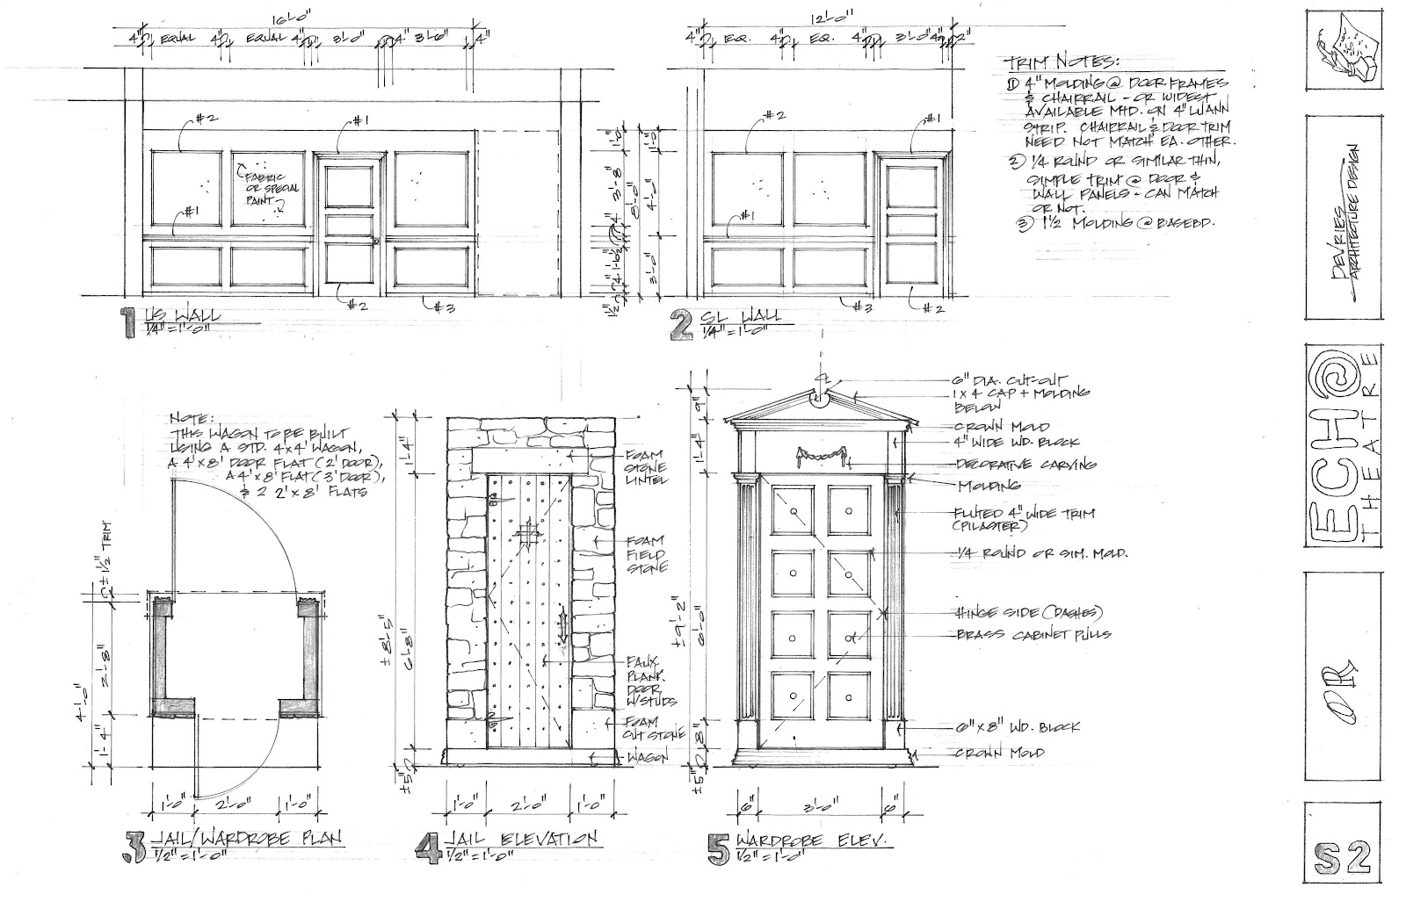
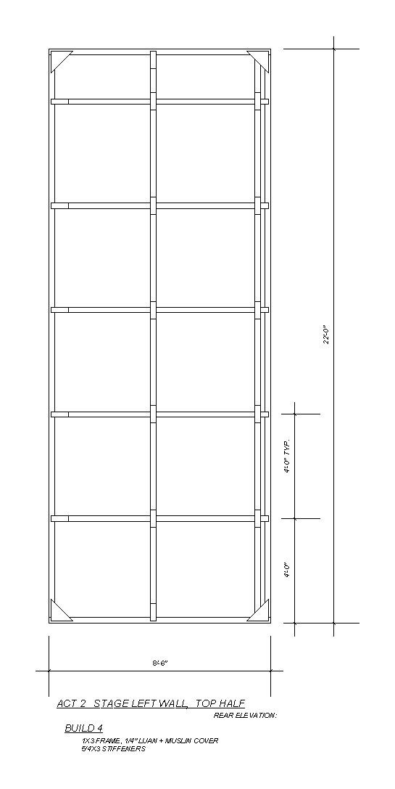
FRONT & DETAIL ELEVATIONS
REAR ELEVATION

Slide 25
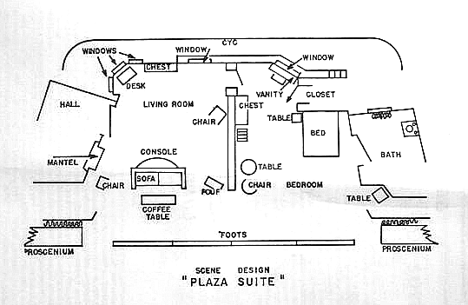

Slide 26
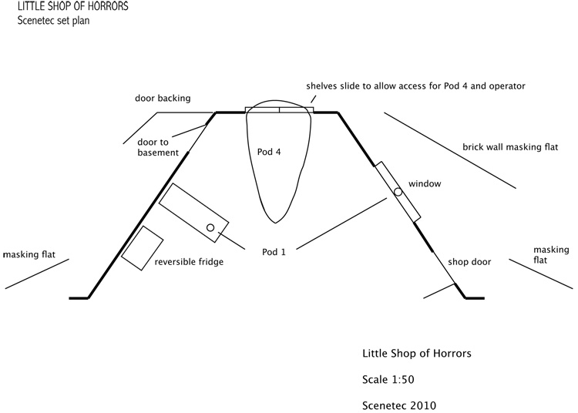

Slide 27
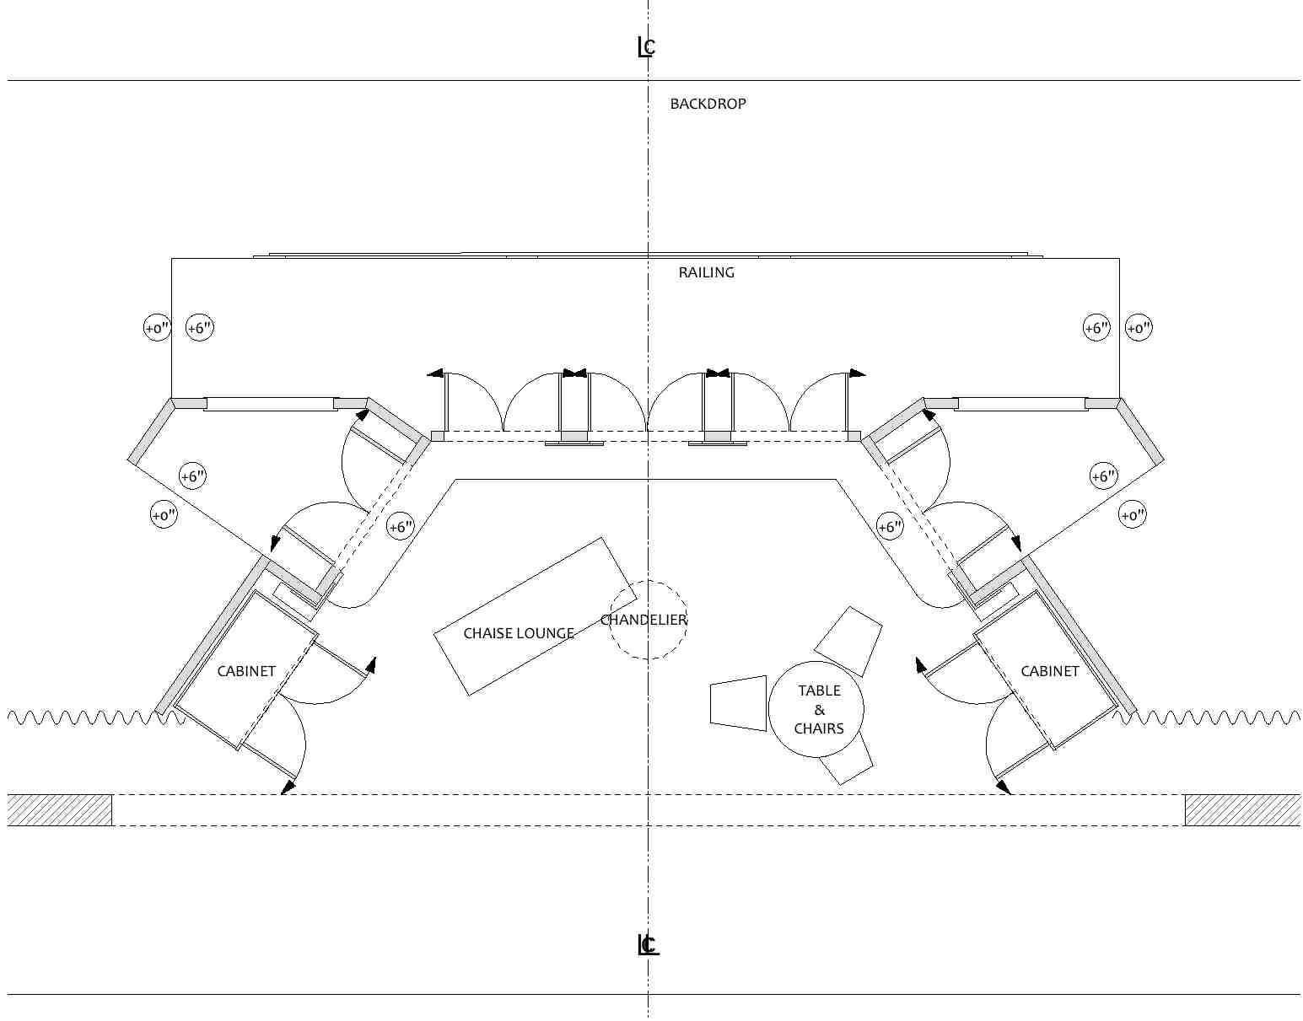

Slide 28
SCENIC DESIGN PROJECT
SCENIC DESIGN PRODUCTION
Conceptual research
  A-D-M theory
  Given Circumstances
  Mood
  Style
  Script Research
  Production Concept
SCENIC DESIGN APPLICATION
Thumbnail sketch- floor plan of the set- get it approved!
Working drawing of the set; floor plan- to scale with correct measurements, labels and furniture placement

Slide 29
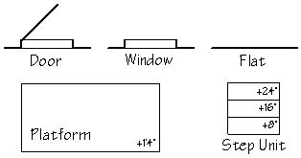
FLOOR PLAN SYMBOLS
Archway
Drapery
Two-Way Door
Casement Window
Couch
Bookshelf, Bar Or Desk
Stuffed Chair
Chair
Table
Entrance/Exit

Slide 30
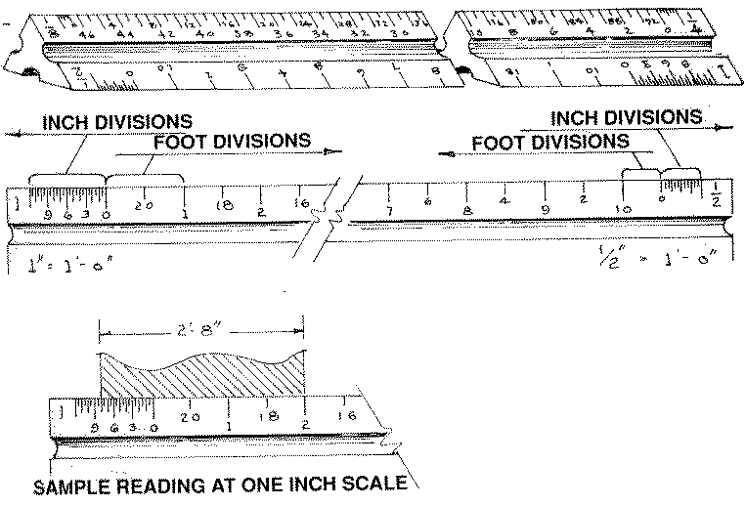
SCALE RULE

Slide 31
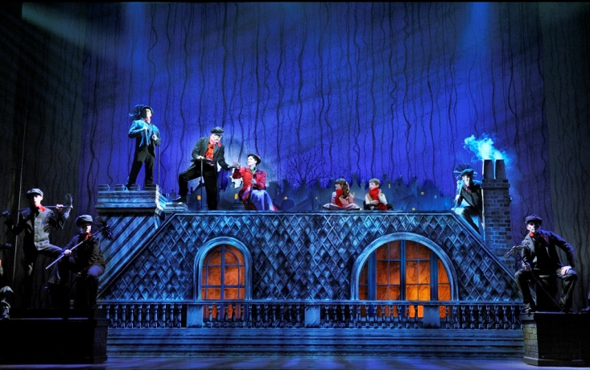
SCENIC DESIGN PRODUCTION
RENT
http://youtu.be/Ax8d7DOcL0E
LION KING
http://youtu.be/e5nZCVXUk3I
SPIDER MAN - Scenic
http://youtu.be/V9oeMitkU0I
MARY POPPINS -Creating Mary's World (blendspace)
http://youtu.be/QlUXbtzCJjU

