Slide 1
SINGING AUDITIONS

Slide 2
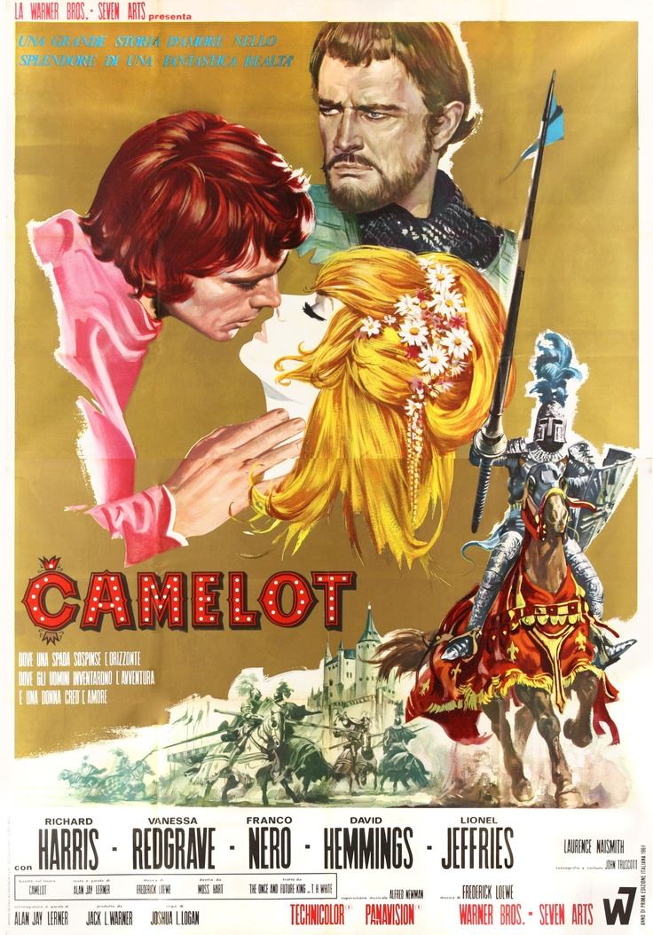
TYPES OF SONGS
  Ballad – Common
    Smooth flowing and usually romantic
    ex. If Ever I Would Leave You
    https://youtu.be/3JYAXydDfFI

Slide 3
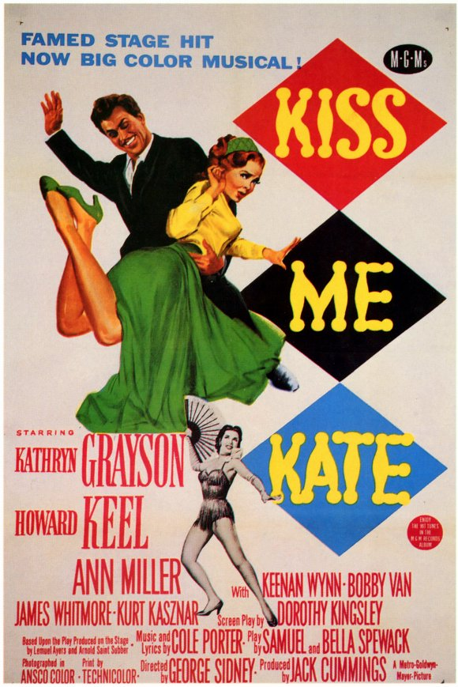
TYPES OF SONGS
  Rhythm or jump song
    ex. Too Darn Hot – Kiss Me Kate
    https://youtu.be/IUFsurgNU9M

Slide 4
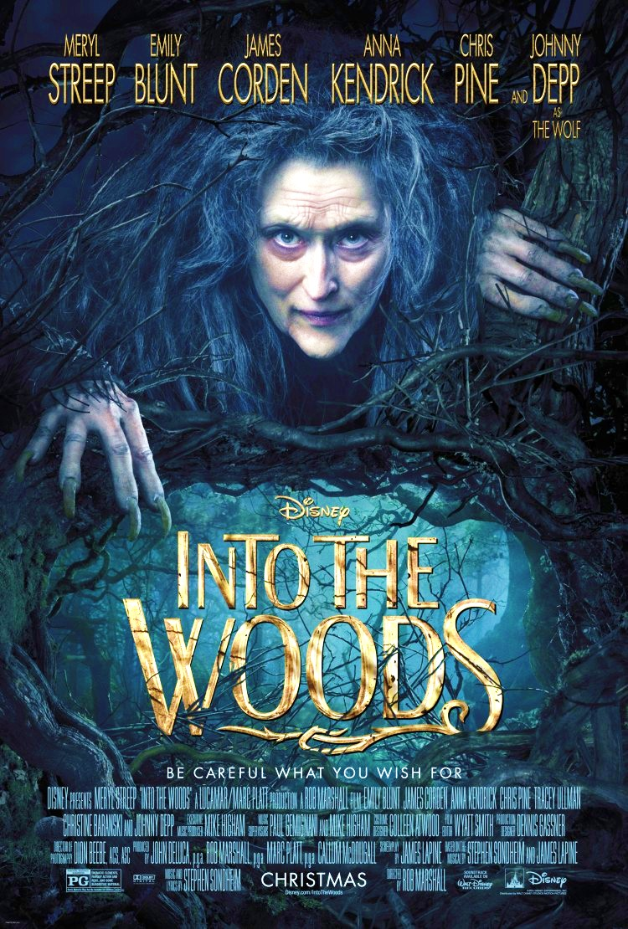
TYPES OF SONGS
  Narrative Songs
    tells of specific events or situations that are important to the development of a character or the plot
    Ex. My Mother’s Wedding Day from Brigadoon, Into the Woods
    https://youtu.be/sBiJ5tgeH84

Slide 5
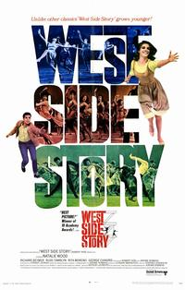
TYPES OF SONGS
  Comedy Songs
    Funny text – sometimes used to add levity to a serious situation
    Ex. Officer Krumpke
    https://youtu.be/j7TT4jnnWys

Slide 6
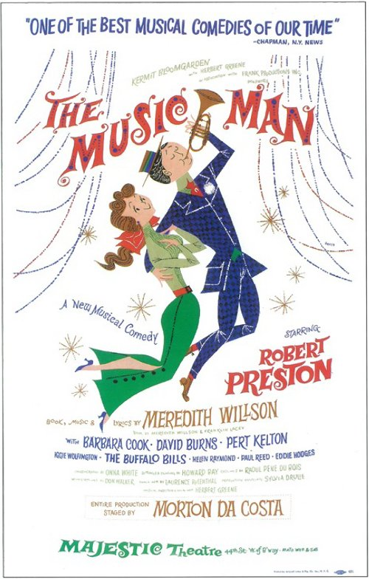
TYPES OF SONGS
  Patter Songs
    Many words, fast paced, often funny
    Ex. Train Song from Music Man
    https://youtu.be/KeJ-YWUr3ME

Slide 7
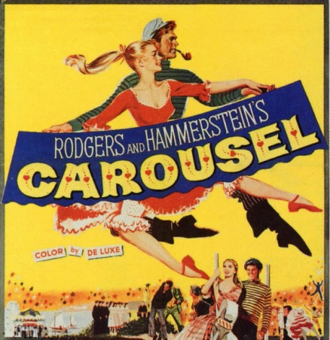
TYPES OF SONGS
  Dramatic Songs
    Often moving, very lyrical, with strong emotional appeal
    Often characterized with strong melodic theme
    Ex. You’ll Never Walk Alone
    https://youtu.be/1izigJX1pxI

Slide 8
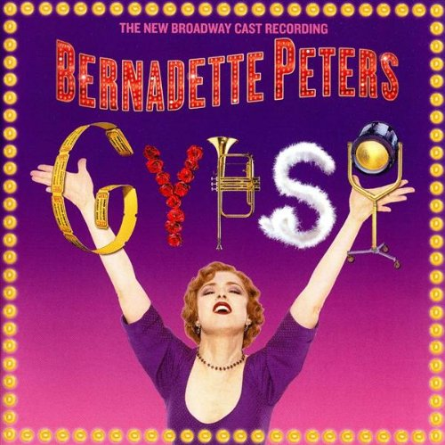
TYPES OF SONGS
  Special Material
    Written for specific talents and personalities
    Ex. Rose’s Turn from Gypsy
    https://youtu.be/4_eD1btsIAE

Slide 9
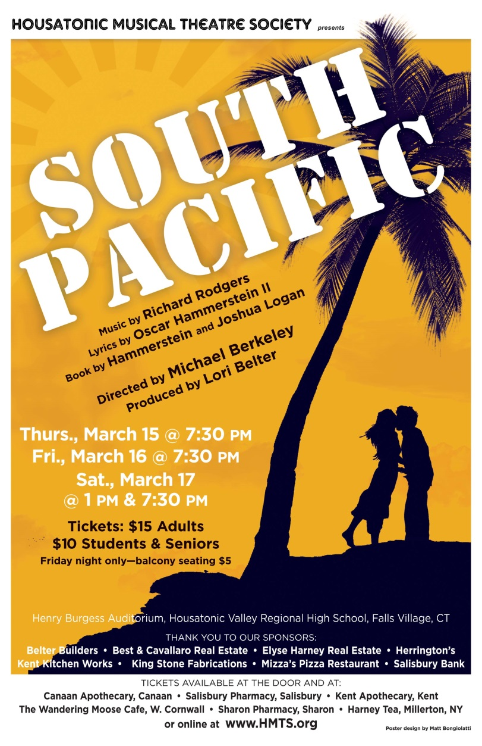
TYPES OF SONGS
  The Reprise
    Repetition of an important song by the person who sang it the first time, or sometimes by a different character with the same or different lyrics
    Ex. Some Enchanted Evening – South Pacific
      Scene 1 – Emile
      Scene 7 – Emile and Nellie
      Near End – Nellie with short repetition
      https://youtu.be/rGyfw3yiMT4

Slide 10
Important Song Characteristics
Songs can provide development of the plot
  Needed by the audience for better plot understanding of the story
Sets mood & atmosphere
Develop personality of the character
Give a look into the future
  Ex. Something’s Coming from West Side Story
Comment on an important theme or social issue
Soliloquy- Allows audience to hear the inner most thoughts of a character
  Ex. So In Love from Kiss Me Kate
https://www.youtube.com/watch?v=xu7sRdRrm_w

Slide 11
Lyrics
Musicals are often written by two people
  Composer-Music
  Lyricist- Words
How to interpret/analyze a song
Song Construction
  Songs are composed in different ways
Most common in simple two-part forms
  Verse- leads into the chorus
      Words specific to situations
      Connected to character
  Chorus
    Words are more general
    Connected to a big idea
  Songs should help move the plot
    Beginning tells listener what song is about and gets them
    Middle develops song’s subject matter
    Ending that provides satisfactory provocative conclusion

Slide 12
The Musical Score
Written by composer
  Overture
    Through composed- new material, may or may not be used later in show
    Medley-Contains the themes of best numbers in the show
      Ex. South Pacific, Guys & Dolls, Oklahoma, West Side Story
    Quiets the audience, arouses interest, puts audience in correct frame of mind
    Some newer musicals have done away with overtures
      Ex. Grease, Evita
The entr’acte
  Usually repeats parts of Act 1 songs
  Can call the audience back to their seats for beginning of second act
Curtain Calls
  Return of the best songs in the show
  Send the audience home humming these tunes
Entr’acte:
https://www.youtube.com/watch?v=TorVIsFiZMg
Curtain Call:
https://www.youtube.com/watch?v=xU2-a97iqzE

Slide 13
The Musical Score
Music for songs
  Written for different vocal ranges
    Soprano
    Mezzo soprano
    Alto or lower contralto
    Tenor
    Baritone
    Bass
  Belter- not a vocal range but a quality of vocal sound
    Not considered a healthy sound
  Songs can be written for two, three or more may be sung in unison/harmony

Slide 14
The Musical Score
Musical Forms
  Variety in forms
    AABA-Most Common
      A- Initial statement of melody
      A- Repetition of the melody
      B- Different melody, called bridge or release
      A- Return of the first melody
  No hard, fast rules
    ABAC (C= new melody)
    ABAB
    AABB
  Construction of phrases-song formulas
  Chorus often has 32 measures divided into 4-8 measures
  Background music for dialogue and action
    Reinforces the dramatic situation by heightening emotion
https://www.youtube.com/watch?v=2s13X66BFd8
Flinstones Theme Song
https://www.youtube.com/watch?v=L_jgIezosVA
Moon River-Andy Williams
https://www.youtube.com/watch?v=mhZ2X9znPxM
Fly Me to The Moon- Frank Sinatra

Slide 15
The Musical Score
  Scene change
    Bridge or segue music
      New music or music from last scene that helps set the mood for the next scene
    Crossover or throwaway music
      Performers move across stage while a scene change happens upstage
      Throwaway has same purpose which is to hold audience attention while a scene change takes place
  Dance (Ballet) Music
    Arranged by a dance arranger from music in the score
    Collaborated effort of the composer, choreographer, and musical director

