Slide 1
characterization
Theatre Arts

Slide 2
http://youtu.be/u8PxG5zvgOM

Slide 3
characterization
Creating a well defined character based on the facts from the script and filling in the holes where needed.
Given Circumstances
Previous Action
Internal Qualities
External Qualities
Profile Questions
Character Archetypes
Western Zodiac
Chinese Zodiac

Slide 4
characterization
Creating a well defined character based on the facts from the script and filling in the holes.
Given Circumstances
Date
Geographical Location
Social Environment
Political Environment
Economic Environment
Religious Environment
Previous Action
Action that occurred prior to the Opening Situation
This specific character action can give justification as to who the character is now.

Slide 5
CHARACTER ANALYSIS
INTERNAL QUALITEIS
1. Background – childhood, siblings, parents, upbringing, where grew up, etc.
2. Mental- common sense, street sense, book sense; type of intellect
3. Spiritual - faith filled life, religion, morals and values of the character
4. Emotional- the emotional state of the character, beginning –middle-end

Slide 6
CHARACTER ANALYSIS
EXTERNALS QUALITIES
1. Dress – casual, dressy, everyday, “go to”
2. Movement / Posture – sway, bounce, stagger, limp, hunched, curved, forward, hips
3. Voice- pitch, volume, emphasis, rate, inflection, vocal expression
4. Mannerisms - habits without a prop
5. Stage Business - habits with a prop

Slide 7
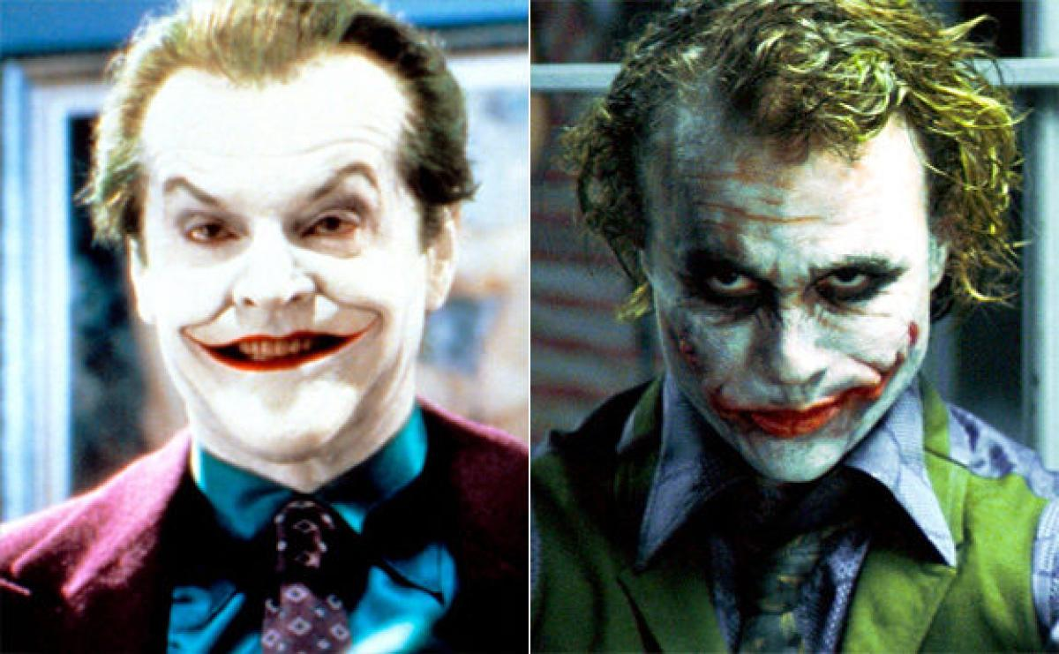
characterization
Jack Nicholson vs. Heath Ledger
As The Joker
http://youtu.be/Nz8AXNi4wnI

Slide 8
CHARACTER ANALYSIS
PROFILE QUESTIONS
1. What is your full name?
2. What is your occupation?
Do you love it/have it? What is your dream job?
3. What are your hobbies?
4. Who is your greatest role model?
5. What is your favorite_________ And WHY?
color? animal? food? book? movie? music?

Slide 9
CHARACTER ANALYSIS
6. What secrets do you have?
7. What are your deepest fears?
8. WHO do you hate? Why?
9. WHO do you love? Why?
10. List 12 adjectives that BEST describe you.

Slide 10
Character archetypes
An archetype is an original model of a person,; a symbol universally recognized by ideal example, or a prototype after which others are copied, patterned, or emulated by.
A full list of archetypes can be found on my website!

Slide 11
Character archetypes examples
THE MOTHER / FATHER
The Mother is the ultimate nurturer both the bearer of the life and the creation of a safe and loving home for her family. "Mother Earth", providing sustenance for all living creatures. The Father is the ultimate protector and provider for his family. His qualities include honor, integrity, loyalty, and physical stamina.
THE PHILOSOPHER
The Philosopher pursues the meaning of life for the sake of obtaining a level of reason beyond human boundary. Questions are pursued for which there are no definitive solutions and answers are not the ultimate goal: the heightening of awareness about the nature of human life is. Example personalities include Socrates and Aristotle.
THE SLAVE / PUPPET
The slave is a person held in a circumstance or situation without opportunity for choice or dignity. The journey of the slave is to become the master of his/her own life and fate. An internal master such as memories, moods, drugs or alcohol can enslave someone as well.
THE TEACHER
This archetype impartially provides instruction to others with the intention of furthering the development of their hearts and minds. While parents, or those that instruct others in a craft of trade may have its influence, the Teacher's energy must resonate in a personal sense to have this archetype. There is a code of honor, or ethics that comes along with the task.

Slide 12
Western zodiac
FIRE SIGNS
(Aries, Leo, Sagittarius)
EARTH SIGNS
(Taurus, Virgo and Capricorn)
AIR SIGNS
(Gemini, Libra and Aquarius)
WATER SIGNS
(Cancer, Scorpio and Pisces)

Slide 13
Sagittarius NOV.22-DEC.21
Restless nature, bores easily; loves to travel, often athletic and needs to be outdoors; exploration is the spice of life, whether mental or in the body; optimistic, often has good fortune just when it is needed the most; may be a risk-taker; interested in theoretical and philosophical fields; naturally gifted teacher; difficulty with follow-through, procrastination, and commitments; prefers to keep all options open; temptation to move on without materializing results; often leans toward the single life.

Slide 14
Chinese zodiac
While Western Astrology is based upon the months of the year, Chinese Astrology is based upon a twelve year lunar cycle. Your sign is determined by the year in which you were born
Each sign and those born under it, are represented by one of twelve animals, and are ascribed a set of attributes the Chinese believe comprise the nature of each particular animal.

Slide 15
Chinese zodiac
Legend has it the 12 animals of the Chinese Zodiac were chosen by Buddha.
When Buddha was near death he invited all the animals to visit him.
Only 12 came: the rat, ox, tiger, rabbit, dragon, snake, horse, goat, monkey, rooster, dog and pig.
For visiting him, Buddha honored each by using them to represent the 12 phases of the Zodiac.

Slide 16
Dog (1910 - 1922 - 1934 - 1946 - 1958 - 1970 - 1982 - 2006 – 2018 - 2030)
Honest, Dependable, Diligent, Perceptive, Selfless, Caring, Moody, Fun-loving, Adventurous.
Dogs are loyal, truthful and live by their own uncompromising code of ethics. While very trustworthy, they do find it difficult to trust others. Dogs are faithful friends and exceptional listeners. They are the caped warriors of the Chinese Zodiac in that they will fight injustice and side with the underdog anytime, anyplace. Dogs can be very rigid in their thinking and behavior. They also tend to be moody and need time alone to sulk and revitalize. Dogs are slow to trust, but with time and evidence that someone is trustworthy they will warm up to them. Dogs need physical activity to be happy. They will champion any cause they deem worthy. In the pursuit of love, Dogs may be their own worst enemy. They can become so anxious from engaging in the mating ritual that they create too much stress in their potential partners for their dance of love to be successful.
Famous DOGS Include: Brigitte Bardot, Candice Bergen, David Bowie, Kate Bush, Naomi Campbell, Cher, Petula Clark, Jamie Lee Curtis, Sally Field, Zsa Zsa Gabor, Ava Gardner, Michael Jackson, Sophie Loren, Shirley MacLaine, Madonna, Liza Minnelli, David Niven, Sydney Pollack, Elvis Presley, Prince, Sade, Claudia Schiffer, Slyvester Stallone, Sharon Stone.
Ideal Jobs Include: Priest, Nun, Trade union leader, Teacher, Charity worker, Nurse, Doctor, Judge, Lawyer, Scientist, Researcher, Social Worker, Lawyer, Community worker.
Lucky Numbers: 1, 4, 5, 9, 10, 14, 19, 28, 30, 41, 45 and 54.
Equivalent Western Sign: Libra

Slide 17
Assignment #1 Character observation
Between now and the next class go to a public place and “people watch”
Choose 1 person to do a character observation on and record only their external qualities.
At home, write out the internal qualities and profile questions.
Bring the information to our class.

Slide 18
Theatre arts performance final
1. Choose a monologue.
2. Complete a character analysis.
3. Write out the blocking for your monologue, next to each line.
4. Only use one focal point and DON’T BREAK CHARACTER!!!
5. Include an introduction and closing
6. Memorize and Perform

Slide 19
Choosing a monologue
Choose 1 monologue
Character should be close to you in age and experience
1:30-2:00 minutes long
Modern, not classical
Avoid violence
No vulgarity
Read the play in which the play comes from
Do a character analysis

Slide 20
CHOOSING A Monologue
Avoid characters “telling a story” about what happened to them – its boring
Instead, find monologues where the character is ACTIVELY talking to another person
Include an INTRODUCTION and CLOSING
Memorize early!
Practice, practice, practice!!!!!

Slide 21
INTRODUCTION
Before you start your monologue, begin with an introduction:
Good morning/afternoon, my name is
(your name) and I will be performing a monologue from the play (title) by
(playwright) and playing the role of
(character’s name) .
After you introduce the piece, then take a few seconds to gather your composure, and “GET INTO CHARACTER”. Then begin the piece.

Slide 22
closing
When you finish the performance, you will break character, look at the audience and say
THANK YOU
and exit the stage.
Do not finish and then just walk away!

Slide 23
Monologue performance
DRESS ATTIRE
This is being treated as an audition, so …
DO NOT DRESS AS THE CHARACTER
rather DRESS NICE.
No jeans, shorts, hats, or sloppy attire.

Slide 24
MONOLOGUE PERFORMANCE EXAMPLE
college audition tape http://youtu.be/tqSVp_hp0eg
Takeis Boston http://youtu.be/oCtWm7cgQvE

