Slide 1
Theatre History

Slide 2
Essential Questions
What is the relationship between a society, a culture or a historical time period and its Theatre?
In what ways can Theatre reflect life?
What are some ways to tell from which historical time period a play originates?

Slide 3
PRIMITIVE MAN 38,000-5,000 BC
Theatre began with primitive man performing RITUALS
Storytelling
Dancing and/or Rhythmic Movements
Masks
Costumes
Song and/or Sounds

Slide 4
PRIMITIVE MAN 38,000-5,000 BC
Rituals helped to explain their…
Traditions
Religion
Nature
Examples:
“hunting” ritual
“coming of age” ritual
Rituals evolved into PANTOMIME; stories shown, not told

Slide 5
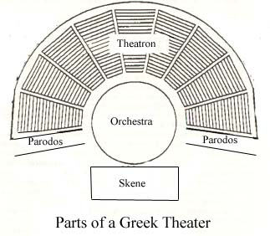
GREEK THEATRE 1200-500 BC
Performed in the THEATRON
Outdoor theater
Seats: 14,000 (1/2 Athens)
Scenic Elements:
Props
Pictures – hung for scenery
Wheeled platforms – carried bodies
Trap Doors
Crane (flying actor)

Slide 6
GREEK THEATRE 1200-500 BC

Slide 7
GREEK THEATRE 1200-500 BC
Greek Theatre:
Began as “Festivals” honoring the Greek God/Goddesses
1st religious, then evolved into dramatic performances
Lasted: 5-6 days 1x year
Focus: TRAGEDY
Character of high esteem “falls” to death or despair because of some fatal flaw within him.
Audience experiences catharsis: empathy for the protagonist
Oedipus Rex, a tragedy by Sophocles, chronicles the story of Oedipus, a man that becomes the king of Thebes and was always destined from birth to murder his father and marry his mother. As a result of this self discovery, Oedipus blinds himself and begs to be exiled.

Slide 8
GREEK THEATRE 1200-500 BC
PERFORMERS:
CHORUS helped tell the story
15-50 chorus members
All male
Wore masks
550 BC 1st actor: THESPIS
Festival of Dionysus
Stage Dialogue created!
2-3 actors followed

Slide 9
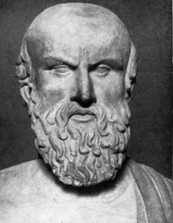
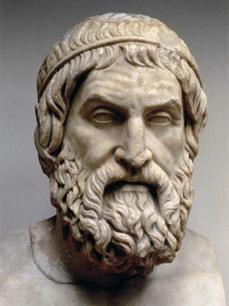
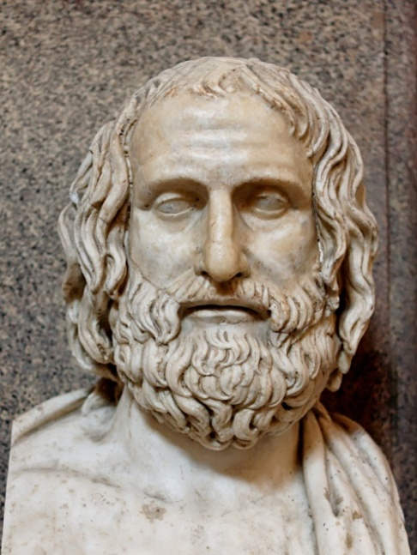
GREEK THEATRE 1200-500 BC
AESCHYLUS
SOPHOCLES
EURIPIDES
“Father of Tragedy”
1st true Greek playwright)
wrote 7 tragic plays
added the 2nd actor
decreased chorus: 50 to 12
5 Act play structure
added the 3rd actor;
increased chorus:12 to 15
wrote of right vs. wrong
focused on character- moral & personal issues
“First Modern” playwright (Medea, Electra)
focused on the psychological motivations of characters and gave them human qualities

Slide 10
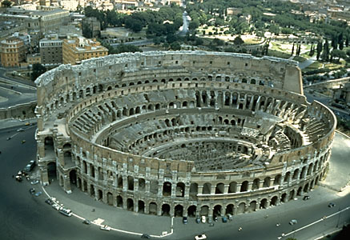
ROMAN THEATRE 200 BC-AD 500
Performed in the COLISEUM
“Arena” style theater
Seats: 20,000
Entrance Fee
Selected Seating
Dressing Rooms
Some covered seating (wealthy)

Slide 11
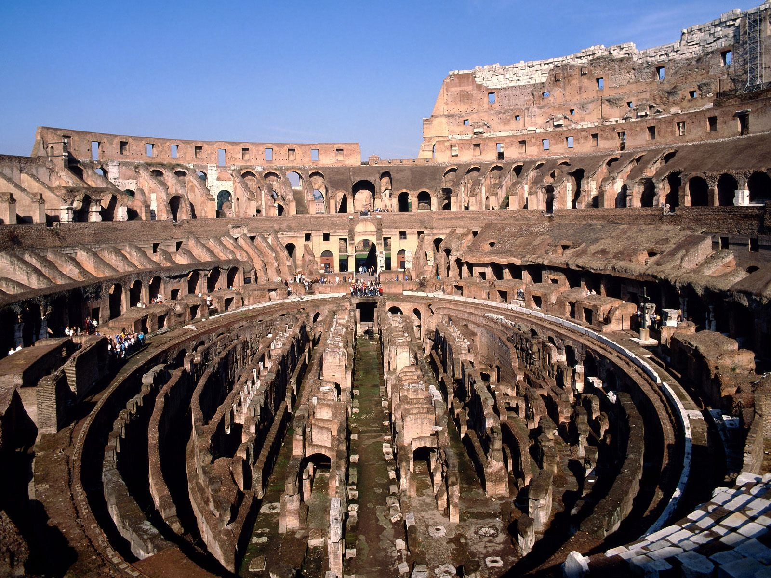
ROMAN THEATRE 200 BC-AD 500

Slide 12
ROMAN THEATRE 200 BC-AD 500
ROMAN THEATRE:
Festivals “ludi” honored human wealth & power
Lasted: some, 100 days
Focus: COMEDY
‘Romanized’ Greek plots, w/ bawdy & vulgar humor
incorporated staged games
AD 80 killed 9,000+ animals
If play good, manager lived, If play bad, manager fed to lions
PERFORMERS:
Were all male
DID NOT wear masks
DID NOT use a chorus
Characters:
comic servants (sly or poor)
comic fools (stupid)
pompous character (over edu. fool)
Criminals/slaves/foreigners (low-life characters) – killed in shows (animals hidden in settings)

Slide 13
MEDIEVAL THEATRE 950-1550
AD 470….As the Roman Empire Fell, the Roman Catholic Church took over and BANNED Theatre in Europe.
This became known as the DARK AGES, as no theatre or Arts of any kind was allowed in Europe without the approval of the church.
Theatre is still very active in Asia

Slide 14
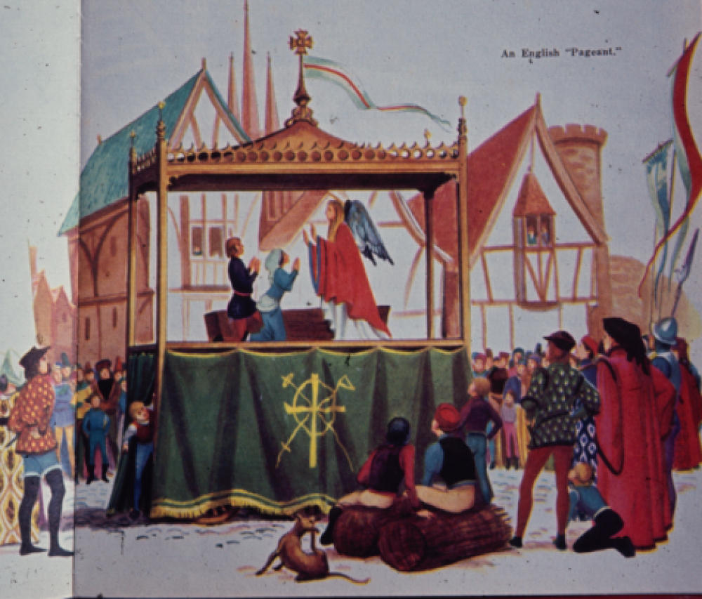
MEDIEVAL THEATRE 950-1550
Eventually, the church allowed traveling troupes to perform plays that reflect the teachings and values of the church.
Mystery Plays
Miracle Plays
Morality Plays
Performed on Pageant Wagons
Horse drawn stages
Opens to create a fixed stage
Props, Costumes
No Women ☹

Slide 15
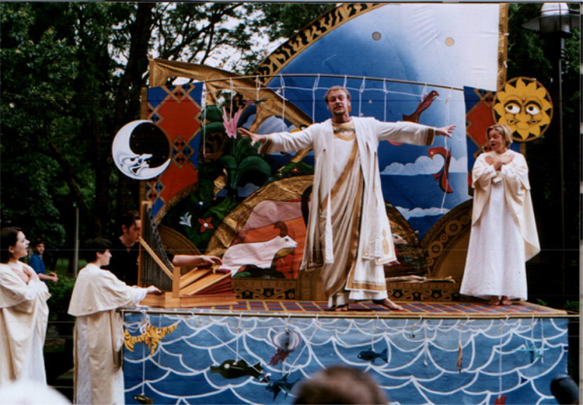
MEDIEVAL THEATRE 950-1550
MYSTERY PLAYS
stories of the Bible
Also known as “Passion Plays”
Central Ch: Adam & Eve
Action not confined to wagon
Became a festival with drinking
(top) Creation of Adam and Eve
(bottom) 5th day Creation

Slide 16
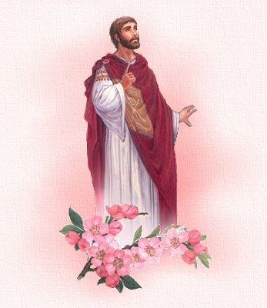
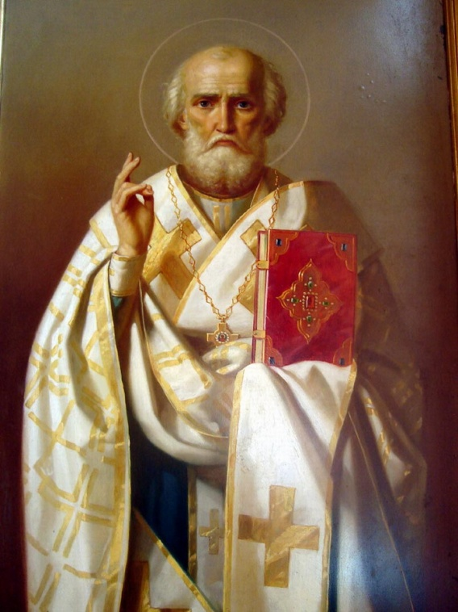
MEDIEVAL THEATRE 950-1550
MIRACLE PLAYS
Stories about the lives of the Saints
Mary Magdalene
Saint Valentine
Saint Nicklaus

Slide 17
MEDIEVAL THEATRE 950-1550
MORALITY PLAYS
Stories that taught about right vs. wrong
Everyman is a morality play that seeks to answer the important religious question: "What must a man do to be saved?"
The play is the story of Everyman's journey to this final reckoning. Along the way, Everyman tries to convince other characters to accompany him in the hope of improving his account. Good and Evil will be tallied like pluses and minuses in an account book.

Slide 18
RENAISSANCE 16th-18thC
Renaissance = “rebirth”
rough outdoor medieval stage to purpose-built indoor theatre
perspective sets and the beginnings of changeable scenery start
Greek and Roman “classics” were being translated and performed
Church became a unified factor & broke away from theatre
ENGLISH RENAISSANCE THEATRE 1562-1642
Elizabethan Theatre
Queen Elizabeth I
William Shakespeare
ITALIAN RENAISSANCE THEATRE 1551-1797
Commedia dell’arte
“comedy of art”
First form of Improv

Slide 19
ITALIAN RENAISSANCE THEATRE 1551-1797
COMMEDIA DELL’ARTE
1st form of improvisation
Europe’s first professional drama
traveled across Europe on a portable stage, for over 200 yrs
performed in exchanged for money from the crowds
First to put WOMEN on the stage
over 800 Commedia scripts recorded

Slide 20
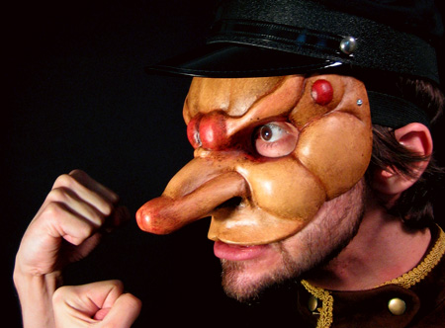
ITALIAN RENAISSANCE THEATRE 1551-1797
PLOT
3 Unities: time, action, place
Used Stock Scenarios: plot summary learned by the actor beforehand
became the skeletal structure for play
Based on familiar situations
plots usually involve the trickster trying to get their hand on the money/daughter or the old fools
used vulgarity, bawdiness and sexual innuendoes
PREPLANNED ACTION
Lazzi: comic bit
Burla: practical jokes

Slide 21
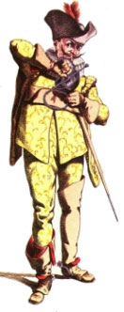
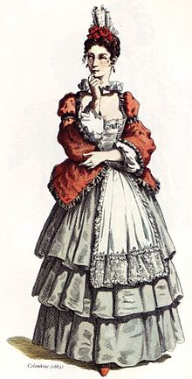
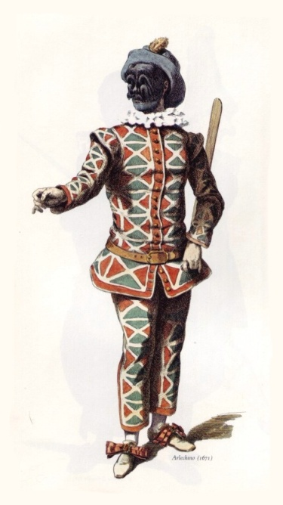
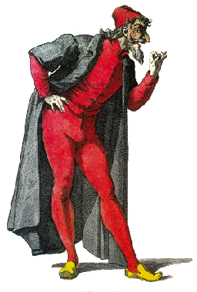
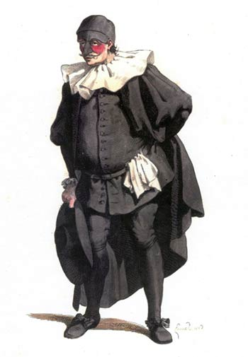
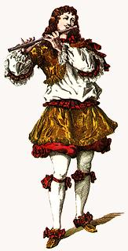
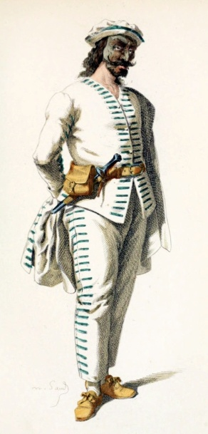
ITALIAN RENAISSANCE THEATRE 1551-1797
STOCK CHARACTERS
Average Troupe size: 7 men and 3 women
Characters- Identified by mask, costume and/or props
stereotyped characters
Old Men: fools (wore masks)
Lovers: realistic (no masks)
Zanni: low-status tricksters (wore masks)

Slide 22
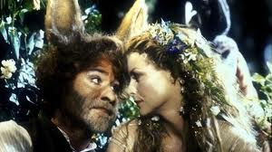
ENGLISH RENAISSANCE THEATRE 1562-1642
William Shakespeare
Actor & playwright
Greatest playwright in history
Authenticity challenged
Wrote 38 plays, 154 sonnets, 2 poems
Plays: comedies, tragedies, histories, & romances (tragiccomedies)
unique use of the language, portrayal of characters and plot
Othello http://youtu.be/RAYuASqrs94

Slide 23
ENGLISH RENAISSANCE THEATRE 1562-1642
THE GLOBE THEATRE
in-door playhouse
Shakespeare’s plays performed here
Built 1599
June 29, 1613 - during Henry VIII, a cannon fired as a special effect, set fire to the thatched roof and the great “Wooden O” was burnt down to nothing.

Slide 24
ENGLISH RENAISSANCE THEATRE 1562-1642
Balcony Seats - Good seats = Wealthy patrons
Floor/Standing Room Only = Poor patrons “Groundlings”
Theater was coined the “Wooden ‘O’” for obvious reasons.
Stage = Thrust – comes out into the audience

Slide 25
ENGLISH RENAISSANCE THEATRE 1562-1642
The Globe allowed for many advancements in theater:
Dressing rooms
Storage facilities
Trap doors
Non-Rep. scenery
Diff. acting areas
Simple mechanics
From Shakespeare In Love http://youtu.be/3Ii5PLxnNpk
http://youtu.be/T3PIhGgtWTs

Slide 26
RESTORATION COMEDY 1660-1710
English Comedies
sexual explicitness, encouraged by Charles II
Audience: aristocrats, their servants & middle-class
Plays: up-to-the-minute topical writing, with crowded and bustling plots
introduction of the first professional actresses
rise of celebrity actors
William Wycherley, The Country Wife
reflects an aristocratic and anti-Puritan ideology
was controversial for its sexual explicitness
complicated, fast-paced plot tangle

Slide 27
NEOCLASICAL THEATRE 18THC
Dominated France
Adhere to 3 unities:
Time: 24 hrs
Action: 1 major action; little or no subplots
Place: 1 location
Costumes & scenery were intricate and elaborate
Acting: large gestures & melodramatic
Molière’s Tartuffe
a hypocrite who ostensibly and exaggeratedly feigns virtue, especially religious virtue

Slide 28
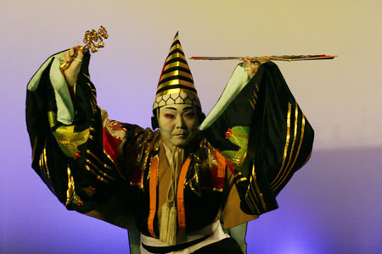
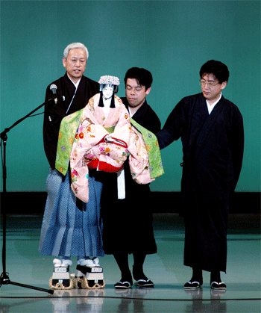
THEATRE OF THE ORIENT 1700s
NOH THEATRE
Performed for upper class
Began as religious ritual
Wore masks
Lead actor and sidekick
Used an orchestra on stage
No women
BUNRAKU
Puppet Theatre
Puppets were 3-4’ tall
Manipulated by 3 puppeteers in full view of the audience
puppeteers control the legs and hands are dressed entirely in black, while the head puppeteer is wearing colorful clothing.
Music and chanting are used
KABUKI THEATRE
Developed in opposition to Noh
Includes music, drama & dance
Meant to shock the audience with more lively and timely stories
wild costumes and swordfights
No women

Slide 29
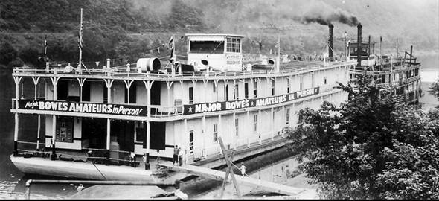
AMERICAN THEATRE 19TH Century (early 1800s)
SHOWBOATS
Major cities were built along a river (Mississippi and Ohio)
Mounting theatre on a flat boat was an efficient way to tour on the rivers
Cities were too small to support residential theatre co.
The 200 seat Floating Theatre is considered America's first showboat. Starting in 1831, it traveled the Ohio and Mississippi Rivers from Pittsburgh to New Orleans
By the 1850s there were dozens of showboats on the water ways & continued to operate into the middle of the 20th C
Jerome Kern - Oscar Hammerstein II musical: Show Boat, (1928)

Slide 30
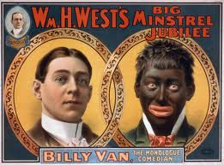
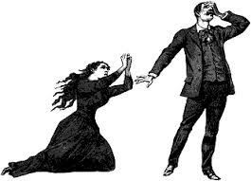
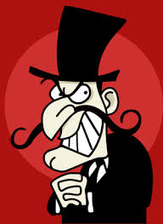
AMERICAN THEATRE 19TH Century (early 1800s)
MINSTRELS
Performed on Showboats
White actors in blackface
Stories of everyday black culture
MELODRAMAS
Sketches that included a hero, a villain and a person in distress
Exaggerated acting

Slide 31
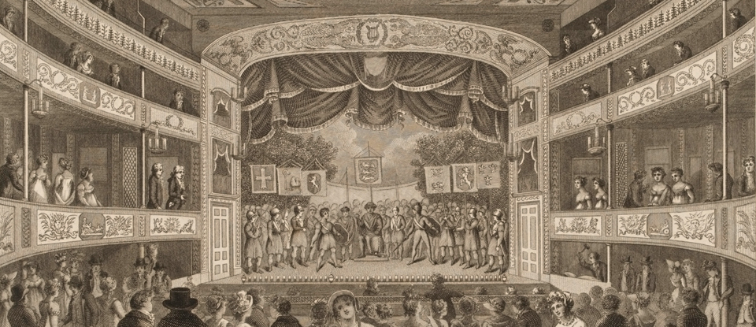
AMERICAN THEATRE 19TH Century (1800s)
By the Civil War, American Theatre established itself in Playhouses:
Box & Reserved Seating
Proscenium Stage
Lighting
Lavish Scenery that could be raised and lowered
Music
Sound Effects
Special Effects
Performances included:
Vaudevilles
Burlesques
Melodramas

Slide 32
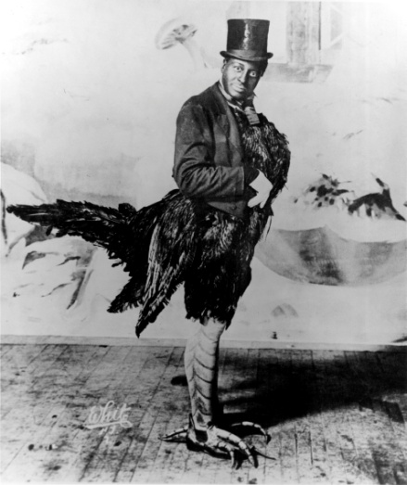
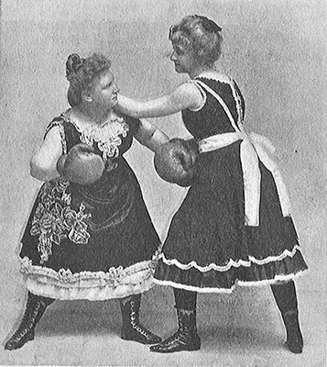
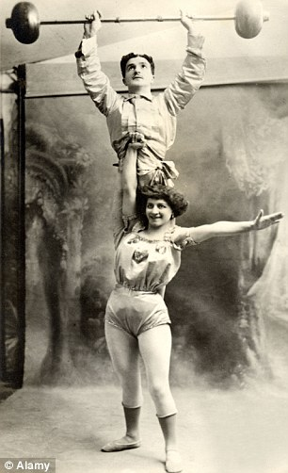
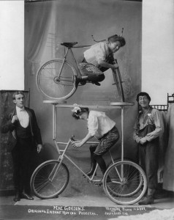
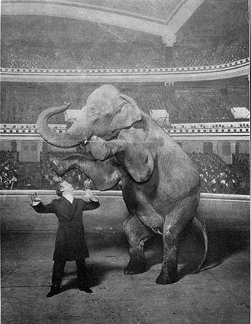
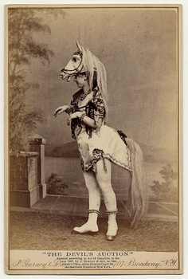
AMERICAN THEATRE 19TH Century (1800s)
VAUDVILLE
Small Group Acts
Singing, dancing, sketches, animal acts, strong men/women, acrobats, magic, clowns, bicycle acts, fighting…quite frankly.. ANYTHING.

Slide 33
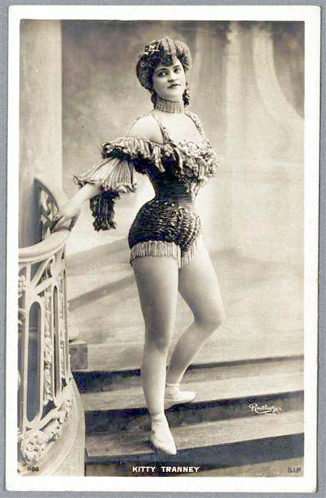
AMERICAN THEATRE 19TH Century (1800s)
BURLESQUE
“Scantily clad” women who undress down to their under-garments while dancing or performing acrobatics like trapeze acts.

Slide 34
19TH Century (early-mid 1800s)
REALISM
A style of theatre showing life as “it really is”
The fourth wall was established as a result of realism
Henrik Ibsen “father of realism”
Most frequently performed dramatist after Shakespeare
Constantin Stanislavski-actor/director/teacher
a "naturalistic" method of drawing on the actor's own emotional memories to convey a character's thoughts and emotions
A Doll House, by Ibsen
Most performed play of 20th C.
Aroused great controversy at the time for its critical attitude toward 19th C. marriage noms.
Nora, leaving her husband and children because she wants to discover herself.

Slide 35
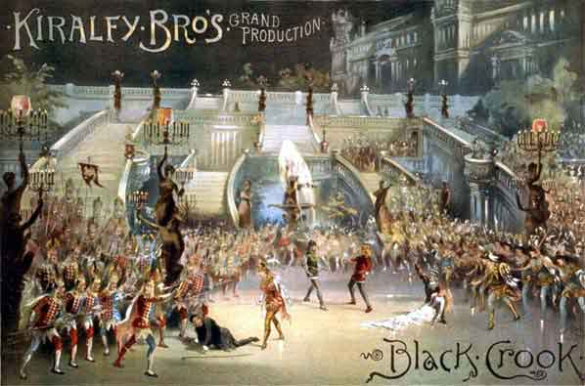
AMERICAN THEATRE 19TH Century - end 1800s
MUSICAL THEATRE
Late 19th c, touring stops and “long run” performances on Broadway are now established
THE BLACK CROOK
1st real American musical (1866) = 475 perf.

Slide 36
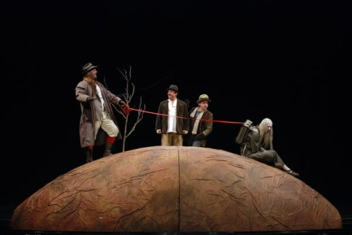
MODERN THEATRE 20TH Century
Rise in Experimental Theatre –(Rejects realism)
Epic Theatre (Bertolt Brecht) Epic theatre makes clear that the audience is watching a play
Theatre of Cruelty (Antonin Artaud) A violent and physical determination to shatter audiences’ false realities
Theatre of the Absurd (Samuel Beckett) Trying to find meaning in a modern world without meaning or purpose (related to Existentialism)
Waiting For Godot, by Samuel Beckett; 2 characters wait endlessly & in vain for the arrival of someone named Godot.
Voted as: "the most significant English language play of the 20th century“
http://youtu.be/tU29RhKTR_M

Slide 37
MODERN THEATRE 20TH Century
MODERN PLAYWRIGHTS
David Mamet
uses great characterization and naturalistic dialogue.
(Sexual Perversity in Chicago, American Buffalo)
Arthur Miller
cited as being America’s greatest living playwright after Williams
Wrote of human existence; uses both realism and expressionism
(Death of a Salesman, The Crucible, All My Sons)
Tennessee Williams
showed tensions, heat, and the need for booze and sex to cope
(Glass Menagerie, A Streetcar Named Desire, Cat on a Hot Tin Roof)
Neil Simon
One of America’s best comedic writers
Uses personal experience in writing
(Trilogy: Brighton Beach Memoirs, Biloxi Blues, Broadway Bound; Plaza Suite)
Sam Shepard
Uses influences like rock and roll, drug culture, and dance. Includes myths of the West, the American Dream and notions of “roots”.
(Fool for Love, True West)

Slide 38
AMERICAN MUSICAL 20TH Century
After the great popularity of the British musical comedies, the American musical theatre came to dominate the stage with such writers & lyricists:
Gershwin brothers
Cole Porter
Jerome Kern
Rodgers and Hart
Rodgers & Hammerstein

Slide 39
AMERICAN MUSICAL 20TH Century
1920’s
Ziegfeld Follies
1st Book Musical
Showboat 1927
1930’s
Of Thee I Sing
Anything Goes
Porgy and Bess
1940’s- 1st Blockbuster Musical
Oklahoma! 2,212 performances
South Pacific
Kiss Me Kate
1950’s
Guys & Dolls
My Fair Lady
The Music Man
West Side Story
1960’s
The Fiddler on the Roof Hello, Dolly!
Man of La Mancha
Funny Girl
1970’s
Jesus Christ Superstar Tommy
Sweeney Todd
The Wiz
A Chorus Line
1980’s
Phantom of the Opera
10,823 perf- longest running
$770 million profit
Miss Saigon
Cats
Les Miserables
1990’s
Rent
Walt Disney Shows: The Beauty and the Beast
The Lion King
2000’s
Avenue Q
Urinetown
Spring Awakening
Juke Box Musicals-Jersey Boys
Film & TV Musicals-Spider Man
Cost $75 mill No Profit made

