Slide 1
SCENIC CONSTRUCTION
Technical theatre

Slide 2
SCENIC CONSTRUCTION
WICKED Scenery: Dragon Clock
http://youtu.be/pIut6-kJsAU
WICKED Scenery: The Oz Head
http://youtu.be/I0atKUyMp6I

Slide 3
CHARACTERISTICS OF SCENIC CONSTRUCTION
Short term construction
Rapid construction
Possible re-use
Built in one place and used in another
Built in units
assembled with temporary joining
Finished one 1 side only
Light weight
Strong for safe usage & moving
Constructed as inexpensively as possible

Slide 4
CONSTRUCTION CONSIDERATIONS
Is it stock scenery to be reused?
Must it support weight?
Does ti have to be moved during a scene shift? Or action?
How much does the audience see?

Slide 5
SHOP SAFETY
1. ALWAYS KEEP EQUIPMENT IN GOOD WORKING CONDITION.
2. MAINTAIN A CLEAN AND ORGANIZED WORKING ENVIRONMENT. AVOID CREATING HAZARDS:
Nails, screws sticking up
Not cleaning up properly
Leaving tools out
Leaving tools left on
Over loading power
3. NEVER EAT OR DRINK NEAR ANY POWER TOOLS.

Slide 6
SHOP SAFETY
4. DO NOT OPERATE ANY EQUIPMENT WITHOUT PROPER TRAINING AND ADULT SUPERVISION.
5. SAFETY GOGGLES ARE REQUIRED AT ALL TIMES WITH POWER TOOLS.
6. DO NOT WEAR LOOSE CLOTHING.
7. SECURE LONG HAIR UNDER A CAP OR TIE IT BACK.
8. USE THE PROPER TOOL FOR THE PROPER JOB.
9.UNDERSTAND YOUR LIMITATIONS.
10. WEAR CLOSED-TOE, HARD-SOLE SHOES AT ALL TIMES.

Slide 7
SHOP SAFETY
11. ALWAYS UNPLUG A POWER TOOL BEFORE CHANGING A BLADE OR BIT.
12. WHEN WORKING WITH MATERIALS THAT EMIT FUMES, GO OUTSIDE.
13. REPORT ANY DAMP OR WET CONDITIONS IMMEDIATELY.
14. KNOW THE LOCATION OF THE CLOSEST FIRE EXTINGUISHER.
15. KNOW THE LOCATION OF THE CLOSEST FIRST AID BOX.
16. USE COMMON SENSE. BE AWARE OF YOUR SURROUNDINGS. BE SMART, STAY FOCUSED ON YOUR TASK!

Slide 8
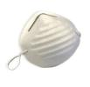
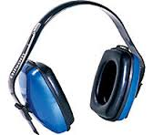
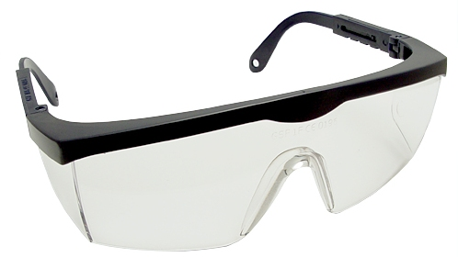
SAFETY EQUIPMENT
Goggles
Dust Mask
Gloves
Earplugs
Shoes
Hair ties
Clothing
1st aid kits
SAFETY PERMITS
Each student will need to sign a contract in that they understand the dangers and precautions to take while working in the scene shop.

Slide 9
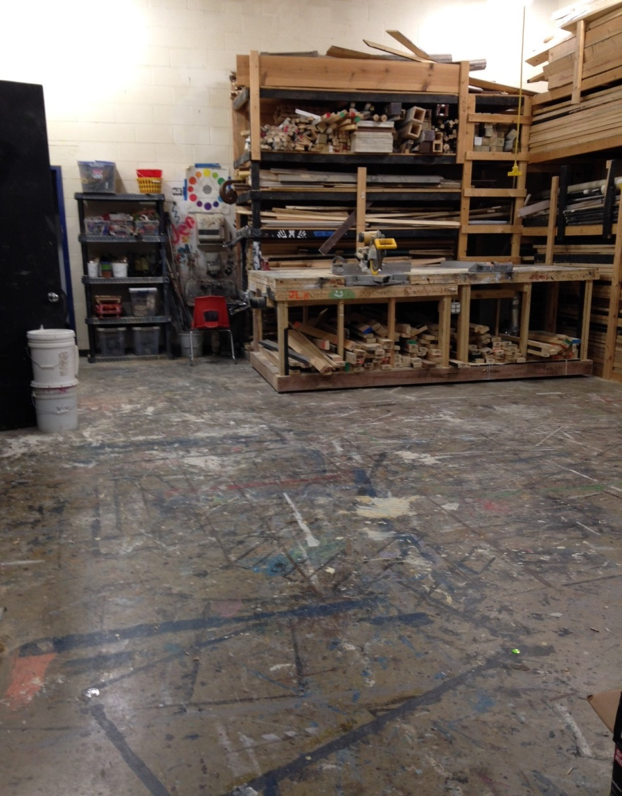
SCENIC CONSTRUCTION
Purpose of a Scene Shop
An area with space and equipment to convert a designer’s plan into completed scenery with the least effort, by the least number of people in the least amount of time, with the least waste of materials.

Slide 10
SCENE SHOP
Two factors that influence the organization and set up of a scene shop…
SIZE
Stage
Shop
Company
FLOW
Receiving & storage of materials
Measuring/marking
Cutting
Working up
Assembly/framing
Covering
Painting
Trial set up
Loading out
Carpentry Shop Tour
-The Grand Theatre http://youtu.be/qwqVXMAqGbo

Slide 11
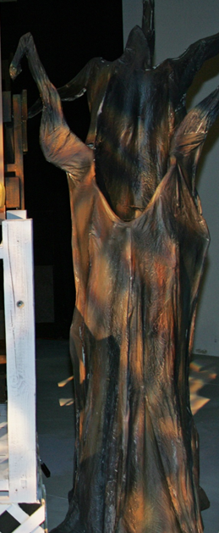
TYPES OF SCENERY
2 Dimensional Scenery
Unframed
Framed
3 Dimensional Scenery
Platform
Step units
Wagons
3D Non Practical Scenery (irregular)
Trees, rocks, columns, etc
Est. time, place, setting, mood.

Slide 12
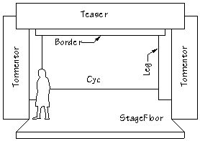
TYPES OF SCENERY – 2D Unframed
DRAPERY
velour curtains
Fire proof
hang from a track above
helps MASK audience’s view of backstage or can be raised and lowered
(legs, tormentors, boarders, grand drape)

Slide 13
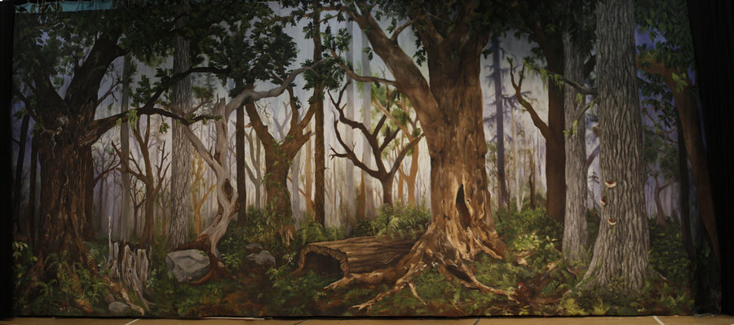
TYPES OF SCENERY – 2D Unframed
DROPS
Muslin or canvas
Painted scenery
Not typically one piece of fabric
Full stage or cut out
Into The Wodds

Slide 14
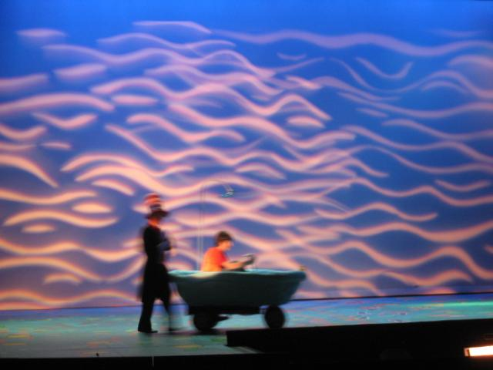
TYPES OF SCENERY – 2D Unframed
CYCLORAMAS
Greek origin: “Sky Cloth”
Used to simulate sky
Great for projection
Usually larger than proscenium opening
Seamless
True cycs are curved

Slide 15
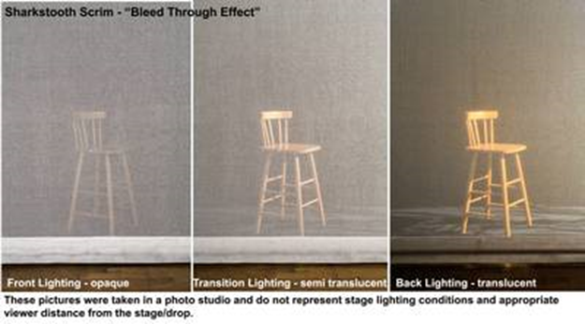
TYPES OF SCENERY – 2D Unframed
SCRIM
NOT a cyc!
Sharkstooth
Knitted fabric with more open space than thread
Light front of scrim
Objects look opaque
Light from behind scrim
Objects visible to audience

Slide 16
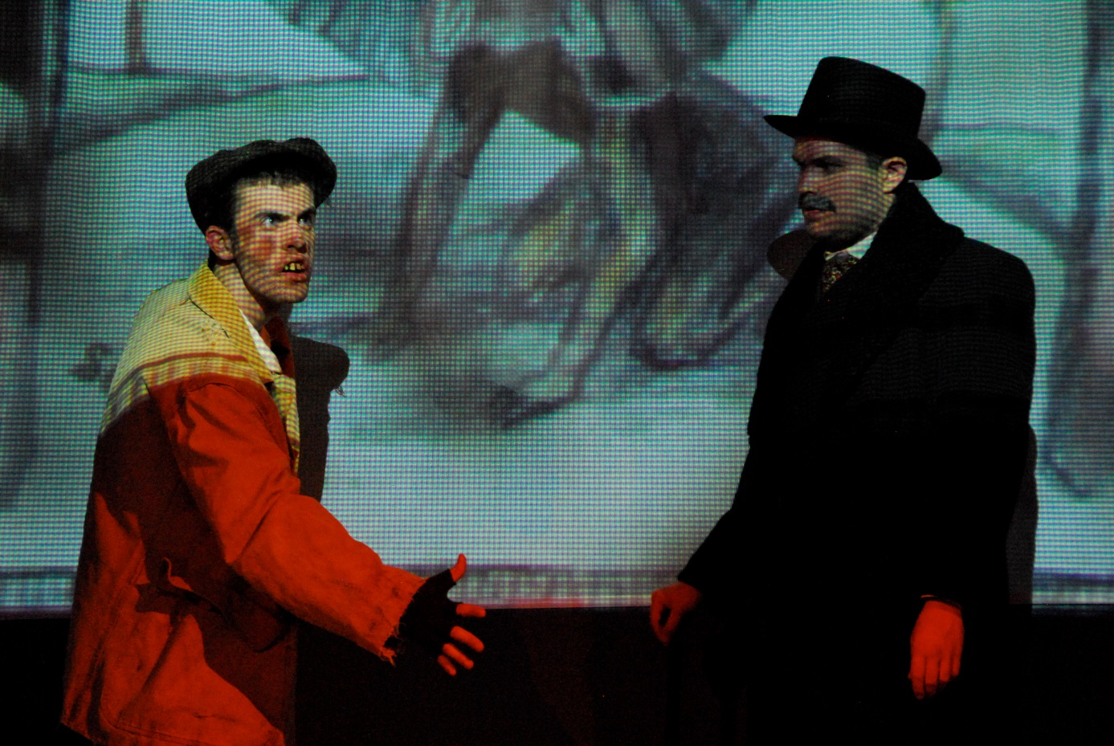
The Elephant Man
Front projection with design lights scrim, & makes Merrick invisible to audience, until…
Back lights fade on to light up John Merrick and he now visible to audience

Slide 17
TYPES OF SCENERY – 2D Scenery
FRAMED - FLATS
Hard cover = luan
Soft cover = muslin
Walls
Windows
Doors
Fireplace

Slide 18
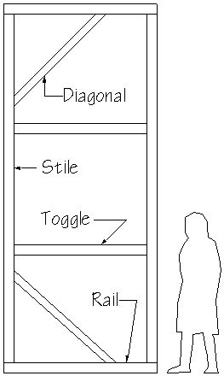
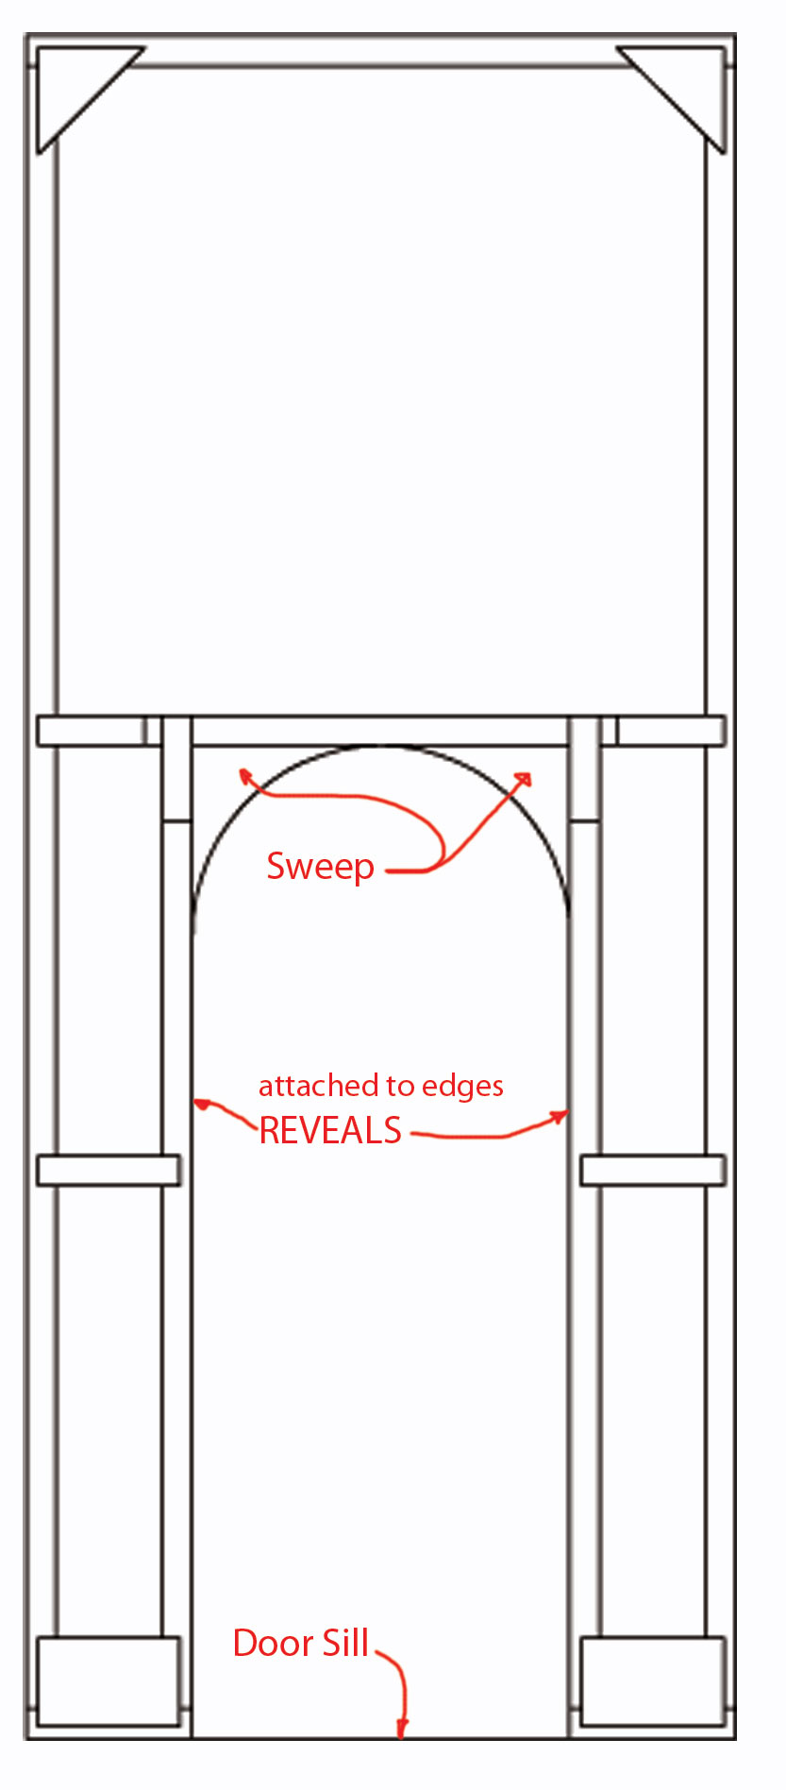
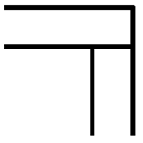
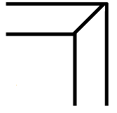
WALL FLAT DOOR FLAT
Corner
blocks
Butt Joint
keystones
Miter Joint

Slide 19
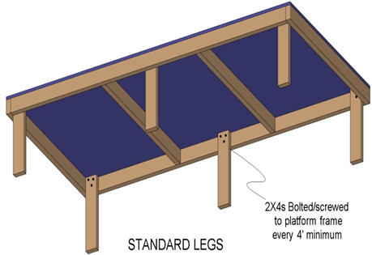
TYPES OF SCENERY – 3D Scenery
PLATFORM
Varied acting levels, actors stand upon
2x4’s – frame
¾” plywood-decking
Legs detachable
Diagonal bracing depending on height
Join multiple platforms with c-clamps, bolts, screws, casket locks
Masking covers the front of the platform, hiding the legs

Slide 20
The Prime of Miss Jean Brodie

Slide 21
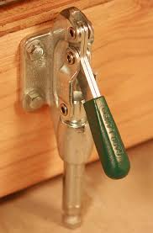
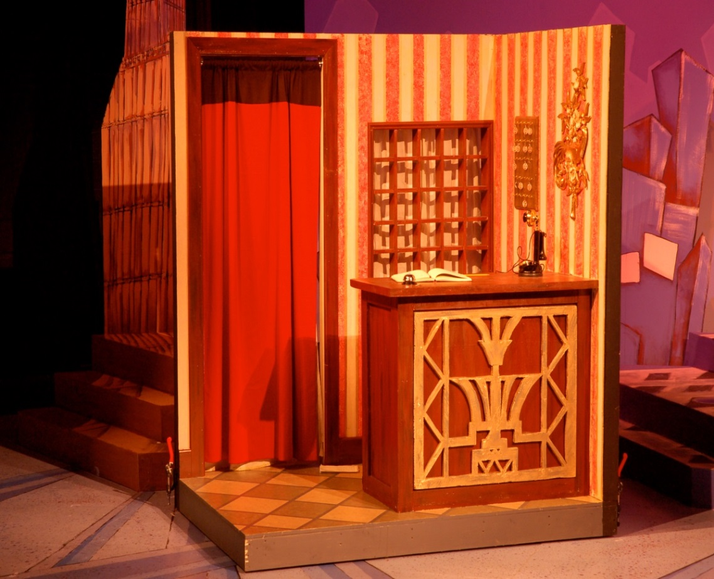
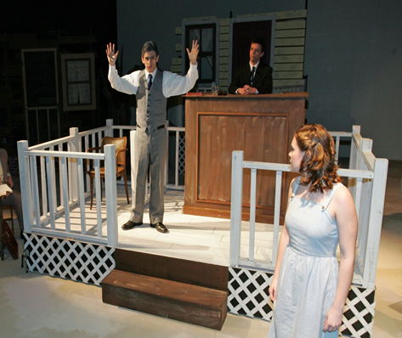
TYPES OF SCENERY – 3D Scenery
WAGON
Platform on casters, instead of legs
Stage Braces keep wagons from rolling

Slide 22
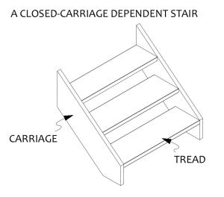
TYPES OF SCENERY – 3D Scenery
STEP UNITS/STAIRS
Tread (run): stand on
Usually 11” wide, ¾” ply
Rise (riser): vertical height
Usually 6-8” tall
Carriage: provides structural support for climber
Dependent: relies upon the upper level structure to support the weight of the climber
Independent: is self-supporting. Will not tip over when climbed.

Slide 23
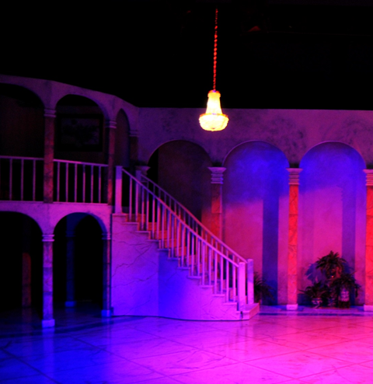
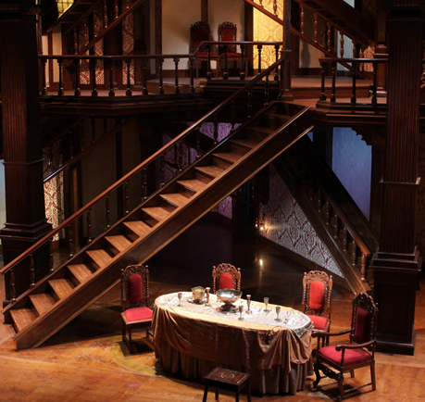
Independent Steps
Dirty Rotten Scoundrels
Dependent Stair Unit - Wagon

Slide 24
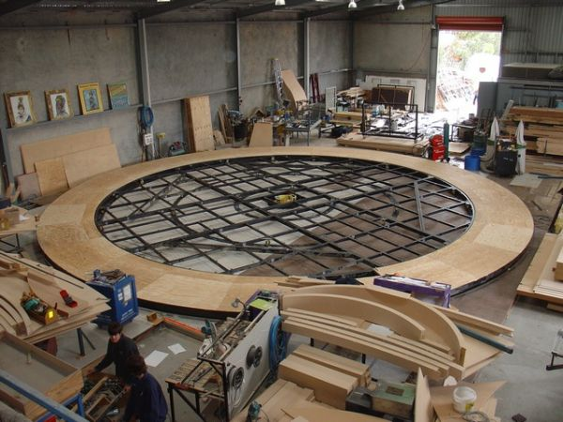
SCENERY MATERIALS
STICK LUMBER
SHEET LUMBER
PLYWOOD
MASONITE
LUAN
METAL
PLASTIC

Slide 25
SCENERY MATERIAL - lumber
STICK LUMBER
(Sticks) solid wood
denoted by nominal dimensions
1x3, 1x6, 2x4, 2x6, 2x10, 2x12 are all common in the scene shop
Nominal vs. True
2x4’s aren’t actually 2”x4”. They’ve been planed to
1 ½”x 3 ½”. The same is true
for all dimensional lumber

Slide 26
SCENIC MATERIAL- sheet lumber
SHEET LUMBER
Standard size: 4’x8’
Grade of lumber
A - clear & strong; $$$$
B - almost clear; $$$
C - few tight knots; $$
D - more knots, less quality, $

Slide 27
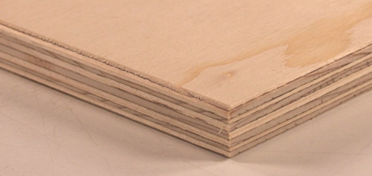
SCENIC MATERIALS - sheet lumber
PLYWOOD
Process wood; several layers glued together with grain in opposite direction
Common width: ¼”, ½”, ¾” (decking)
LUAN
Type of plywood, but thinner & lighter
Good hard cover on flats
Common width: ¼”, ½”
MASONITE
Wood pulp with glue
smooth surface 1 side
Rough back side
Good to cover decking on platforms
Breaks easily

Slide 28
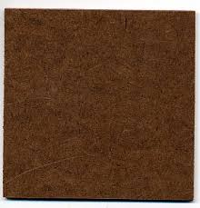
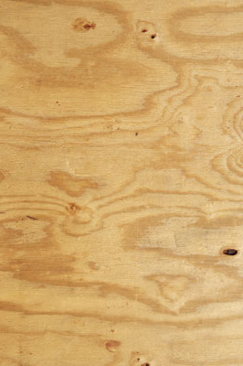
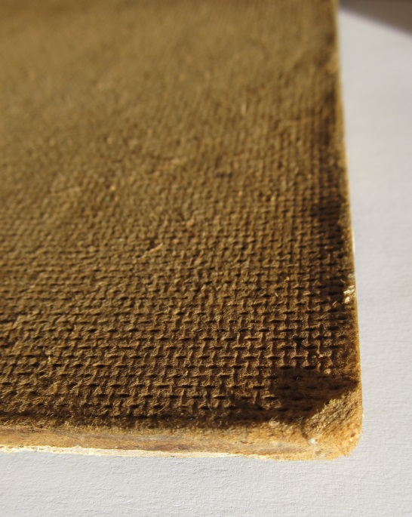
SCENIC MATERIALS
PLYWOOD LUAN MASONITE

Slide 29
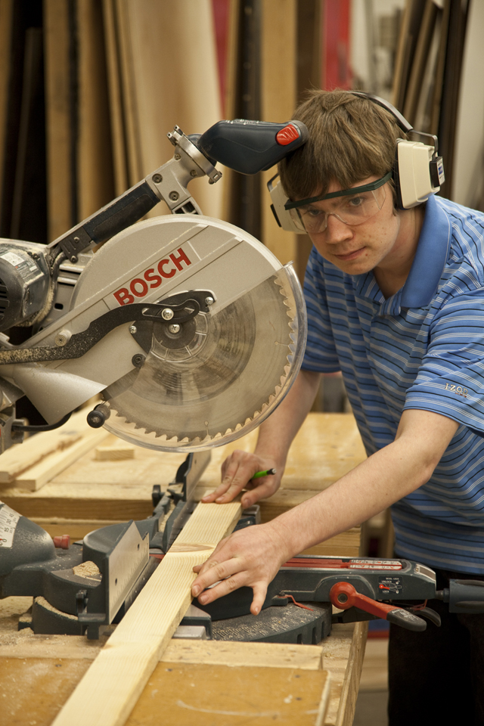
TYPES OF TOOLS
HAND TOOLS
POWER TOOLS
FASTENERS

Slide 30
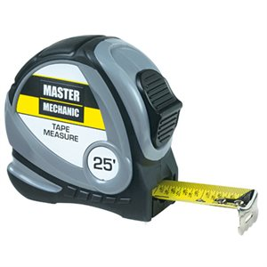
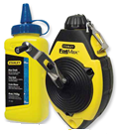
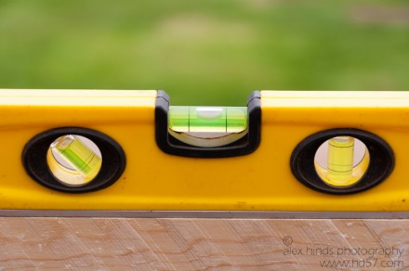
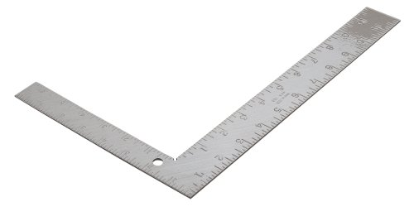
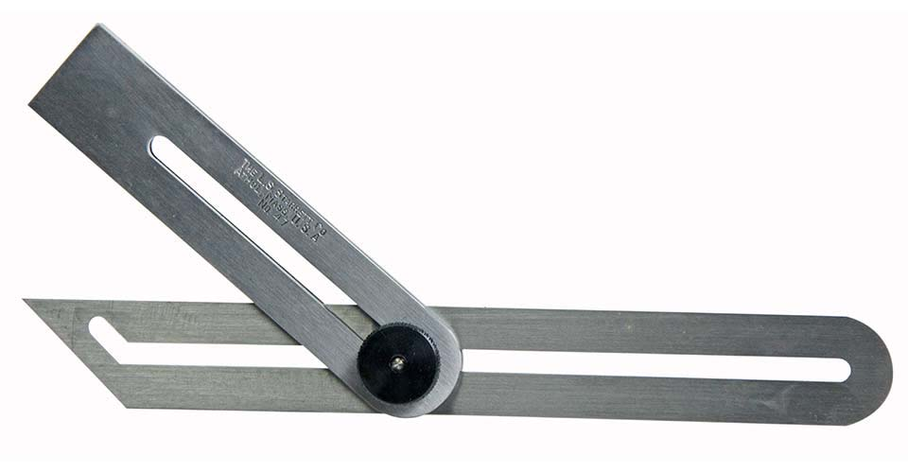
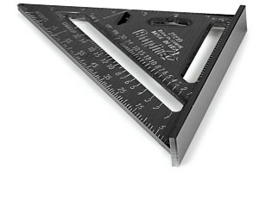
HAND TOOLS *marking & measuring tools
Measuring Tape
Spirit Gauge
Chalk Line
Carpenter’s Square Combination Square Bevel Gauge

Slide 31
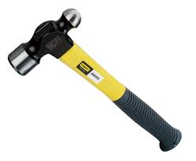
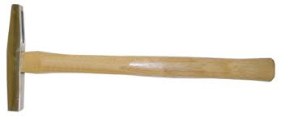
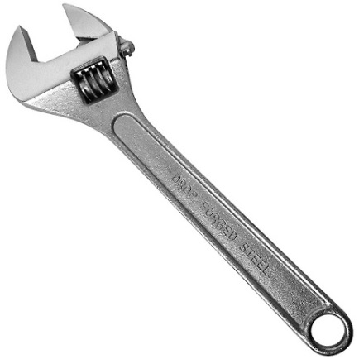
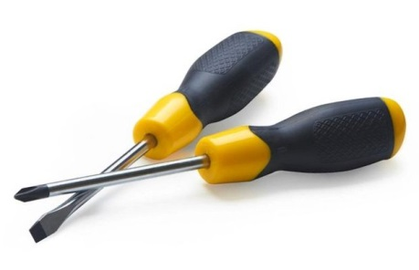
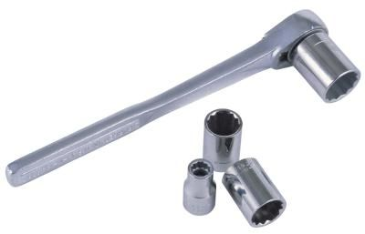
HAND TOOLS *driving tools
Claw Hammer Ball Peen Hammer Tack Hammer
Phillips & Slotted
Screwdrivers
Socket Wrench
Adjustable Wrench

Slide 32
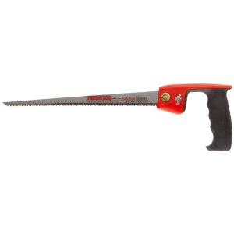
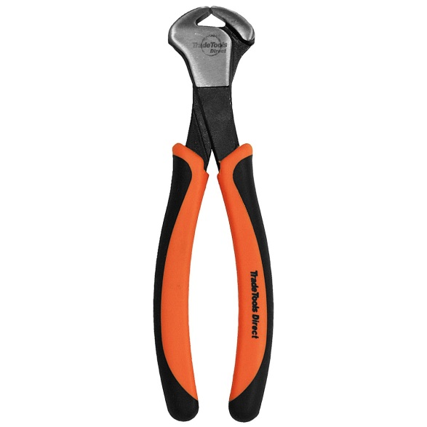
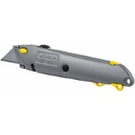
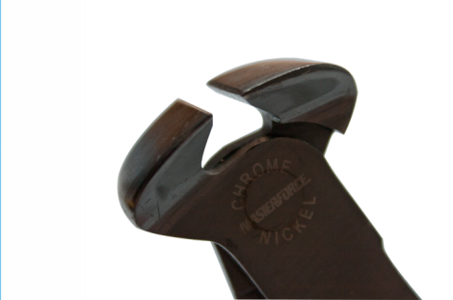
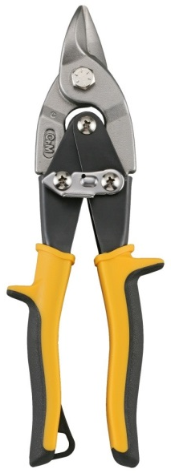
HAND TOOLS *cutting tools
Rip Saw Hack Saw Key Hole Saw
End Nips
Tin Shears
Matt Knife

Slide 33
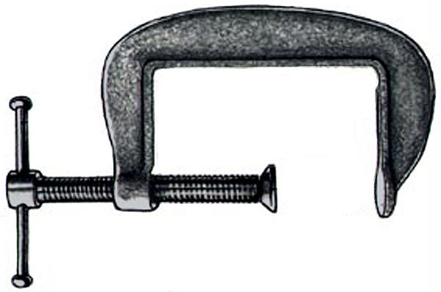
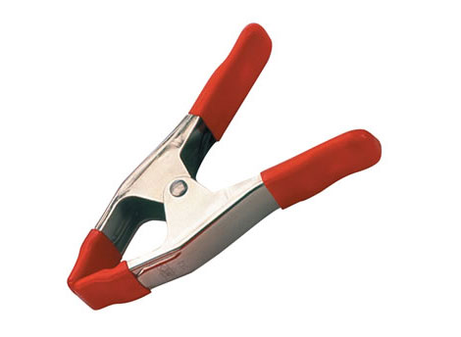
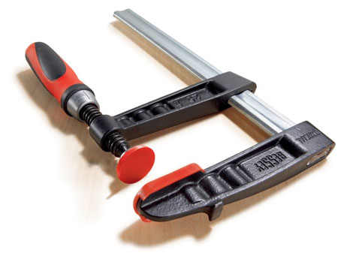
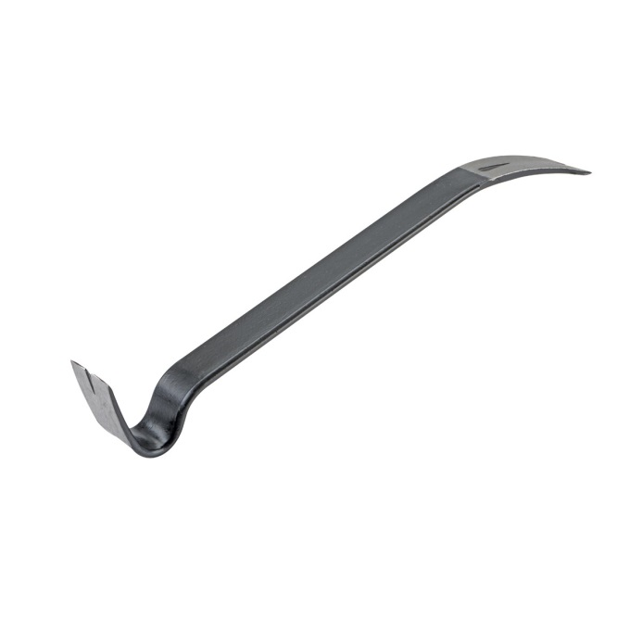
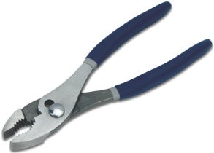
HAND TOOLS * prying & clamping tools
C-Clamp Clamps
Pry Bar
Slip Joint Pliers

Slide 34
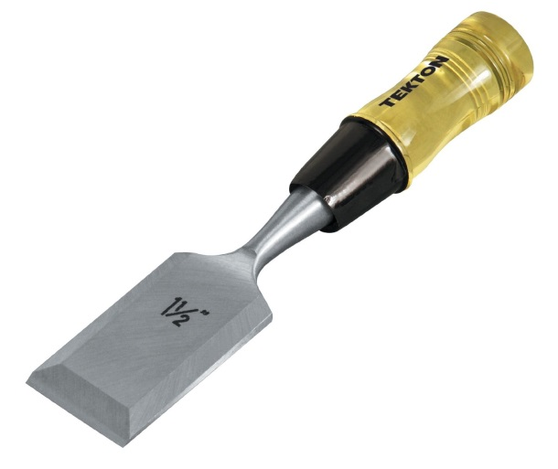
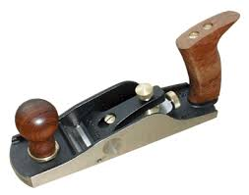
HAND TOOLS * plaining & paring tools
Smoother Plane
Wood Chisel
Sand Paper
Rasp

Slide 35
POWER TOOLS
Table Saw
Miter Saw
Panel Saw
Circular Saw
Electric Drill
Router
Electric Sander
Jig Saw (saber saw)

Slide 36
FASTENERS
Bolts-Nuts-Washers
Screws
Nails
Casters
Cleats
Hinges
Latches
Hot Glue Gun
Staple Gun

Slide 37
SCENIC DESIGN PRODUCTION
MASTER CARPENTER
Interprets Scenic Designer’s Front, Rear and Detail Elevations
Oversees the building of the scenic design
SET CREW
Builds set
Building the Set for CLYBOURNE PARK on Broadway
http://youtu.be/slBUx-LBPaA

Slide 38
SCENIC DESIGN PROJECT PT2
SCENIC DESIGN PRODUCTION
Front elevation with measurements & cut list details
SCENIC DESIGN APPLICATION
Construct a ¼ scale model of a stock scenery piece from your show.

Slide 39
CUT LIST
(4) 3”x3”x2’6”-legs
(2) 2”x2”x1’11”-mid support
(2) 2”x2”x4’-mid support
(1) 4’9”x2’8”x1”MDF – top
(2) 4’x5” – trim
(2) 1’11”x5” – trim

