Slide 1
SCENIC PAINTING
Technical theatre

Slide 2
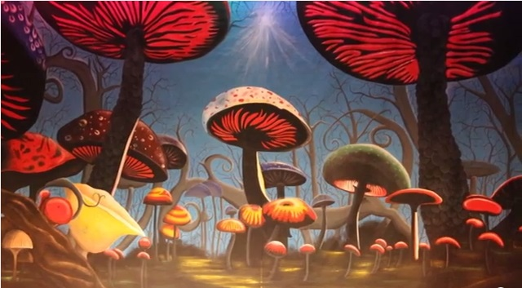
SCENIC PAINTING
Purpose of Scenic Painting:
To make a set look like anything –
real or imaginary
Provides most opportunity for freedom and creativity
MUSHROOM FORREST
http://youtu.be/sjLMWVRcC8c

Slide 3
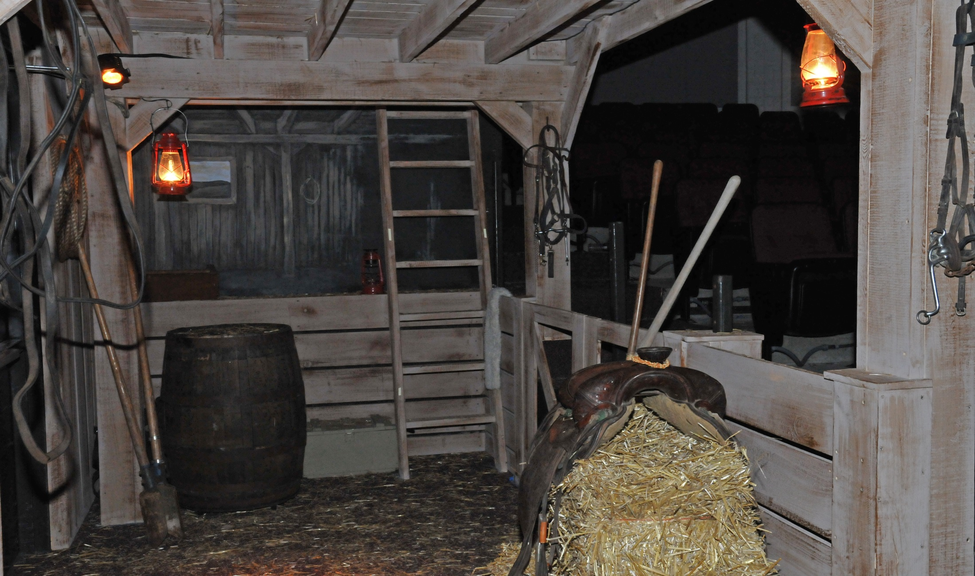
Oklahoma!

Slide 4
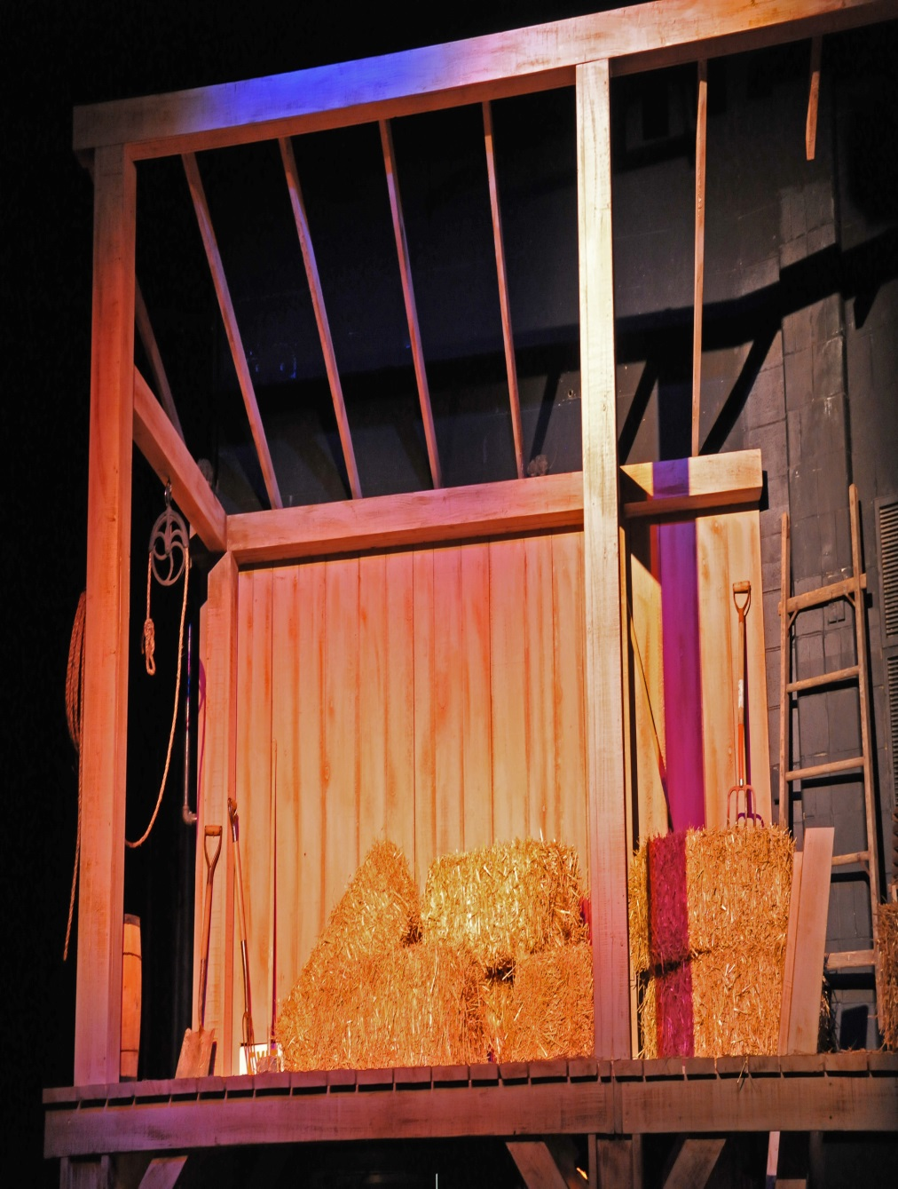


Slide 5
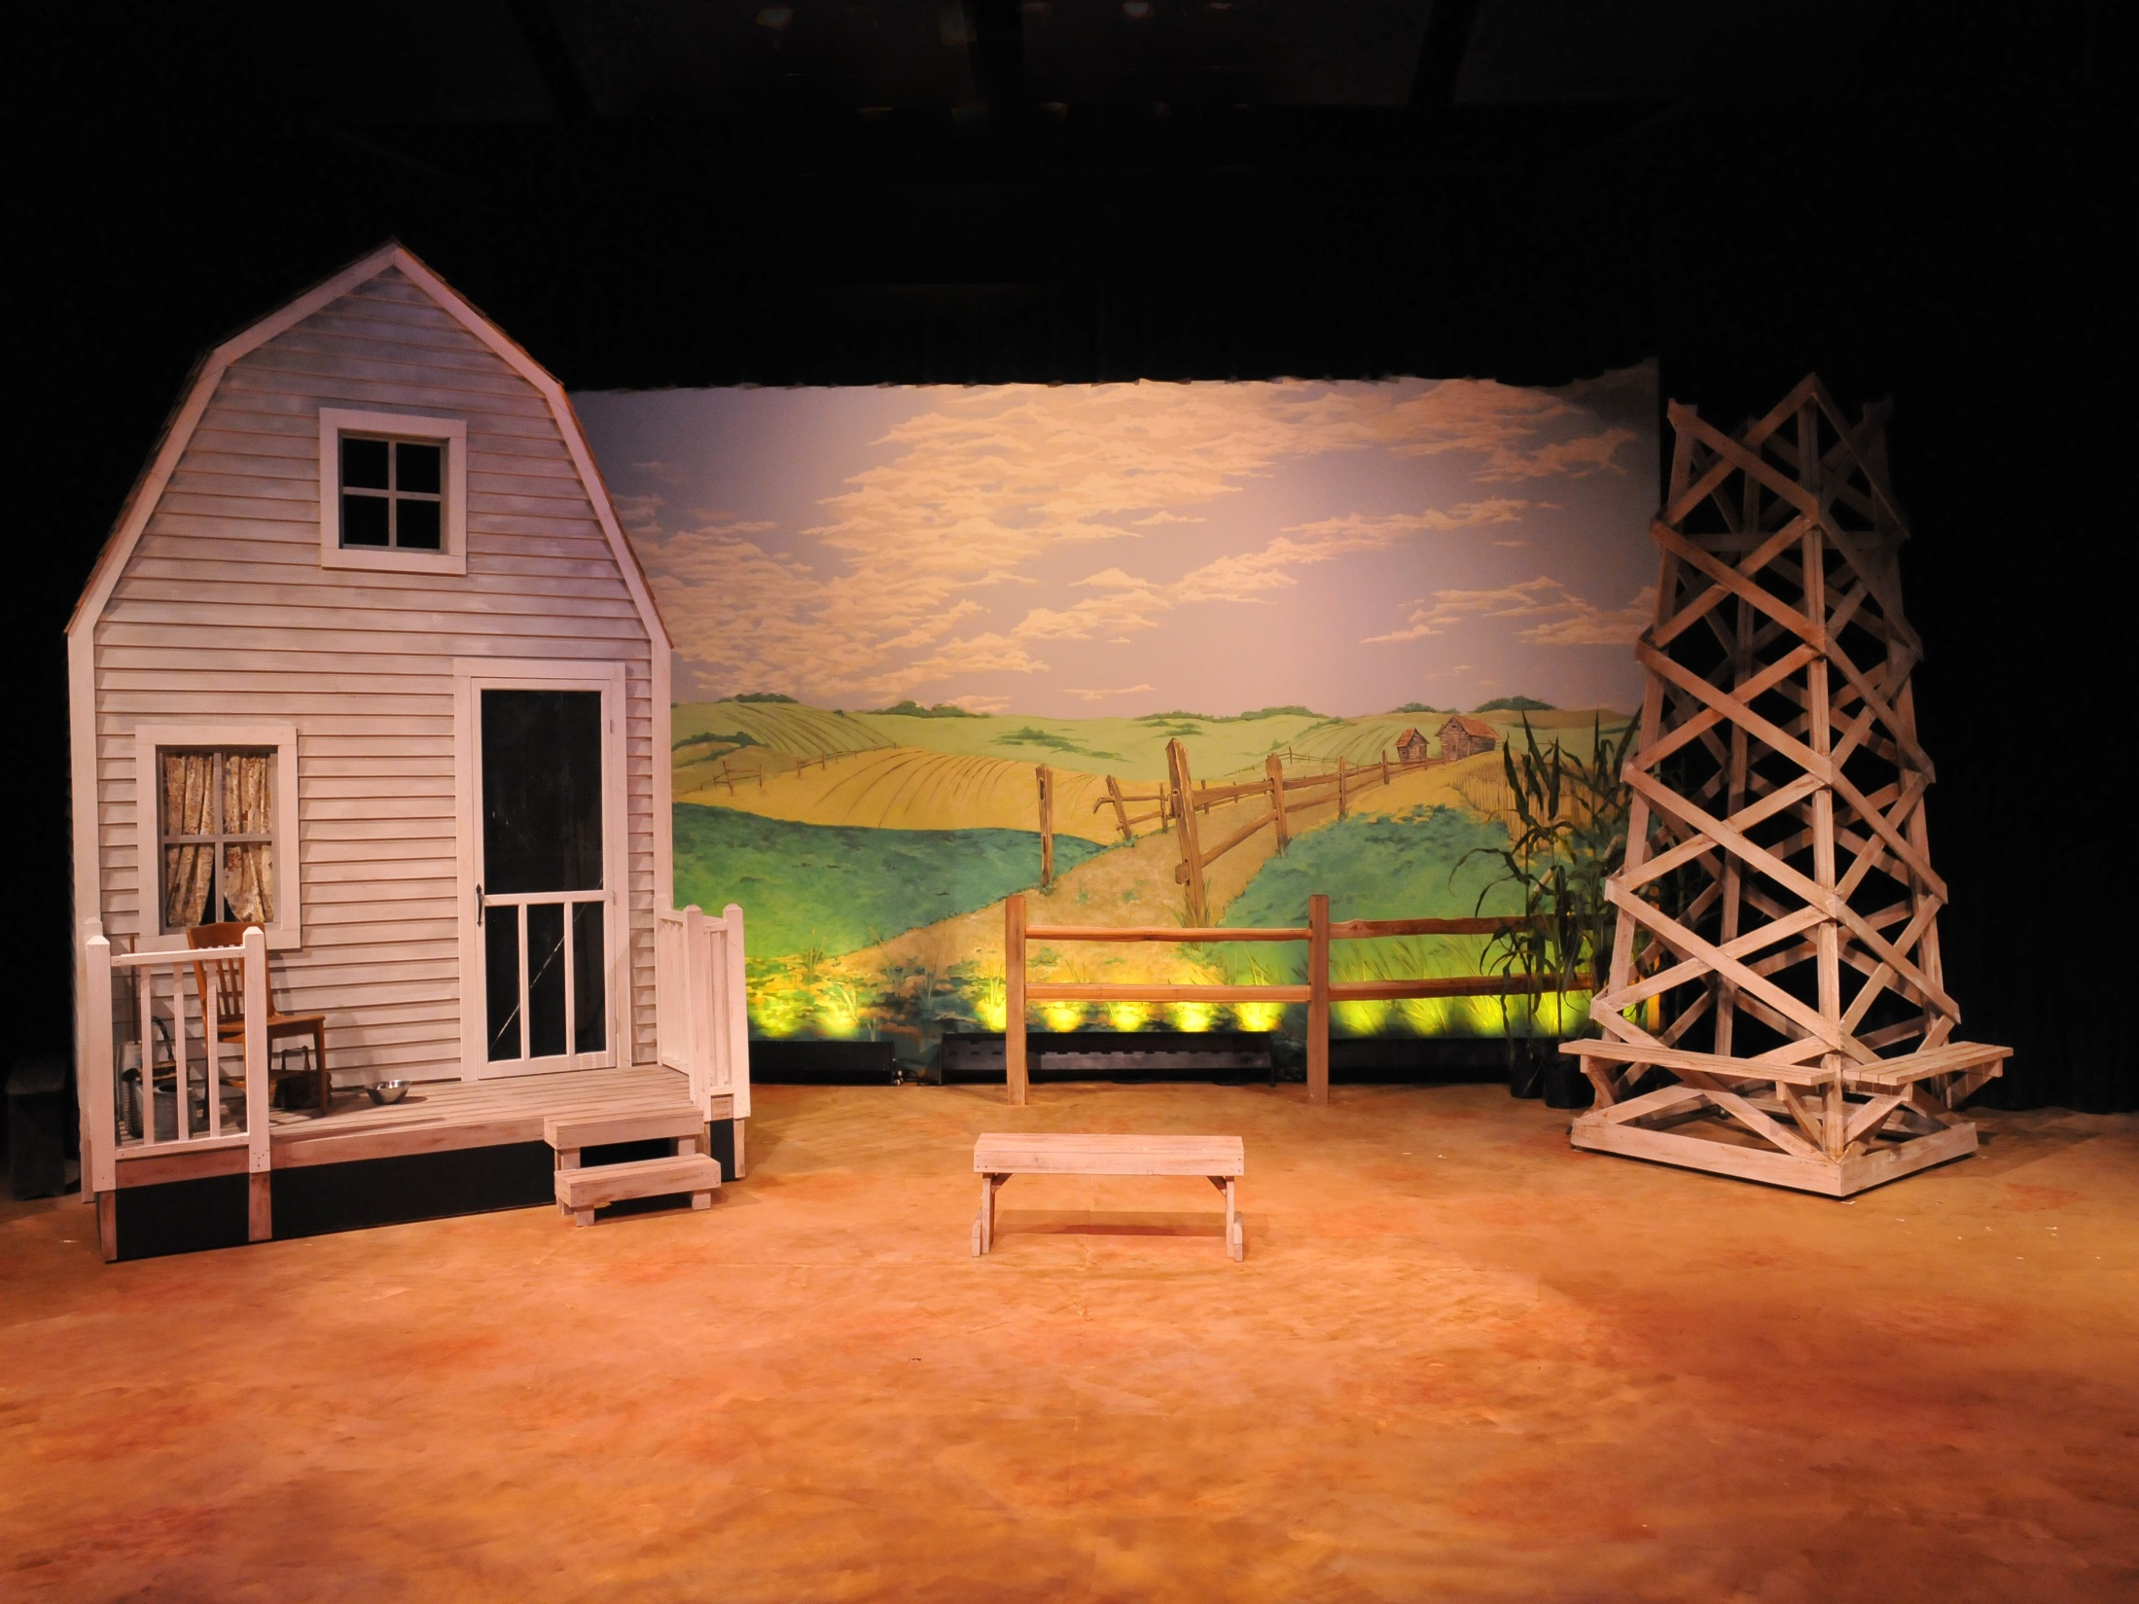

Slide 6
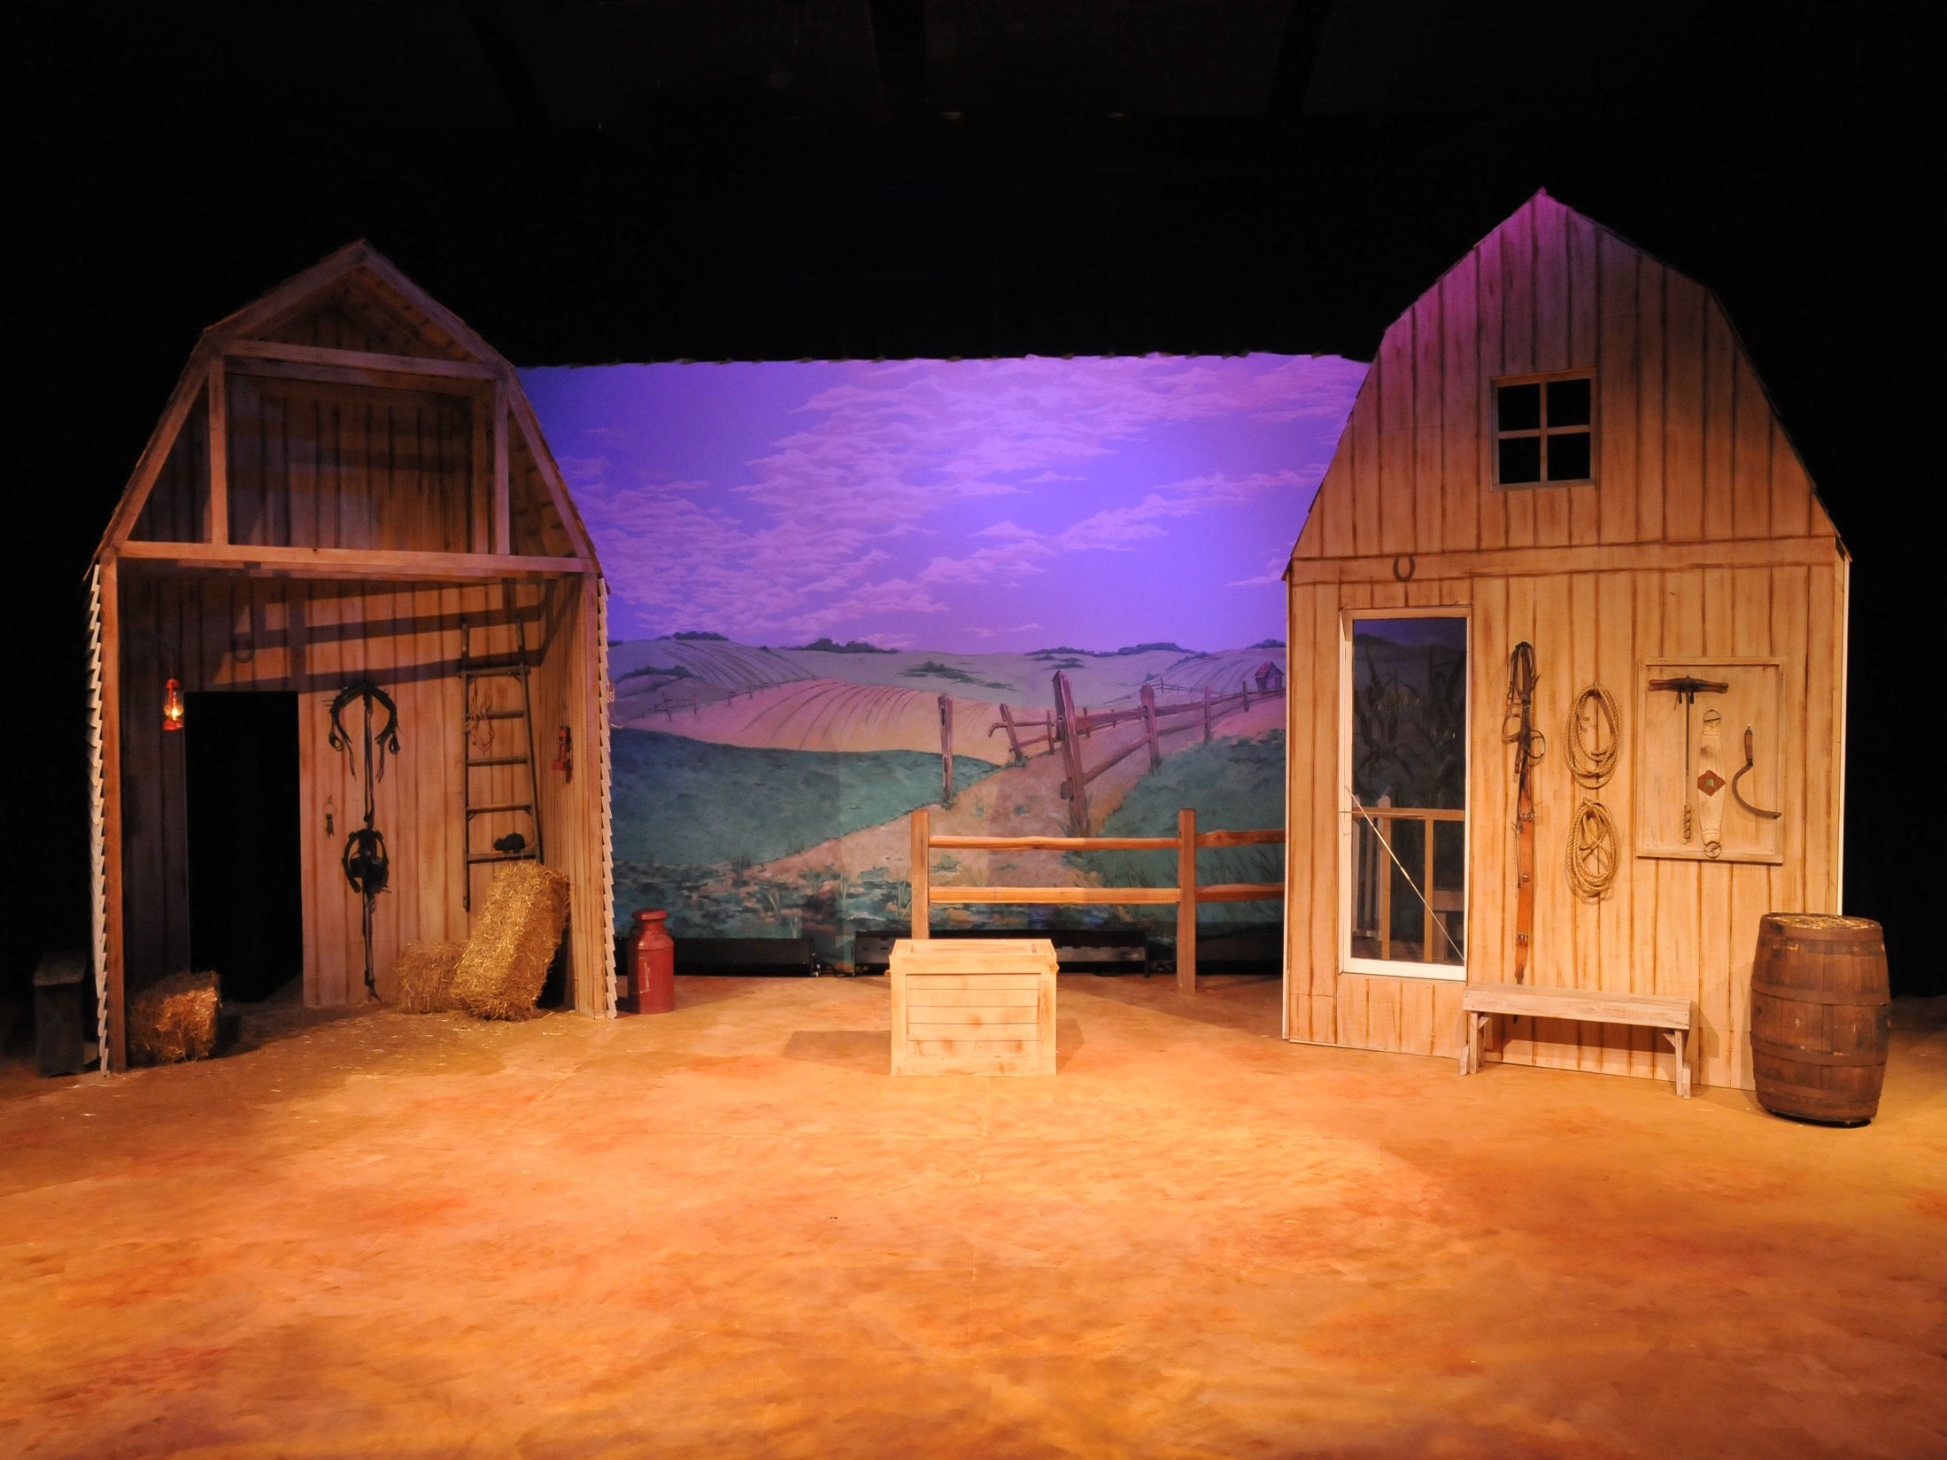

Slide 7
PAINT SAFETY
1. MAINTAIN A CLEAN AND ORGANIZED WORKING ENVIRONMENT.
2. KEEP SINK CLEAR OF ANY PAINT PARTICLES, RAGS OR BRUSHES.
3. CLEAN BRUSHES , SPONGES AND ROLLERS WITH WARM WATER & SOAP. RINSE THOROUGHLY AND HANG TO DRY.
4. SOME PAINTS ARE FLAMMABLE. KEEP PAINT STORED IN CABINET.
5. NEVER USE A SCREW DRIVER TO OPEN A PAINT LID.
6. REPLACE PAINT LIDS BY USING A RUBBER MALLET.

Slide 8
PAINT SAFETY
7. USE THE RIGHT BRUSH FOR THE RIGHT JOB.
8. MIX AND PREPARE PAINT IN THE SHOP FIRST, THEN TRANSPORT.
9. WHEN SPRAY PAINTING, GO OUTSIDE.
10. REPORT ANY DAMP OR WET CONDITIONS IMMEDIATELY.
11. KNOW THE LOCATION OF THE CLOSEST FIRE EXTINGUISHER.
12. USE COMMON SENSE. BE AWARE OF YOUR SURROUNDINGS.

Slide 9
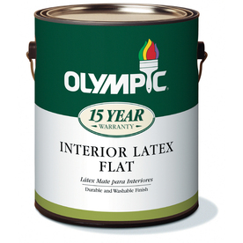
SCENIC PAINT
WATER-BASED LATEX PAINT
Pigment: color agent
Binder: adhering agent
LEVELS OF REFLECTIVITY
Flat
Egg Shell
Satin
Semi-Gloss
High Gloss

Slide 10

PAINT APPLICATORS
BRUSHES
Use the right one for the job
Never dip the brush more than 1/2 way up the bristles
Shown: ½”-4”

Slide 11
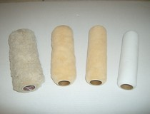
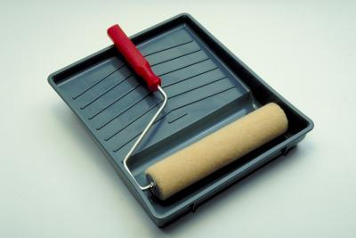
PAINT APPLICATORS
ROLLERS
Used for covering a lot of surface area quickly
8” inch roller is standard; thinner are available
Thickness of nap: 1/4”, 3/8”, 1/2", 3/4”

Slide 12
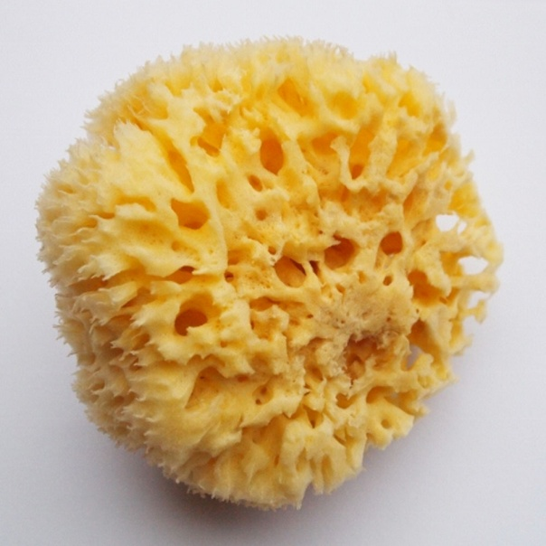
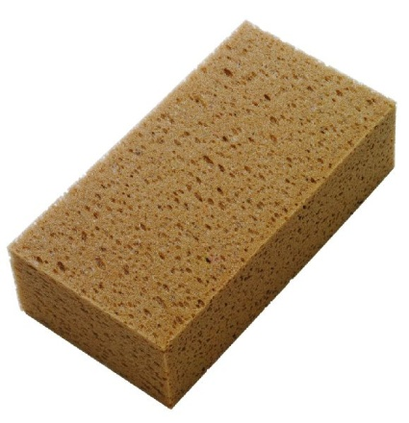
PAINT APPLICATORS
SPONGE
Natural - used for texture, stenciling
Artificial - cut into a shapes, used for stenciling and texturing

Slide 13
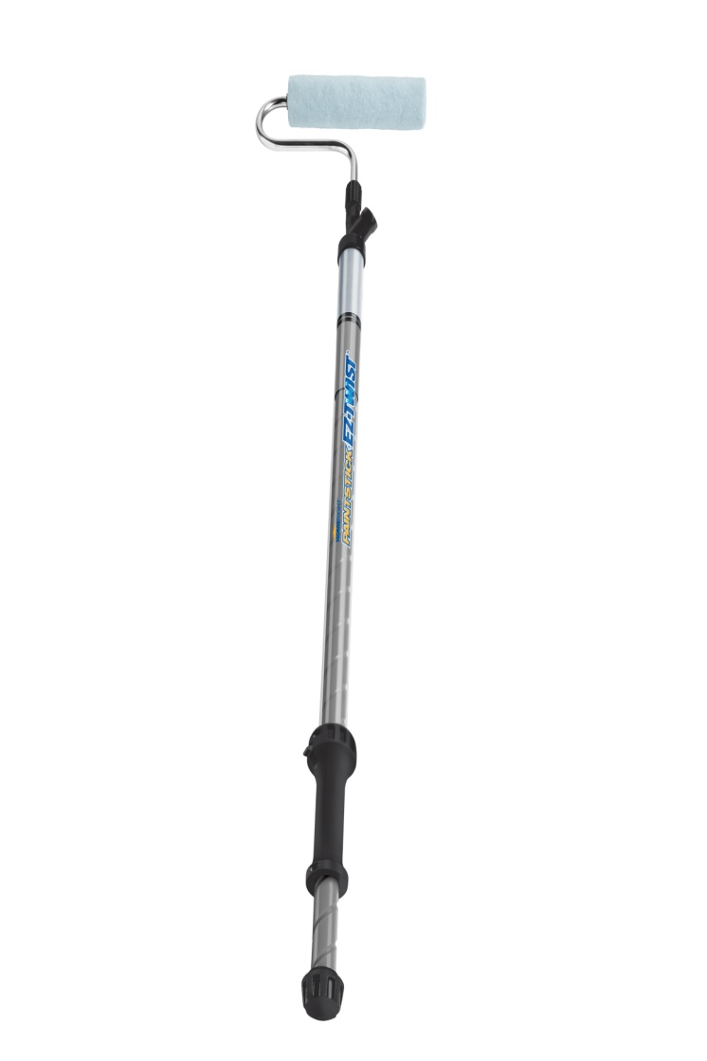
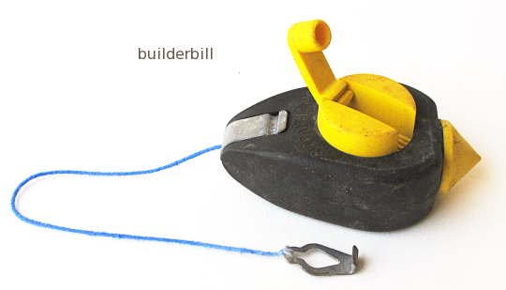
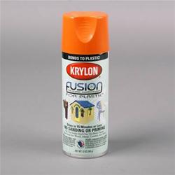
PAINTING TOOLS
chalk line
sprayer
spray paint
extension handles
straight edge
drop cloth
templates
muffin or pie tins to mix paint

Slide 14
PAINT CLEAN UP
hand or dish soap
warm to hot water
massage bristles, away from base
water should run clear
stand covers on end
hang brushes to dry
IS IT CLEAN? TRY THE SUCK TEST!!!!

Slide 15
STEPS IN PAINTING
1. PRIME COAT
Provides uniform base for the rest of the paint job
Fills in pores and holes in canvas
2. BASE COAT
color of elevation
foundation used for any texturing
3. TEXTURE
Applied on top of the base coat to provide visual interest, variety, and depth to scenery

Slide 16
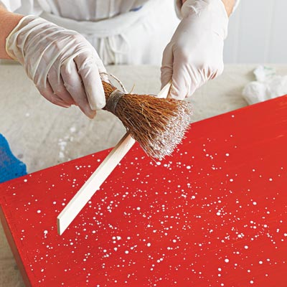
TEXTURE: SPATTERING
Applying small drops of paint to a surface
Effect => to show age of paint, to cover irregular surfaces, to alter a hue
How => dip tips of brush in paint, stand 3-5 feet back, slap the FERRULE (metal part of the brush) against heal of hand
Tip = > Use a cross-hatch pattern to create a natural spatter

Slide 17
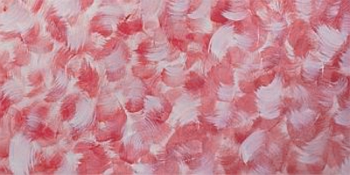
TEXTURE: SCUMBLING
Blending of several hues
Effect => creates a multihued texture; rough or smooth
How => blending of different hues together while the paint is still wet
circular, swirling, cross-hatch, straight, curved
- high vs. low contrast
Tip = > 1. Use separate brushes for each color hue 2. work rapidly while paint is still wet

Slide 18
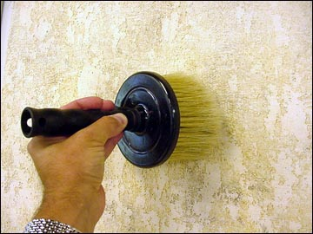
TEXTURE: STIPPLING
Applying a heavier texture to a surface
Effect => gives a heavier texture look
How => dip the end of the applicator into the paint and touch to surface
Brush sponge feather duster edge of burlap end of rope
Tip = > 1. Change the position of the applicator to avoid making an obvious pattern 2. Change the pressure when touching the surface

Slide 19
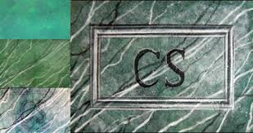
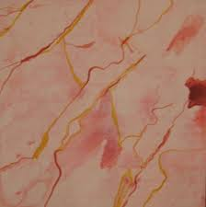
TEXTURE: FLOGGING/VEINING
Applying a very large amount of paint to a surface
Effect => to give a random, heavy look
How => attach strips of canvas to a piece of 2 x 2 lumber that is 2 – 3 feet long. Fling the flogger until it hits the surface. Continue in random positions.
Tip = > make sure set pieces and others are out of the way – this is messy

Slide 20
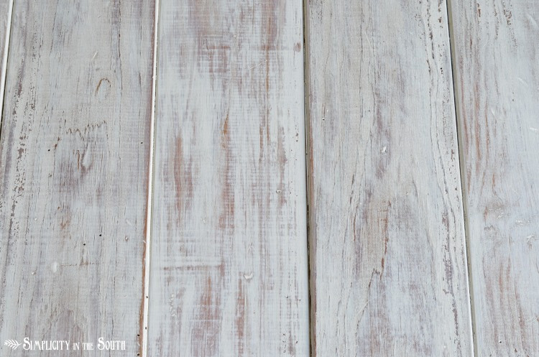
TEXTURE: DRY BRUSHING
Painting with a brush that has little paint
Effect => used to create wood grains and can be used on things other than scenery
How => Dip tip of brush in paint and scrape excess paint on lip of bucket.
Lightly draw brush across surface.
Tip = > 1. If hue and value is close to base coat- result is smooth 2. If hue and value is greater that of base coat – result is rough

Slide 21
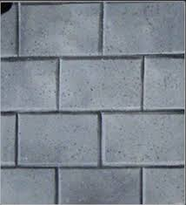
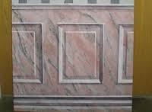
TEXTURE: LINING
Using straight lines of varying widths
Effect => creates the appearance of depth to show a source of light on the object
How => use highlight and shadowing lines with a lining brush
Tip = > use a straight edge (bricks - paneling on doors)

Slide 22
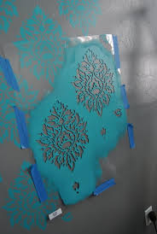
TEXTURE: STENCILING
Large, cut out patterns
Effect => creates repetitive, intricate designs, as with wallpaper
How => Cut a stencil from stencil paper, card stock paper, or poster board and cover with shellac, lacquer, or spray varnish to waterproof stencil (or go buy one). Use a sponge, sprayer or stencil brush to apply paint to surface.
Tip = > 1. don’t apply too much paint in that it seeps under the stencil 2. spraying works best because it is more gentle on the stencil 3. clean the stencil to remove excess paint

Slide 23
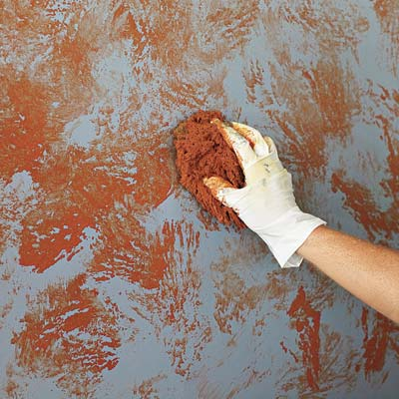
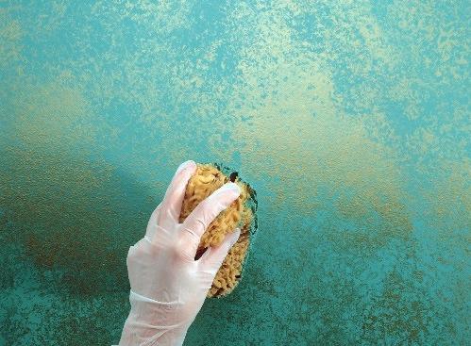
TEXTURE: SPONGING
Using a synthetic or sea sponge to to paint, dap or stamp with; used for faux finishes or in conjunction with stenciling
Effect => creating a random appearance (sea sponge) or rhythmic pattern (synthetic)
How => First wet the sponge then dab in paint and wipe off access.
Then working from the middle lightly blot the surface of set piece
Tip = > 1. careful not to smear 2. go up and down movements 3. light on dark = brighter 4. try multiple colors by layering

Slide 24
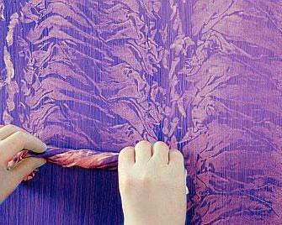
TEXTURE: RAG ROLLING
Rolling a rag on a surface to create random lines
Effect => create a marble effect
How => use a rag and dip into the bucket of paint.
Ring out excess paint and roll up loosely. Roll the rag around on the surface, changing directions often.
Tip = > 1. wear gloves 2. start out lightly – you can always add more

Slide 25
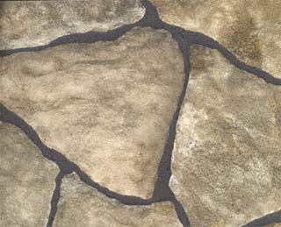
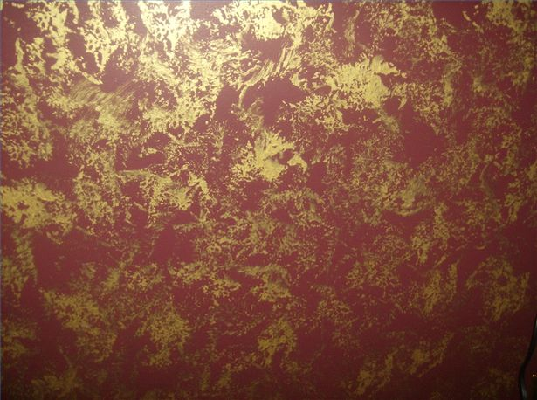
TEXTURE: OTHER
STONES
FEATHER DUSTER

Slide 26
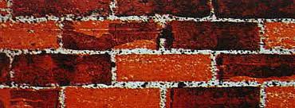
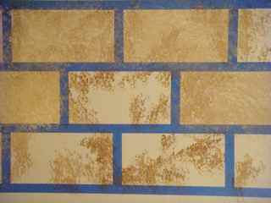
TEXTURE: BRICKS
Realistic or Stylized bricks
How => use the side of a rectangular sponge. Dip into the paint and wipe off the excess paint on the lip of the bucket.
Gently set the sponge on the surface. Continue to set the sponge
down in a row, leaving about 1/4” between each “brick”. Offset each row that follows. Follow up by lining the bricks with highlight and shadow.
Tip => Be sure to base the surface with a color that would naturally work as the grout color. This will show between the bricks.

Slide 27
SCENIC DESIGN PROJECT PT.3
SCENIC PAINTING PRODUCTION
Scenic painting Research
Painter’s Color Elevation
SCENIC PAINTING APPLICATION
Take the scale model stock scenery piece and paint it to reflect the color elevation EXACTLY.
Prime, Base and Texture the piece.

Slide 28
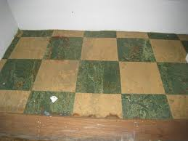
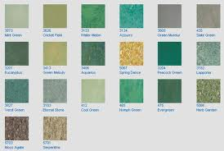
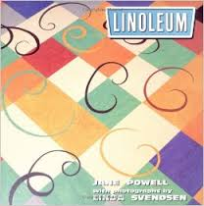
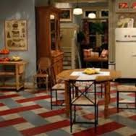
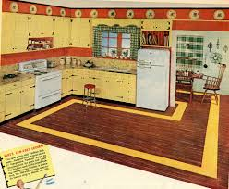
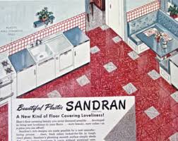
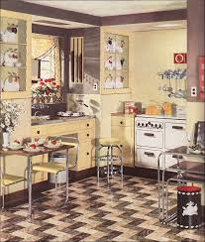
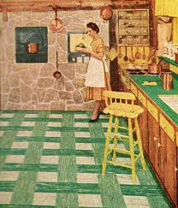
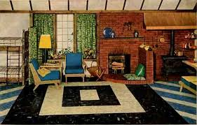
1949 KITCHEN FLOOR RESEARCH

Slide 29
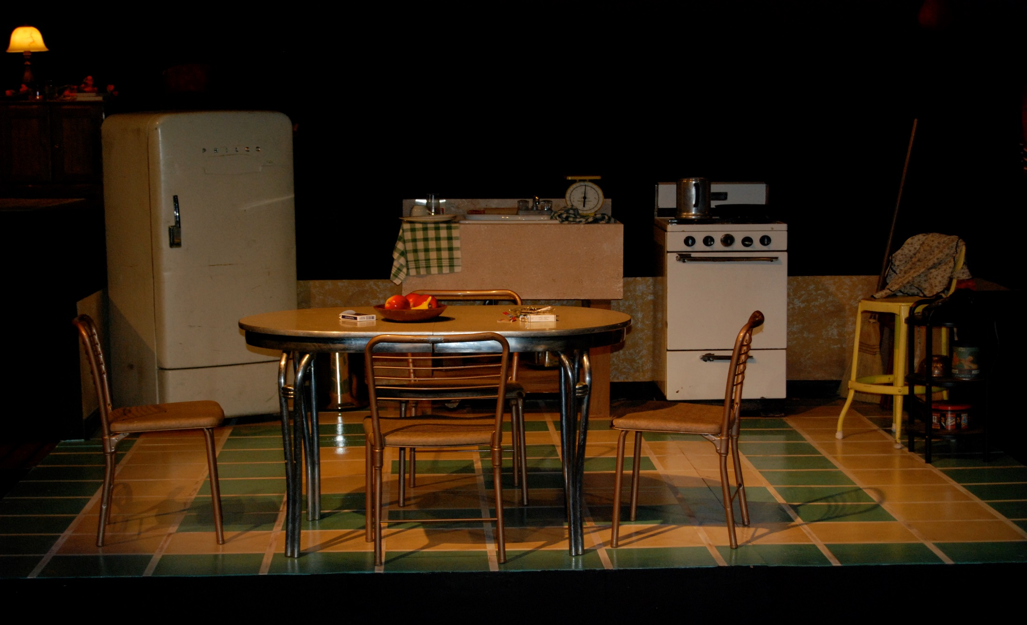
DEATH OF A SALESMAN

Slide 30
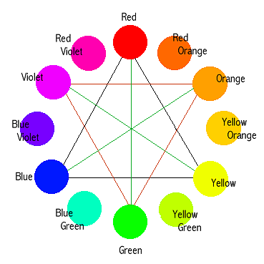
COLOR SCHEMES
Primary colors:
Red, Yellow, Blue
Seconday Colors:
Red + Yellow= Orange
Red + Blue=Violet
Yellow + Blue=Green

Slide 31
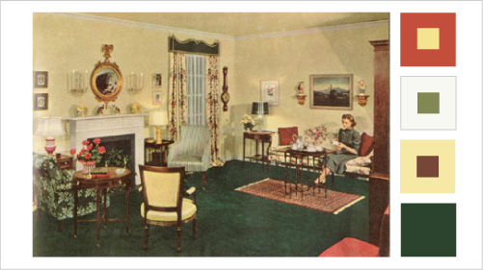
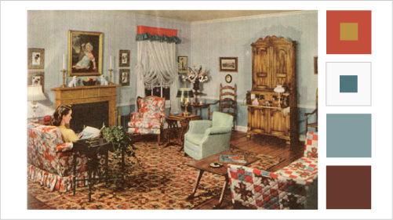
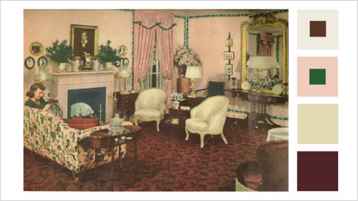
Early American
18th Century
Victorian

Slide 32
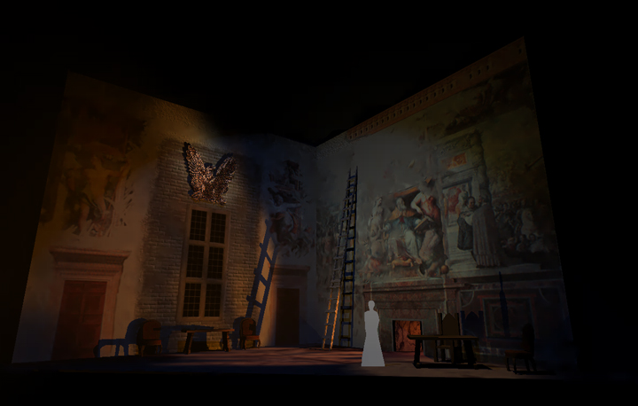
FRONT COLOR ELEVATION

Slide 33
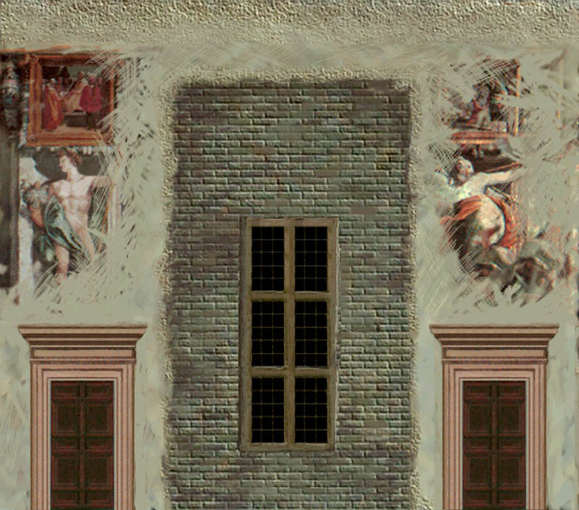
PAINTER’S ELEVATION
A PAINTER’S ELEVATION is a copy of the front elevation which has been rendered to indicate the color and painting techniques which are to be applied to the final set.

Slide 34
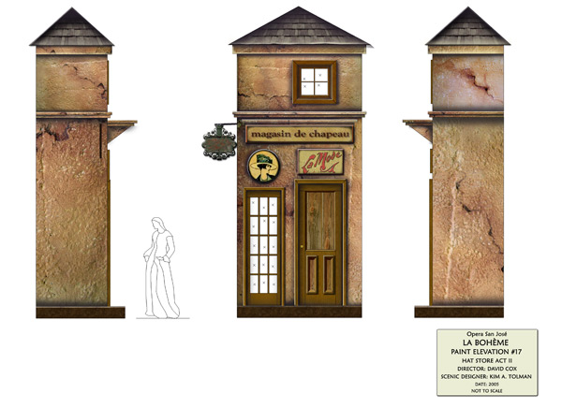
PAINTER’S ELEVATION

Slide 35
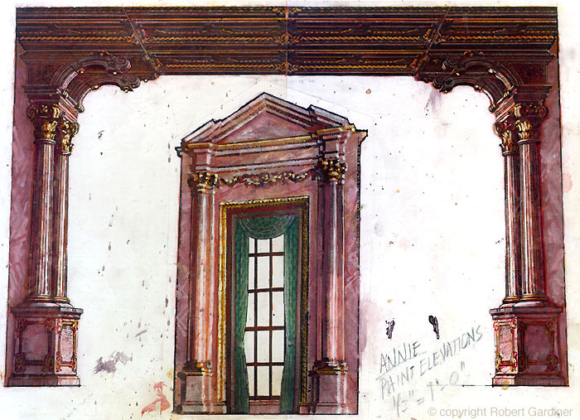
PAINTER’S ELEVATION

Slide 36
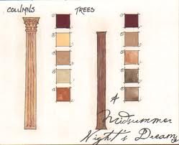
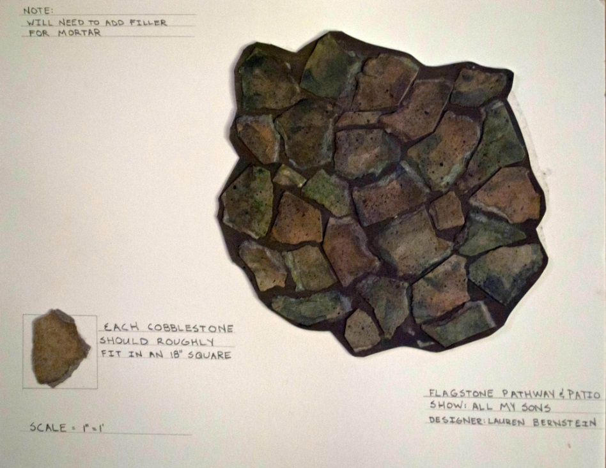
PAINTER’S ELEVATION

Slide 37
Scenic Painting Examples
Painting fake brick and plaster walls
http://youtu.be/eidKQ6ELClk
A scenic artist
http://youtu.be/CfyEXX6NsMk
Painting the scenic cloth for The Royal Opera's Robert le diable
http://youtu.be/gnh8-BQLP1c

