Slide 1
PARKWAY CENTRAL
HIGH THEATRE DEPT
POSTERS

Slide 2


Slide 3


Slide 5


Slide 6


Slide 7


Slide 8


Slide 9


Slide 10


Slide 11
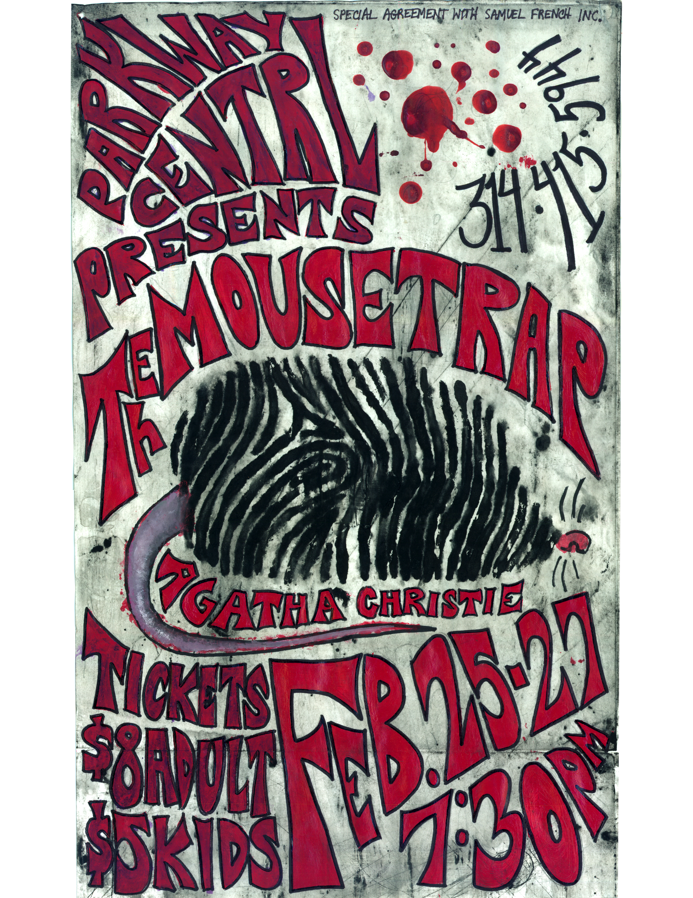

Slide 12


Slide 13


Slide 14


