Slide 1
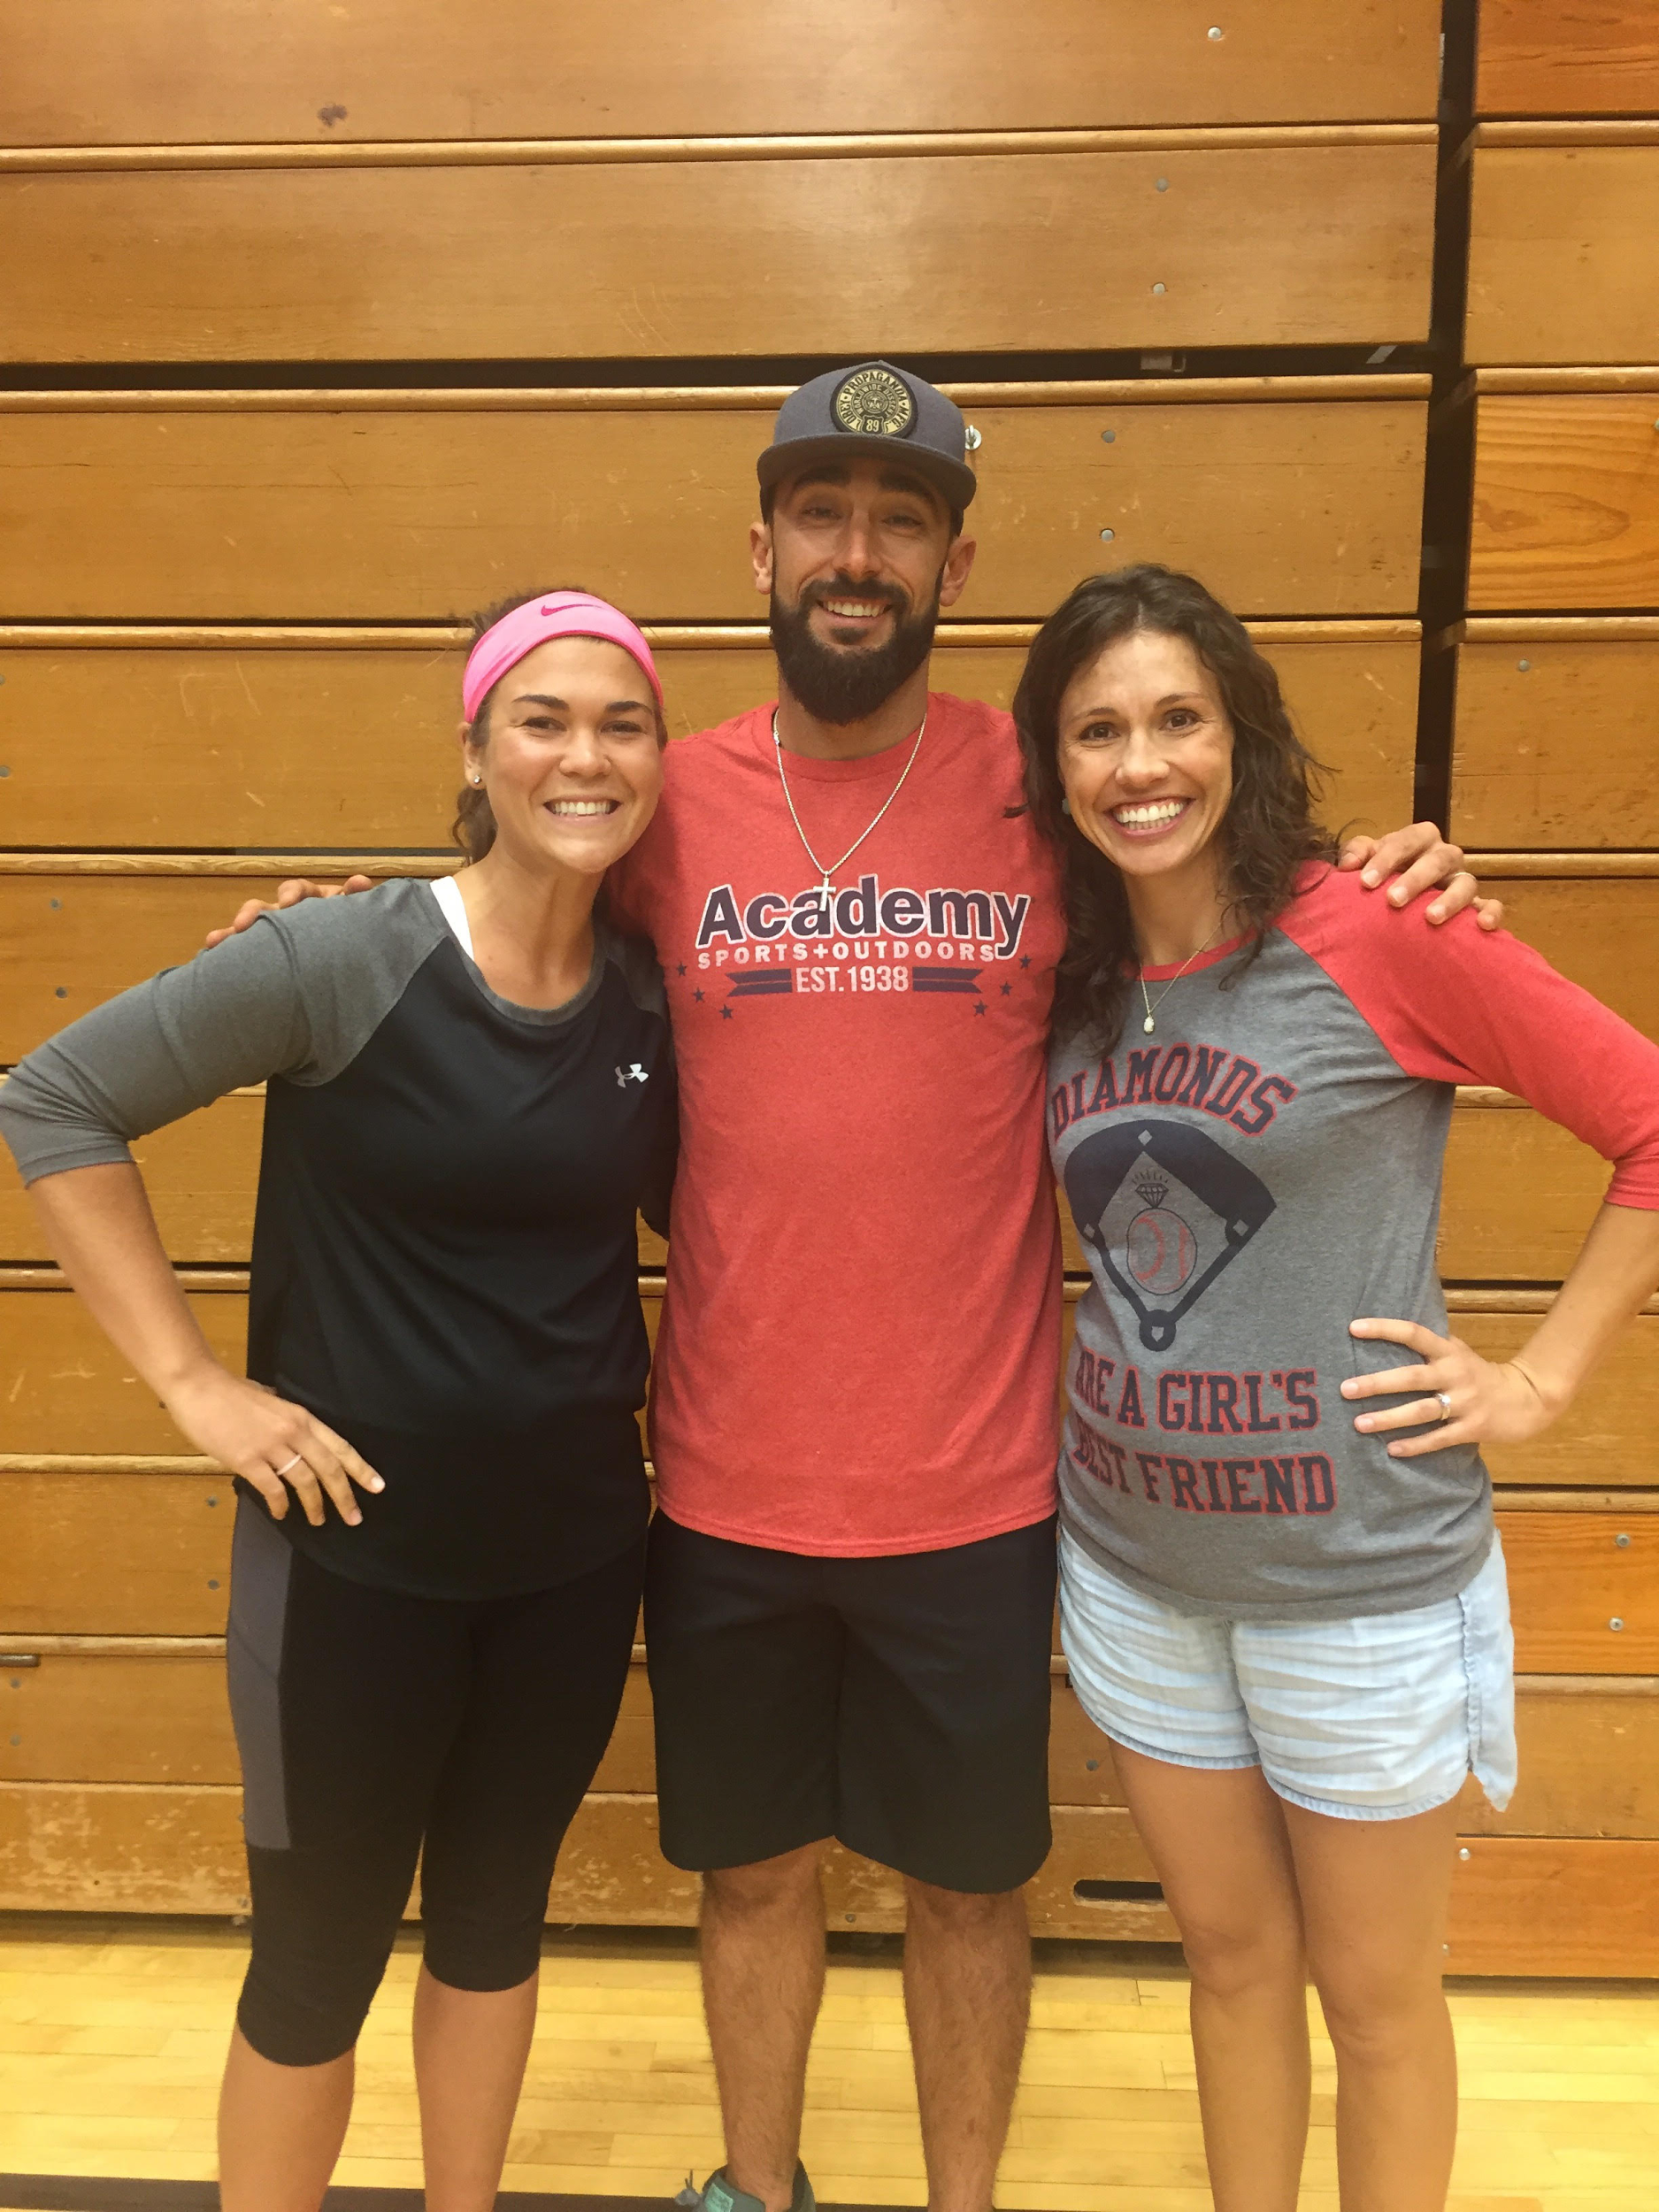
Physical Education/ Health Teachers at McKelvey Elementary
Mrs. Jessica Wheeler
Mrs. Ally Gardner

Slide 2
Physical Education/Health Expectations
Hello! Our names are Mrs. Jessica Wheeler and Mrs. Ally Gardner and we are the PE & Health Educators at McKelvey Elementary. We have had the pleasure of meeting many of you and look forward to continuing and cultivating those relationships new and old. The following document was created in an effort to give you an idea of the expectations we have for the students and how you may aid us in meeting those high expectations. We are blessed with many great kiddos at McKelvey, but nothing can replace having teachers and parents on the same page—with the kids best interests in mind. We look forward to working with you this year and in the future and please feel free to contact us via email or phone (information on the webpages) with any further questions, concerns or comments! Thank you!

Slide 3
Physical Education/Health Expectations
1. Students are required to wear tennis shoes to PE every day. Please ask your child (or see McKelvey’s PE Schedule to know) which days they come to PE. (It is every other day usually, unless scheduling changes)
2. Students are asked to wear clothing that is appropriate for physical activity (i.e. Tennis Shoes, T-Shirt, Shorts, Long Pants). Please refrain from having students wear exceptionally nice clothing on PE days.
3. We will gladly help our students tie their shoes, especially our younger ones who are just learning, but we ask that you encourage all students who have not yet mastered this skill to continue practicing at home. J
4. Students are expected to treat each other and the teachers with the utmost respect. We espouse to a high level of character at McKelvey and especially in PE where teams play together and partners are used often. Students are expected to look teachers and peers in the eye and not argue when a teacher is talking to them.

Slide 4
Physical Education/Health Expectations cont.
5. Students are expected to treat PE/Health as what it is; a mainly action-based class. We like to remind them that this is a fun time of movement, but their focus should still be on LEARNING and MASTERING skills and concepts, just like any other class. On days where we are teaching a more health-based lesson, we expect their focus on the information being taught as well.
6. We expect our parents to ask their students about how PE is going, we want you to know what is going on in our classroom and how much fun your son or daughter is having J
7. We ask for your support in your child’s continued physical fitness at home and outside of the classroom. We do our best to make students aware of opportunities for activity outside of the classroom and please check our website and look at our monthly health tip for those. However, even if it is just throwing a ball or riding a bike around the neighborhood, please encourage at least 60 minutes of physical activity a day.
8. You can expect that your child is important to us. We care about and strive to give each student a positive experience in our class. You can expect that our door is always open and you can contact us anytime.

Slide 5
School-Wide Food Safety Expectations
“In order to help protect the health and safety of our students with life-threatening food allergies and to contribute to the health and academic success of all students, the Parkway School District has adopted new district-wide Food Safety Expectations. Beginning with the 2017-2018 school year, all schools will promote these best practice guidelines.
Classrooms should be food-free whenever possible. Consumption of food in the classroom is strongly discouraged due to allergy and sanitation concerns.
Students may continue to bring a snack for their own consumption, especially students with an individual health plan. Students are encouraged to bring healthy snacks to promote health and wellness. Parents may be advised to send in snacks without a particular allergen, if needed, to prevent cross-contamination, which could impact safety for food allergic students. Careful cleaning of surfaces with soap and water after consumption of food is essential. Food may not be brought from home for sharing class-wide.
The school nurse will be informed and consulted to identify students with known food allergies. Teachers will make alternative lesson or curricular plans if students with known food allergies could be adversely impacted.
Find safe and inclusive ways to celebrate without food. To maintain healthy learners, the safest celebrations occur without food. Birthday celebrations at school and holiday celebrations at school will not include food. Schools are encouraged to be creative in celebrating without food.”

Slide 6
Please Follow Us on Twitter
@McKelveyPE1

