Slide 1
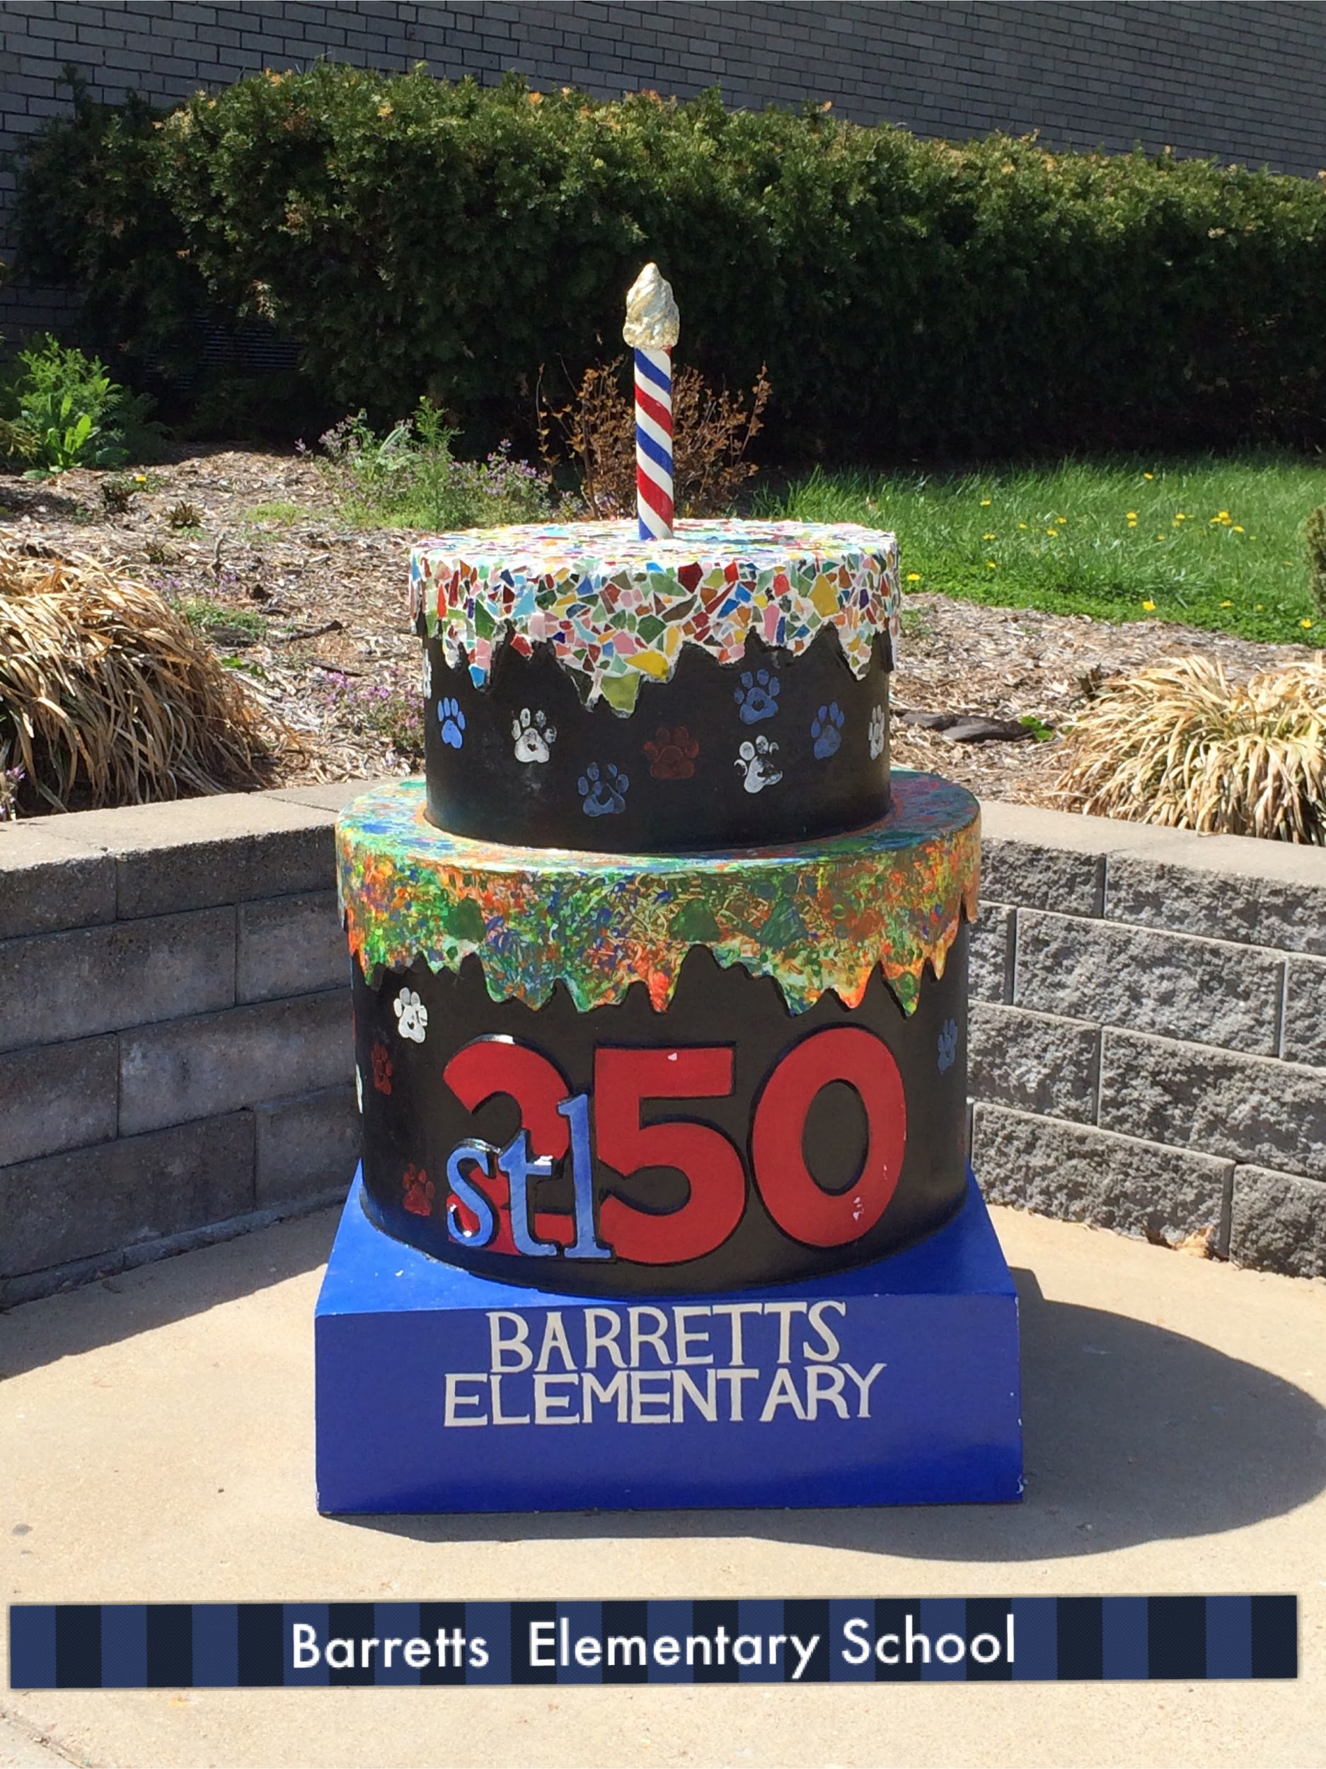
Welcome to the September PTO Meeting
We will get started at 7pm and end no later than 8pm.
Feel free to grab a seat and get comfortable.
And we promise, we won’t force your into volunteering! :-)

Slide 2
Barretts Elementary School
PTO General Meeting Agenda
September 10, 2019
Welcome - Katie Werner
Treasurer Report - Laura Schisler/Katie Werner
Fundraising Co-Chair’s Report - Laura Bohon/Michelle Millonas
Volunteer Coordinator’s Report - Brittney Caban
Way & Means Report - Kat Anderson
Barretts Blast Survey Recap - Kat Anderson
Playground Committee Discussion - Kat Anderson & Kyle McCool
Principal’s Report - Dr. Moreton
Q&A Time

Slide 3
Important Dates to Remember
Oct 15 – 17 (Tues – Thurs) – Book Fair
Oct 15 (Tues) & 17 (Thurs) – Parent/Teacher Conferences
Oct 18 (Fri) & Oct 21 (Mon) – No School
Oct 27 (Sun) – Trunk or Treat
Oct 30 (Wed) – Late Start
Sept 11 (Weds) – Picture Day
Sept 20 (Fri) – Principal’s Coffee for Parents (9a-10a)
Sept 25 (Wed) – Late Start
Sept 27 (Fri) – Field Day
Oct 11 (Fri) – Bobcat Dash

Slide 4
Treasurer’s Report
Laura Schisler & Katie Werner

Slide 5
Where Do the Barretts PTO Dollars Go?
What the PTO Spent in the 2018 – 2019 School Year
When You Contribute to the Barretts PTO You Are Contributing to the Futures of Hundreds of Kids
Donations Over $50,000 Made All of These Amazing Things Happen!
A Huge Thank You to All Who Contributed!
Student & Teacher
Grants
Book Fair & Grand Event
Playground
Fund
Field Trips & Grade Level Events
Classroom Improv.
Teacher &
Staff Appreciation Week
Capital
Improv.
Science
Lab
Updates
Arts
Partners
Principal’s
Fund
Library
Improv.
Abilities Awareness
Classroom Parties
Bobcats Backpacks
$500
$1,030
$1,050
$1,080
$3,900
$5,000
$9,790
$6,310
$6,214
$4,078
$2,635
$2,120
$1,840
$1,500

Slide 6
Fundraising Report
Laura Bohon & Michelle Millonas
Bobcat Dash
Parties with a purpose- update tomorrow on website
Progressive Dinner- we’d like more people to join us! Italian theme
need trivia chair for next year

Slide 7
Volunteer Coordinator’s Report
Notes from meeting:
Sign up for membership toolkit
Book fair- Grand Breakfast-NEED VOLUNTEER
Membership toolkit-add bobcat auction link
Brittney Caban

Slide 8
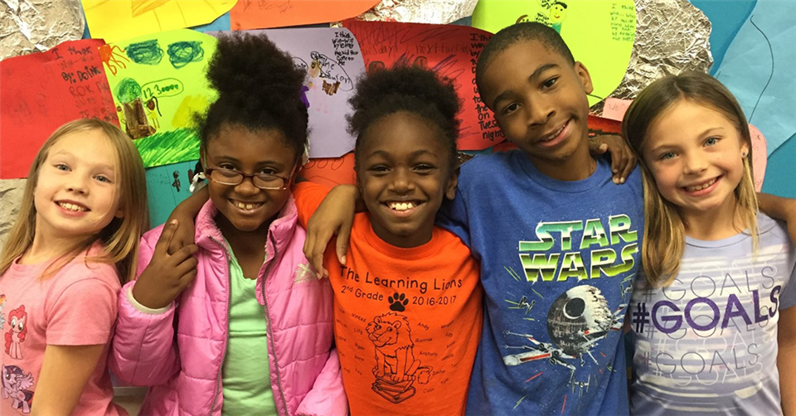
Ways & Means Report
Kat Anderson
Letter going out this week for Teacher Grant

Slide 9
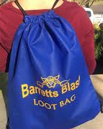
Barretts Blast
Ideas to help with cost:
Give every kid 5 tickets
Bring in petting zoo
Inflatables for free
Kat Anderson
Survey Recap
Anticipated Changes in 2019-2020
Additional Funding for 2019-2020

Slide 10
Playground Committee Discussion
Kat Anderson & Kyle McCool

Slide 11
Principal’s Report
Dr. Kelli Moreton

Slide 12
Q&A Time
Katie Mulchek- raffle part of trivia night to Barretts blast
Kyle- like FB page, Friday newsletters,
Parent said no robo calls (for progressive dinner)

Slide 13
Thank you for coming!
See you at the next General PTO Meeting on November 19, 2019
7p in the Barretts Library

